Slide 1
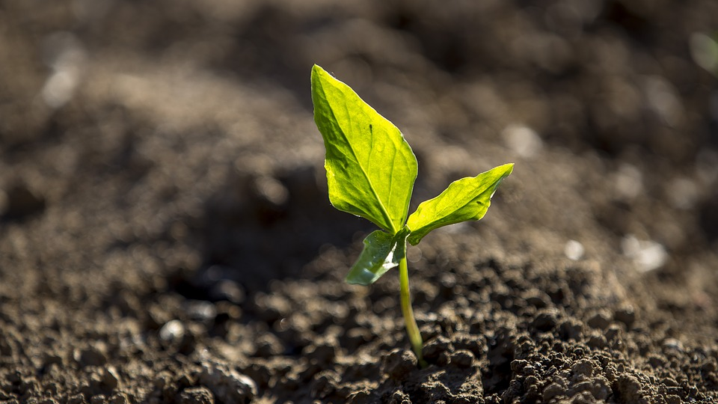
Bring on the Food! STEM, Agriculture, and You
Welcome!

Slide 2
Your STEMAZing Leaders
Danielle Coleman- daniellec@stcyril.com
7th & 8th Grades Science and STEM Enrichment at St. Cyril of Alexandria School, Tucson
Bachelors in Elementary Education and Arizona Highly Qualified Middle School Teacher of Science
Certified in K-8 Elementary Education
Robyn Yewell- ryewell@amphi.com
4th/5th Multiage Classroom Teacher at Donaldson Elementary, Tucson
Masters in Elementary Education and Masters in Bilingual/Multicultural Education
Certified in Gifted Education (PreK-12), K-8 Math Specialist, Academic Certificate in K-12 STEM

Slide 3
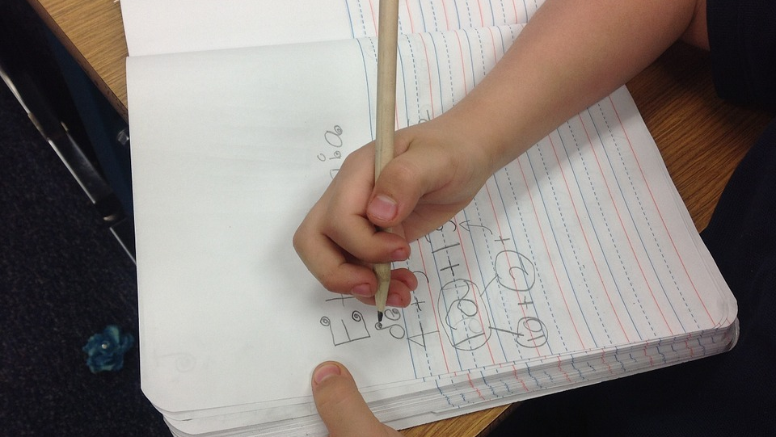
Notebook Hack
Materials: 6 pieces of graph paper, pencil, and scissors

Slide 4
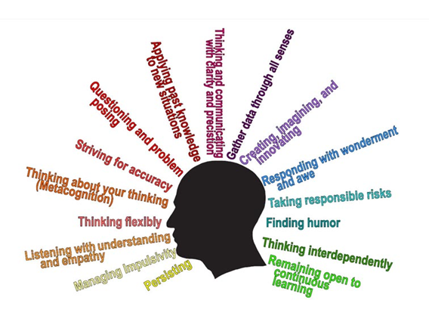
re-the-habits-of-mind/
How do you see these Habits of Mind?
Habits of mind
/http://www.teachthought.com
/pedagogy/what-are-the-habits-of-mind/

Slide 5
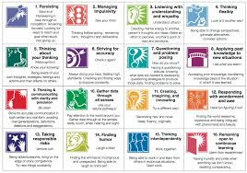
Habits of Mind
“16 problem solving, life related skills, necessary to effectively operate in society and promote strategic reasoning, insightfulness, perseverance, creativity, and craftsmanship.”
Arthur L. Costa and Bena Kallick, Habits of Mind: A Developmental Series

Slide 6
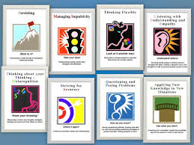
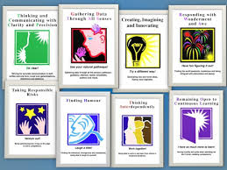
Habits of Mind: How Can We Make Connections?
http://www.sacsjs.wcape.school.za/academics/habits-of-mind/

Slide 7
5E Model of Instruction (Engage, Explore, Explain, Extend/Elaborate, and Evaluate)
The National Research Council released the report, How People Learn in 1999 stating:
Students enter the classroom with preconceptions regarding the works of the world.
Developing competence in areas of inquiry requires a) foundation of factual knowledge, b) understanding facts and ideas in the concept of conceptual framework, and c) organizing knowledge for retrieval and application.
Helping students to take control of their own learning and defining goals and monitoring their progress in achieving them.
https://www.bscs.org/sites/default/files/_legacy/BSCS_5E_Instructional_Model-Executive_Summary_0.pdf

Slide 8
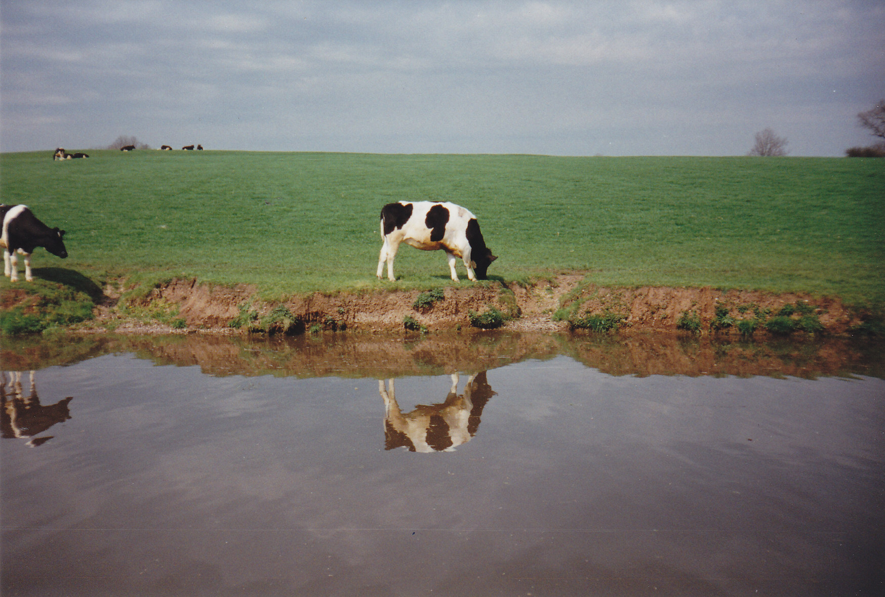
Habits of Mind/5E Review, Reflection & Sharing

Slide 9
What’s in the Garden? (Engagement) Written by Marianne Berkes and illustrated by Cris Arbo

Slide 10
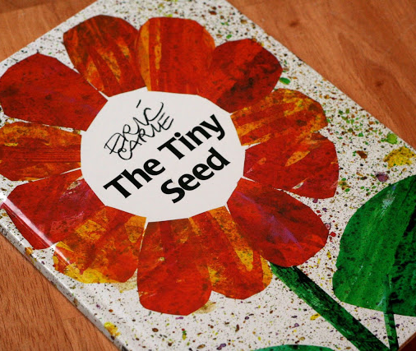
Annotate!
The Tiny Seed
Written and illustrated by: Eric Carle
http://teacherweb.com/LA/FloridaAvenueElementary/Wood/006-The-Tiny-Seed.pdf

Slide 11
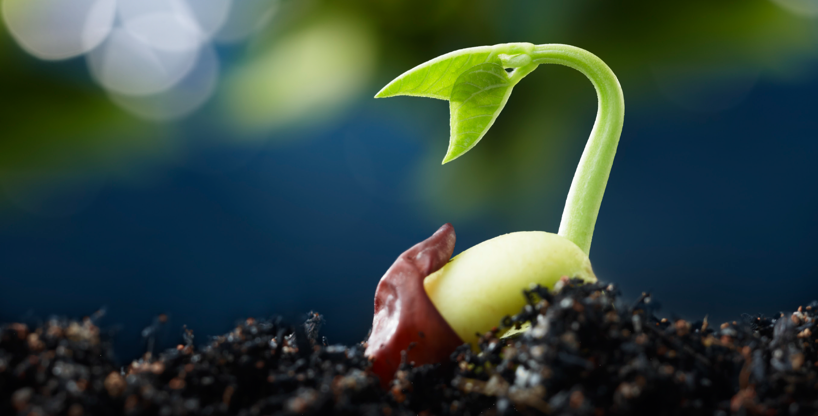
Where Does Food Begin? (Explore)
Lesson Goal: Discover the seed and its beginnings as food using a 5 E format.

Slide 12
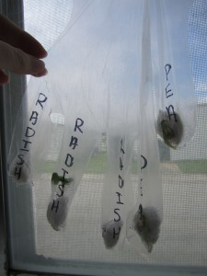
Garden
in a Glove
(Explore) seed germination using gloves and cotton balls.

Slide 13
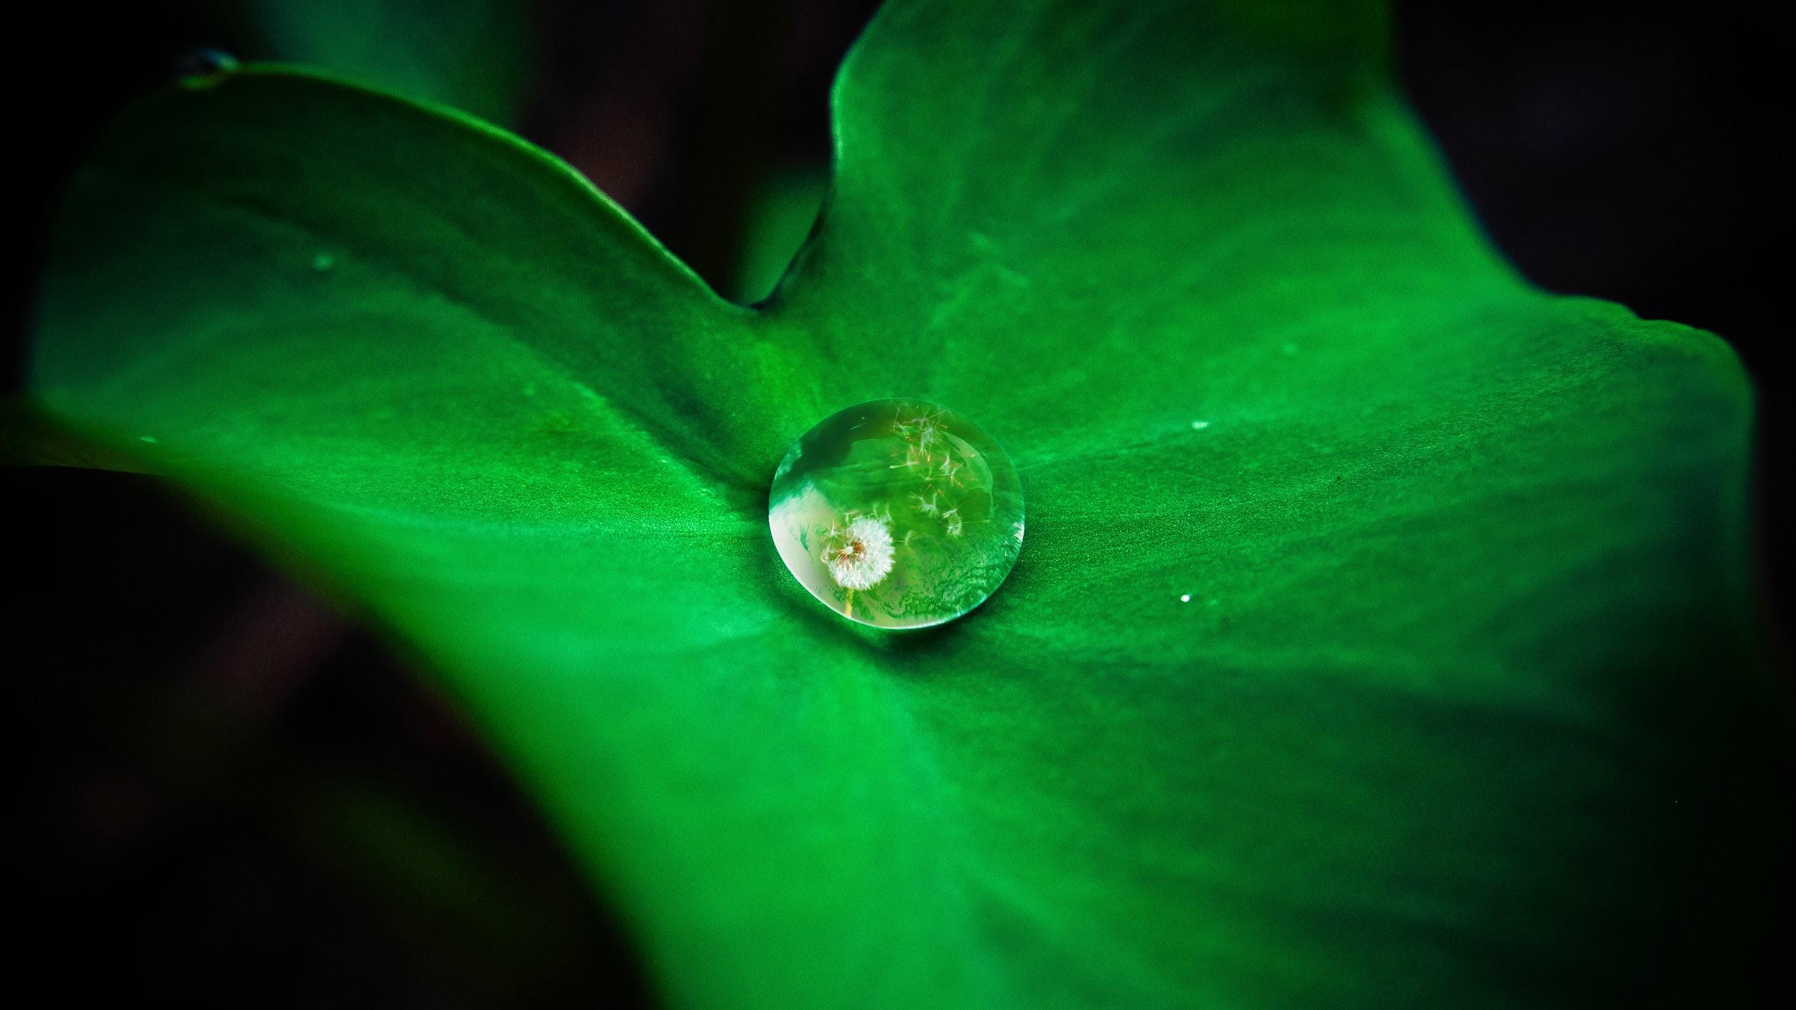
Habits of Mind/5E Reflection
3 minute quiet writing time. Which habits did you use as you engaged in the exploration of the seed?

Slide 14
3D STEM Flower Model (Explain)
http://www.newtonsapple.org.uk/wp-content/uploads/2013/05/parts-of-a-flower-display.jpg

Slide 15
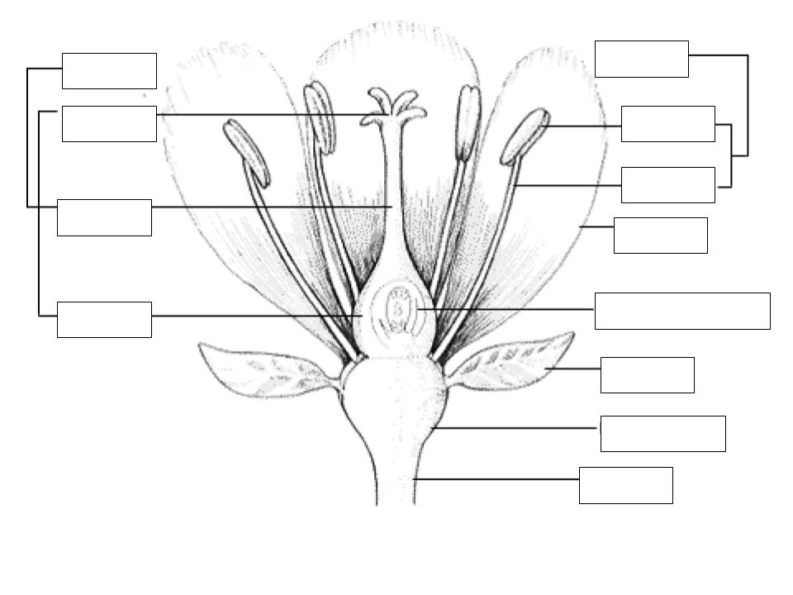

Slide 16
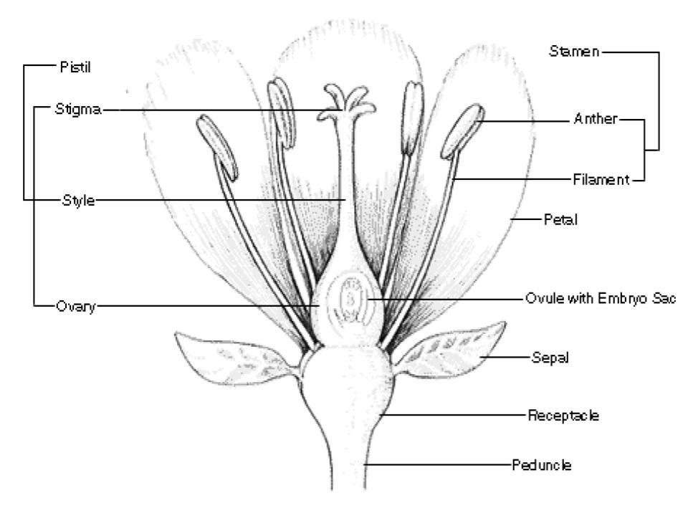

Slide 17
Parts of a Flower
Flowers hold the reproductive parts of some plants. The pistil, stigma, style, and ovary are parts of the female reproductive system and this is where seeds are made.
Pistil: The entire female unit of the flower.
Stigma: Located at the top of the pistil and this is where pollen is collected.
Style: As a part of the pistil, it is a long tube between the stigma and the ovary. When pollen grains that land on the stigma, a pollen tube grows inside the style.
Ovary: An organ that produces ovules. An ovule is a reproductive cell. After fertilization, ovules become seeds.
The stamen is the male reproductive part of the flower and is where pollen is made.
Stamen: The male part of the flower which produces pollen.
Anther: The top of the stamen is the anther. The anther makes and holds the pollen.
Filament: A stem-like part which gives support for the anther.
The areas that are below the flower have important jobs.
Receptacle: Located at the end of the stalk or stem of the plant.
Sepal: Small leaves right below the flower.
Stem: A stem-like part which holds the plant upright and also into the ground.
Petals: Brightly colored leaf-like parts of the flower which attract birds and insects and may have a pleasant odor.
Peduncle: A stalk which can bear a flower or fruit, or the main stalk.

Slide 18
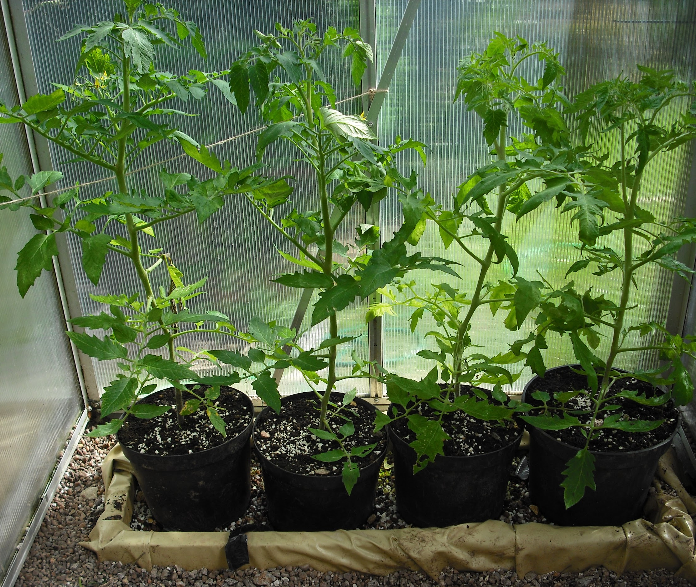
Habits of Mind/5E Reflection

Slide 19
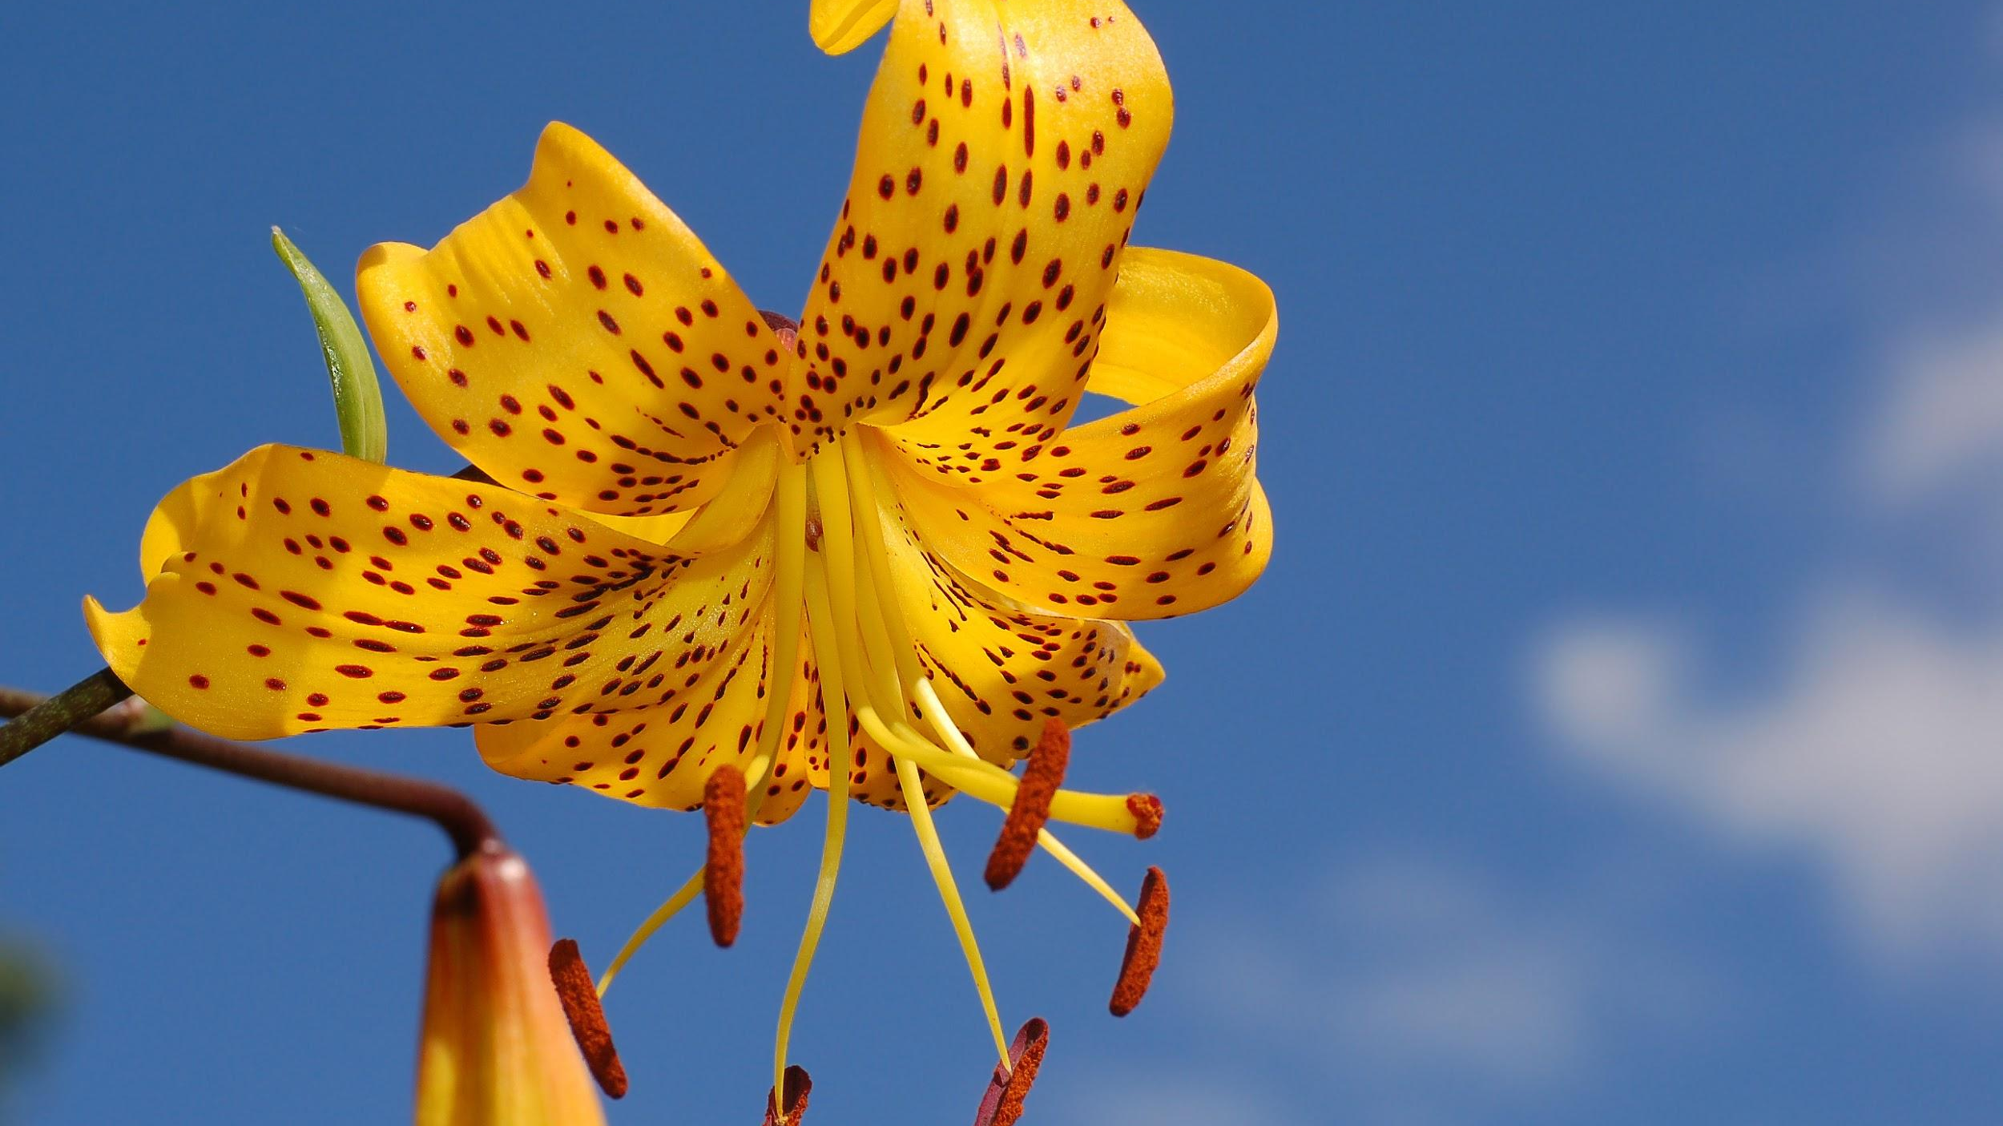
Activity/Speaker Plant Biologist: Bringing the Outside World In!

Slide 20
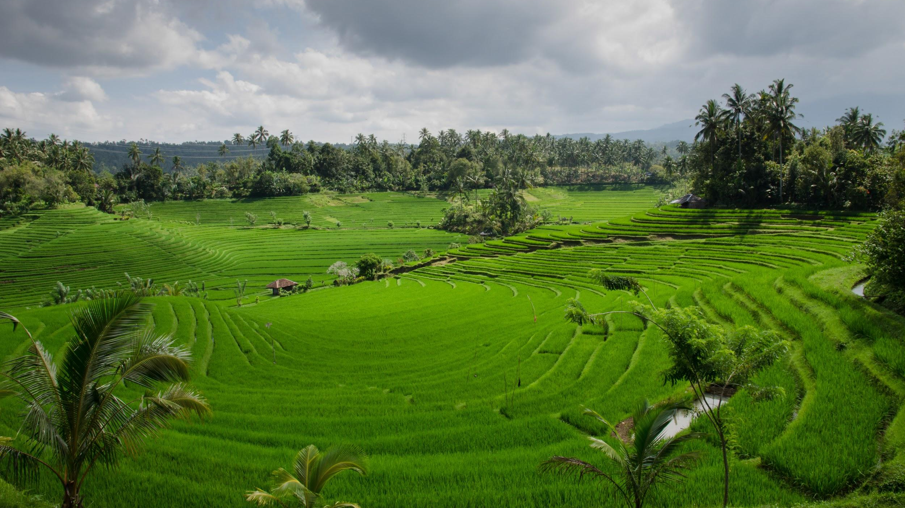
Working Lunch

Slide 21
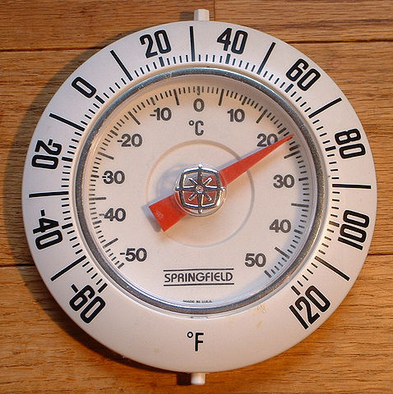
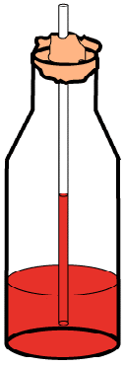
Make a Thermometer

Slide 22
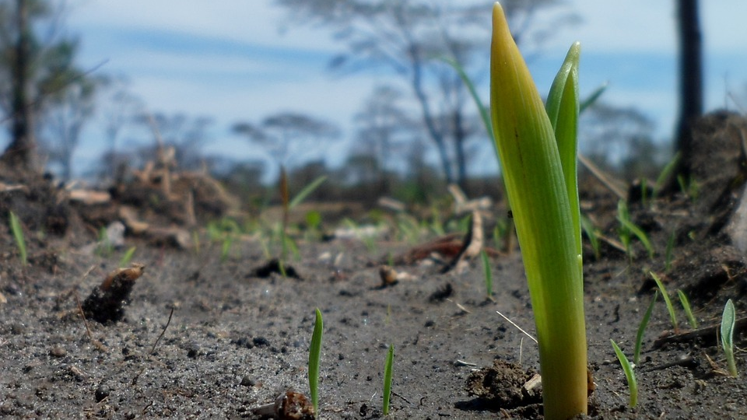
Habits of Mind/5E Review and Reflection

Slide 23
How the UA Delivers ‘Martian’ Food: Sustainability

Slide 24
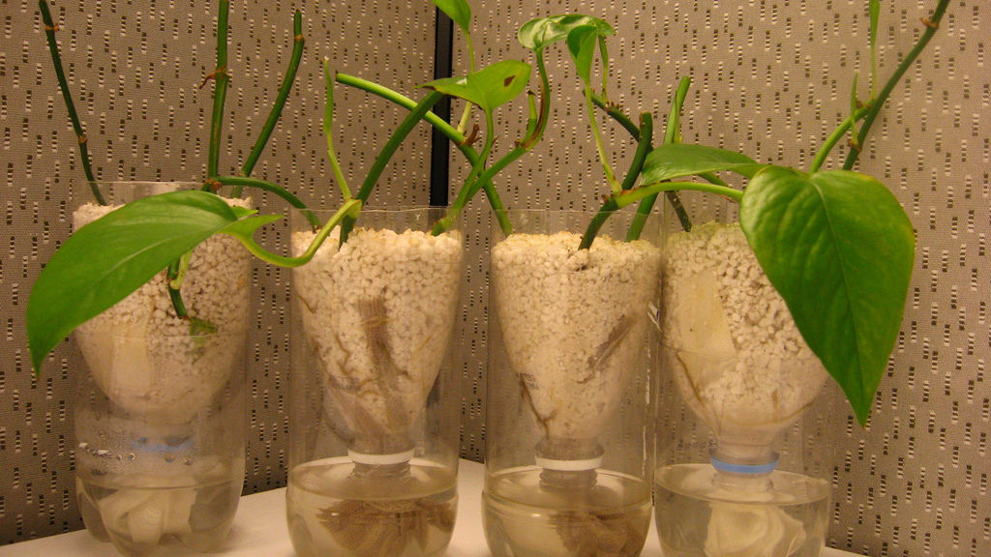
STEM Challenge: Growing Plants Hydroponically (Extend/Elaborate)

Slide 25
Engineer Engineeri

Slide 26
What Do You Do With An Idea?
Written by Kobi Yamada and Illustrated by Mae Besom

Slide 27
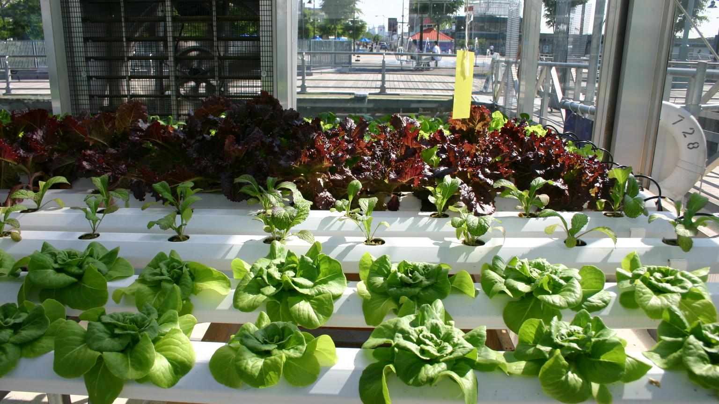
Habits of Mind/5E Review and Reflection (Evaluate)

Slide 28
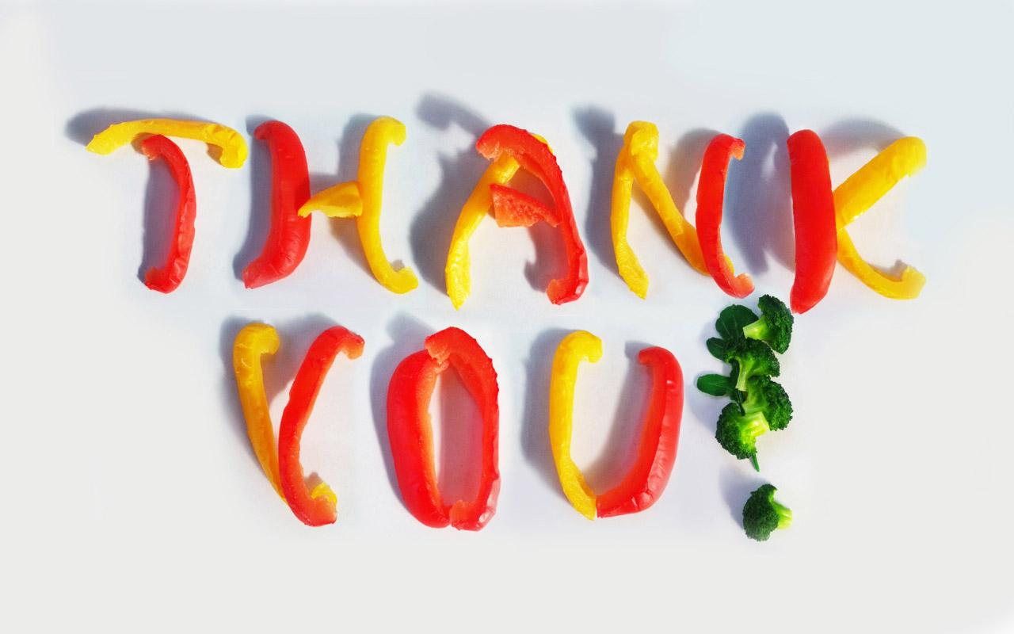
30 Day Commitment and Exit Evaluations
Danielle Coleman
daniellec@stcyril.com
Robyn Yewell
ryewell@amphi.com

Slide 29
Helpful Resources
STEMAZing Institute - http://www.stemazing.org/
Growing Plants Hydroponically- http://www.thirteen.org/edonline/tech/lesson2-students.html-
SOLE Sciences of Life Explorations- Agriculture in the Classroom- www.agclassroom.org/ny/resources/pdf/activities/meta.pdf
National Agriculture in the Classroom- https://www.agclassroom.org/
Agriculture in the Classroom, National Farm Bureau, Arizona- https://www.azfb.org/Programs/Agriculture-in-the-Classroom
Agriculture in the Classroom (AITC) Program- https://nifa.usda.gov/program/agriculture-classroom-aitc-program
Nutrients For Life - Curriculum and Free Materials- https://www.nutrientsforlife.org/

Slide 30
Helpful Resources (Continued)
Habits of Mind Teacher’s Companion http://www.habitsofmind.org/client/hom/HOM_teacher_Companion.pdf
NGSS-Matrix of Cross-cutting Concepts http://nstahosted.org/pdfs/ngss/MatrixOfCrosscuttingConcepts.pdf
Engineering and Design Method

Slide 31
Works Cited
http://www.chsvt.org/wdp/Habits_of_Mind.pdf- Habits of Mind
http://www.wisd.org/users/0001/docs/GVC/5E%20Model.pdf - The 5E Model of Instruction
https://www.bscs.org/sites/default/files/_legacy/BSCS_5E_Instructional_Model-Executive_Summary_0.pdf - 5E Instructional Model
https://www.youtube.com/watch?v=2x9dMt-dg0w- What’s in the Garden?
http://ediblegardenproject.com/wp-content/uploads/2015/10/How-Does-a-Seed-Become-Plant.pdf - Where Does Food Begin?
https://uanews.arizona.edu/videos/how-ua-delivers-martian-food - How the UA Delivers ‘Martian’ Food
http://teacherweb.com/LA/FloridaAvenueElementary/Wood/006-The-Tiny-Seed.pdf

