Slide 1
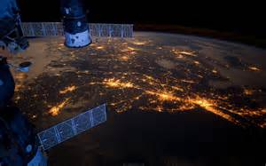
FAR OUT!
Exploring Space
Through STEM

Slide 2
YOUR STEMAZING LEADERS
Amanda McPherson - admcpherson@pima.edu
Pre-K Teacher at Picture Rocks Elementary, Marana
Adjunct Faculty at Pima Community College
Masters in Early Childhood Education
Jennifer Maxwell - jmaxwell@tanq.org
MS Science Teacher at Emily Gray Junior High, Tucson
Certified in Secondary Math & Science

Slide 3
CROSS CUTTING CONCEPTs

Slide 4
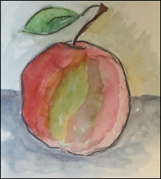
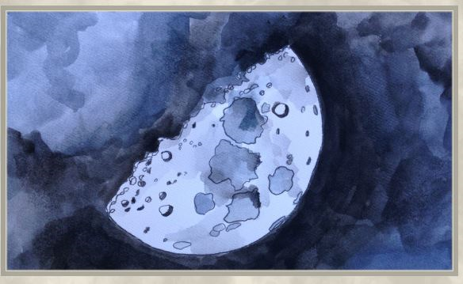
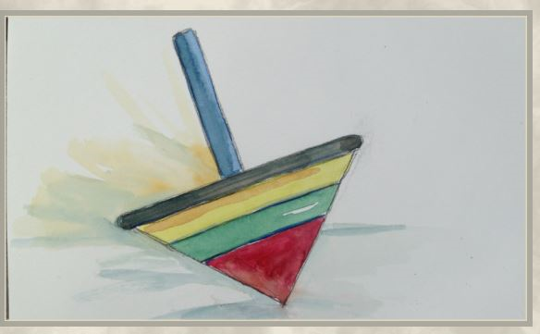
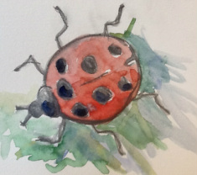
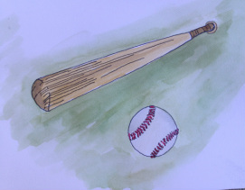
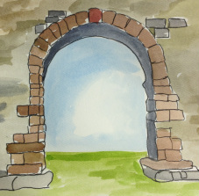
http://crosscutsymbols.weebly.com/

Slide 5
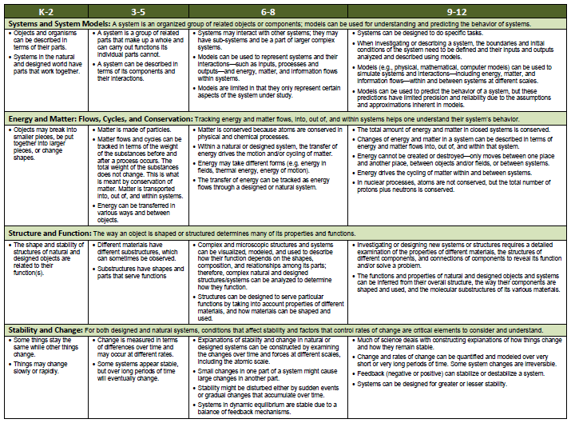

Slide 6
MAKING connections
Cause
& Effect
Patterns
Systems & System
Models
Structure & Function
Scale, Proportion, & Quantity
Energy
&
Matter
Stability
&
Change
List a few Earth/Space related concepts below each CCC that fit with your grade level. How might you connect these with your students?

Slide 7
SAMPLE connection board

Slide 8
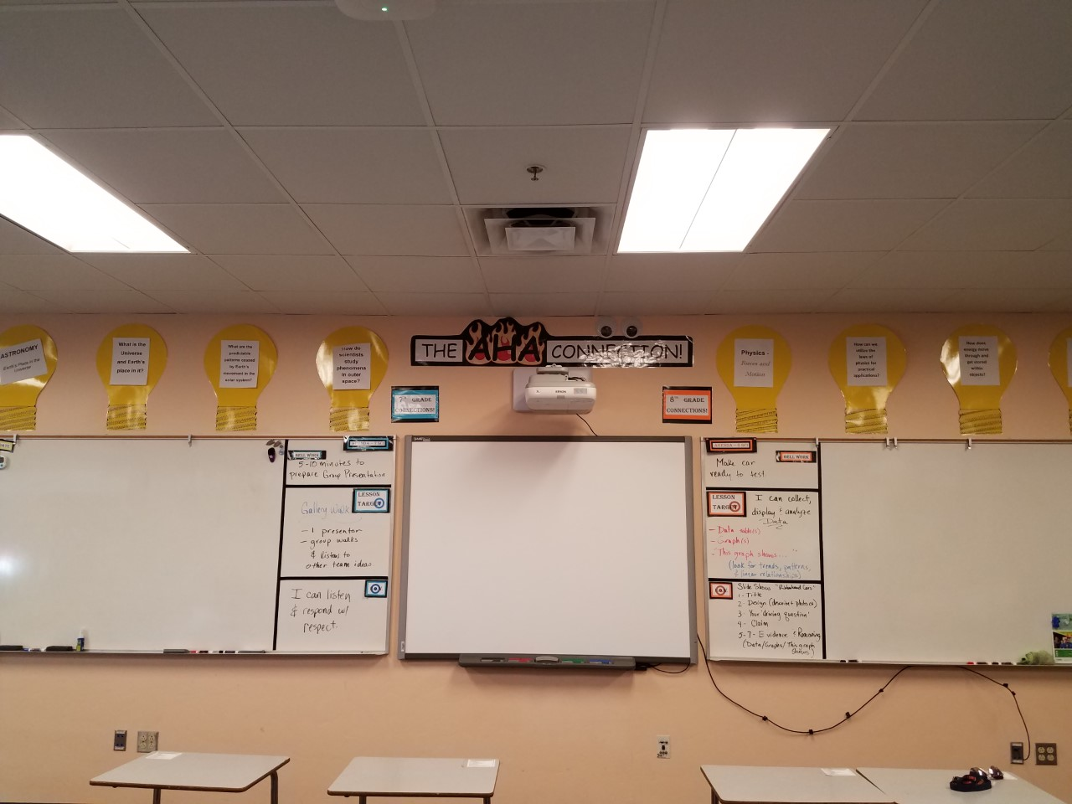
SAMPLE connection board

Slide 9
Making Observations from EARTH (PreK-8)

Slide 10
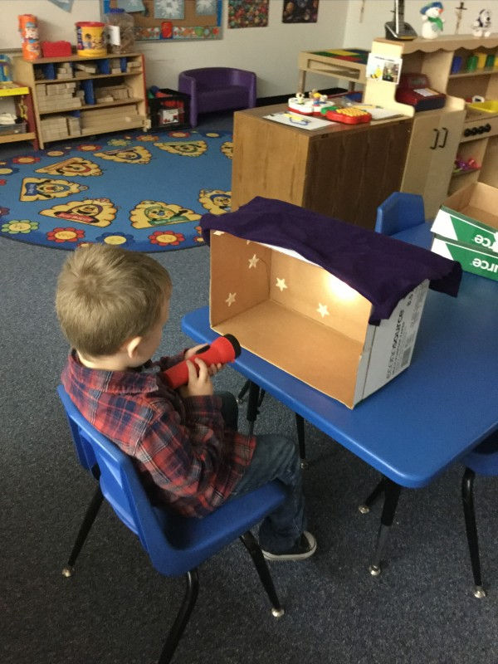
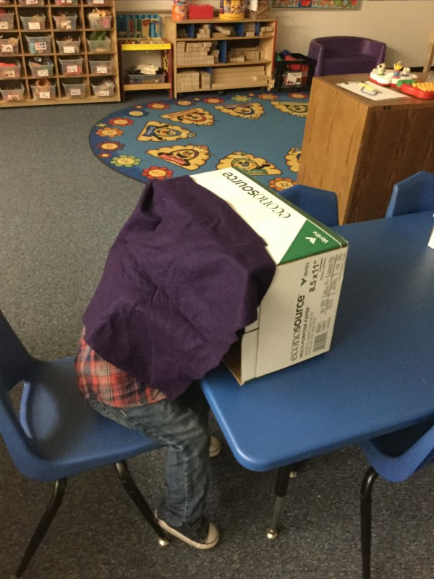
STAR Boxes
Notes:
(Amanda)
(Jeni) –I have used a smaller box with 3-D constellations to help older students understand that the star patterns are formed by stars at varying distances, not on the same plane. Sample tissue box: constructed by students as they create their own constellation.

Slide 11
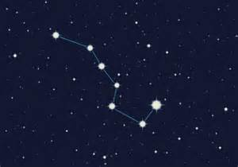
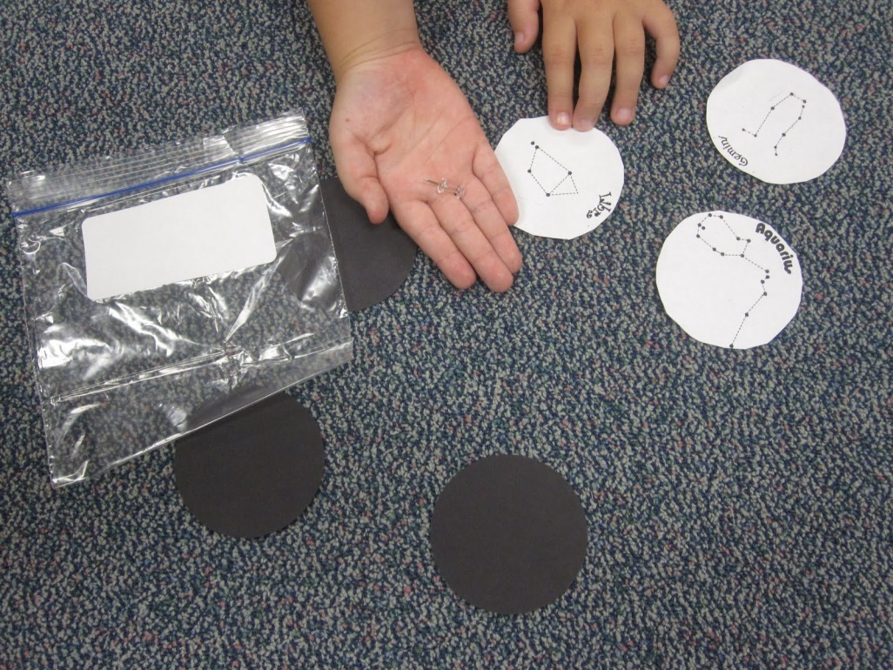
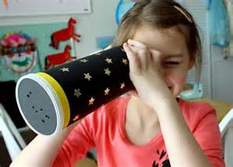
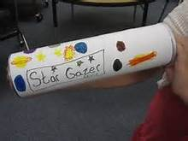
Pringles Viewers

Slide 12
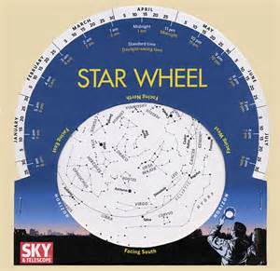
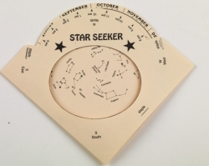
Star Finders
Identify
Predict
Observe
Connect
Notes:
Websites for both templates are at the end of the PPT. We are using the BW one(s) which come with teacher instructions and hints.. For younger kids, use the simple version. In MS, we use them with the Pringles cans to identify constellations and make predictions of when we could observe them from the Northern hemisphere. I also have them practice using their star wheel by asking, ”at what time tonight would you see…???”or “when would …..be rising in the east?” and “ when will it be directly over head…or south….or setting?” This leads to them noticing patterns in how the sky changes over a period of time. Students can graph their observations using the dial and be challenged with performing this same exercise as a HW assignment at night or at a star party. Another thing that students make a connection to is their Zodiac signs. Have students move the dial and track where and how the zodiacs move across the sky in this model. Discuss what they notice. When are the seasonal zodiacs visible? (Jeni)

Slide 13
MAKING connections
Cause
& Effect
Patterns
Systems & System
Models
Structure & Function
Scale, Proportion, & Quantity
Energy
&
Matter
Stability
&
Change
How do these activities connect to the CCC’s?
Notes:
(Digestion time) What do these activities look like in your classroom with your grade levels standards? How do these activities connect to the Cross Cutting Concepts of the k-12 Framework? (Break)

Slide 14
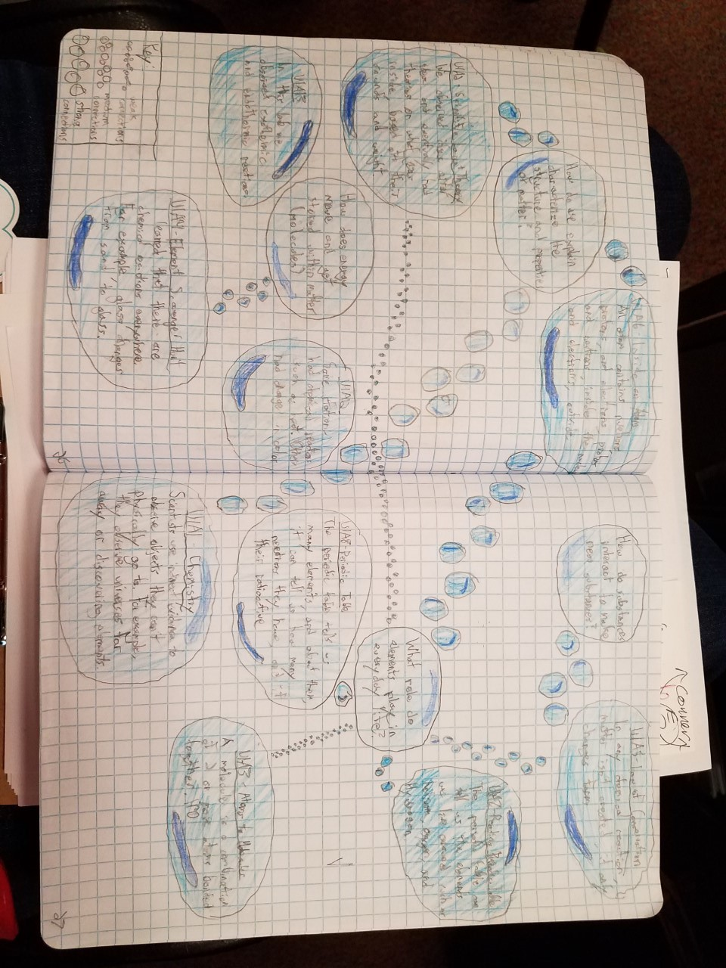
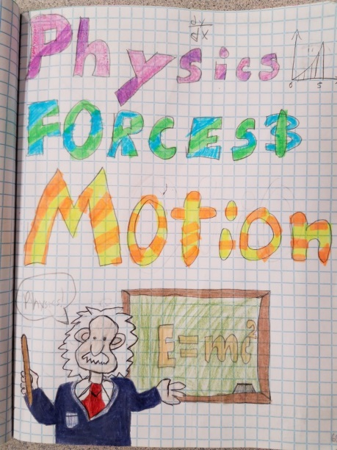
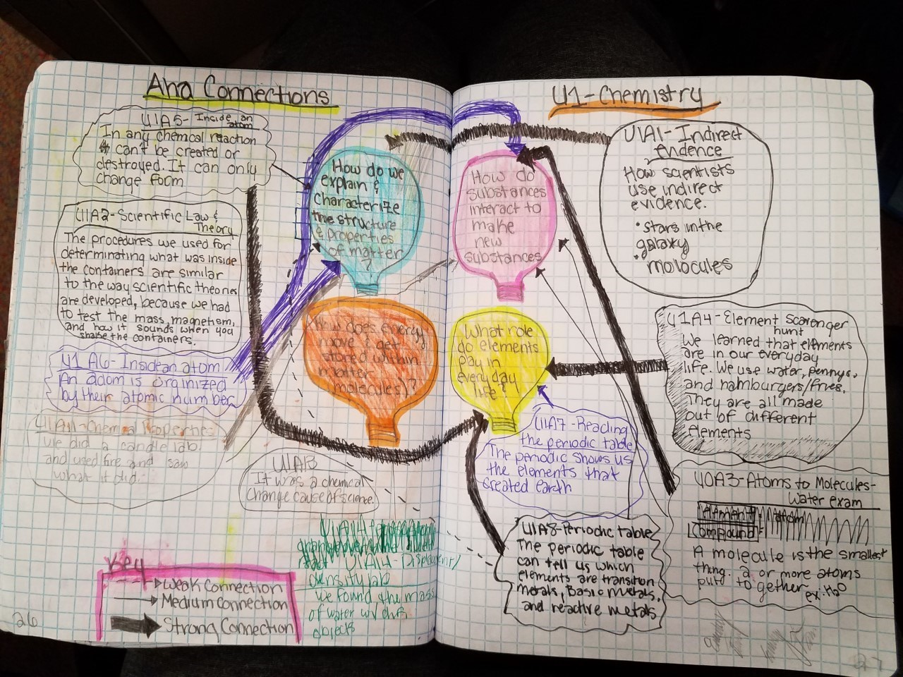
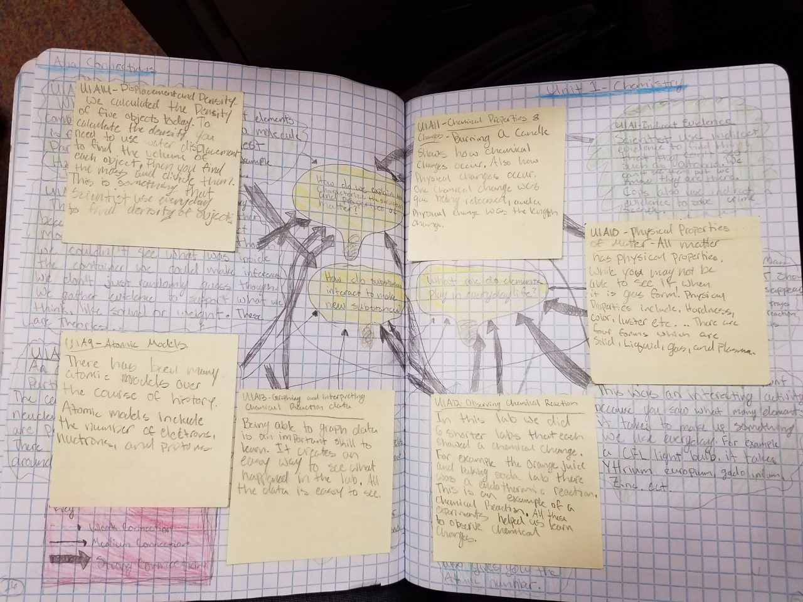
Sample Connection pages
Notes:
Middles school notebook samples. I have used Connection Pages with 6th through 8th grade students with great success. The Connection pages follow the very first page of each science unit – their Cover Page. The students return to their connection page after completing each activity and reflect on what they learned and how it connects to our big idea (questions formulated from the standards influenced by student curiosity). These are sample student pages. As they run our of room, flaps are added using sticky notes or tape. (Jeni)

Slide 15
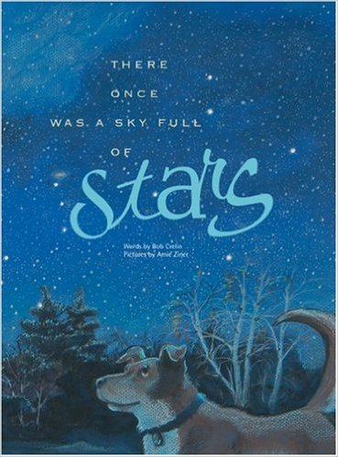
Words by
Bob Crelin
Pictured by
Amie Ziner
https://www.facebook.com/300736727031/videos/1382214754220/

Slide 16
Light Pollution Challenge
Notes:
(Jeni) Demo and Challenge…..Identify the three types of light pollution ( Sky Glow, Glare, and Light Trespass).

Slide 17
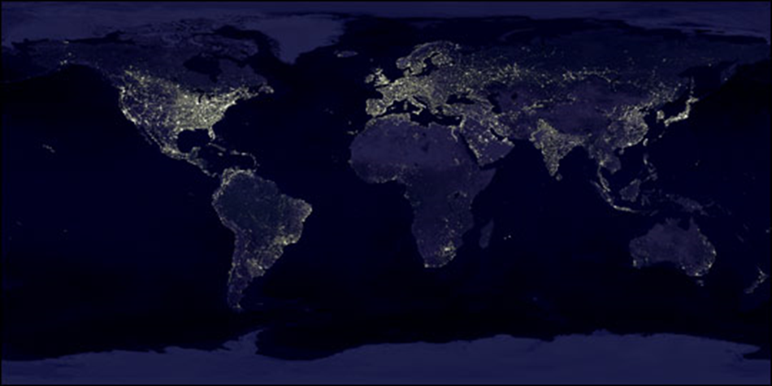
LIGHT POLLUTION
Shielding the Problem

Slide 18
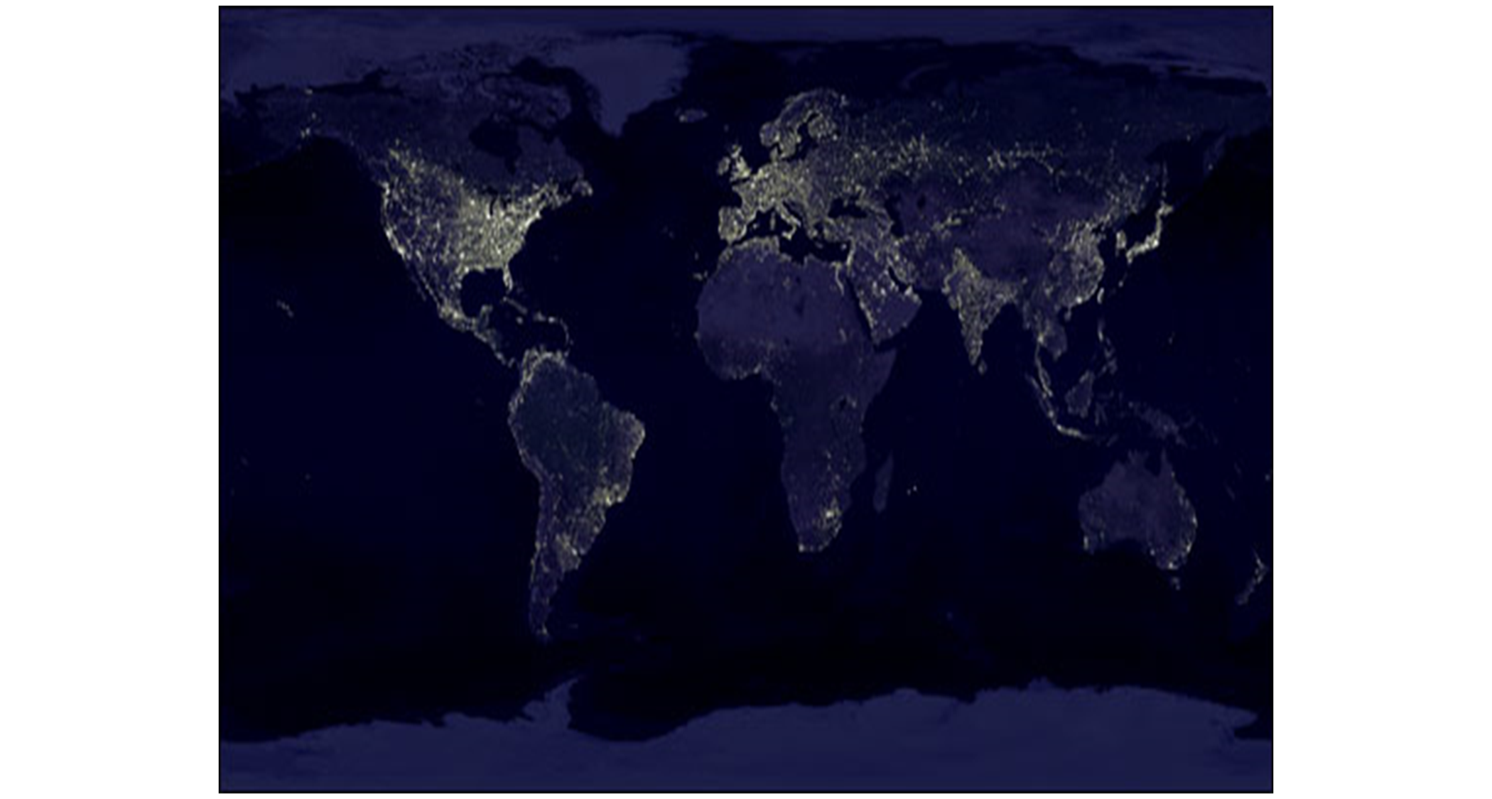
What is Light Pollution?
Wasted artificial light that performs no function and/or goes where it’s not supposed to go.

Slide 19
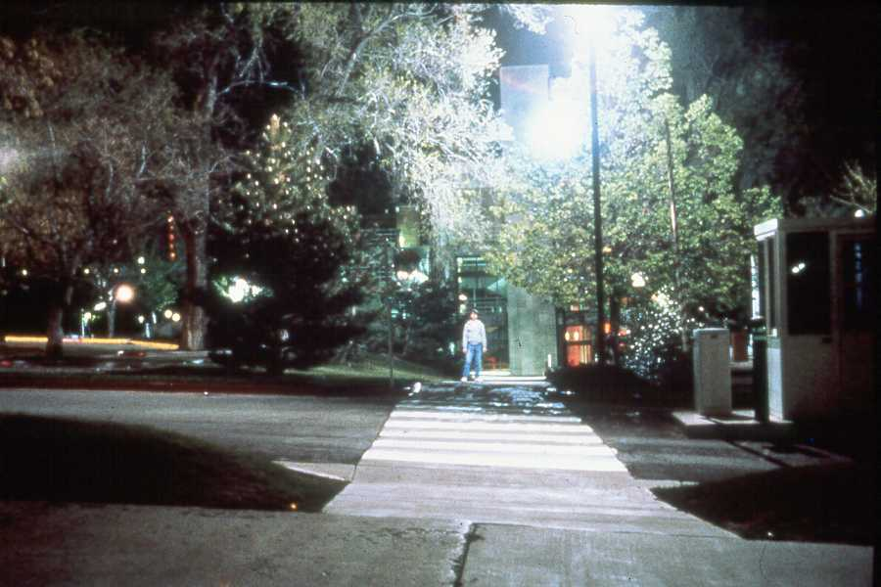
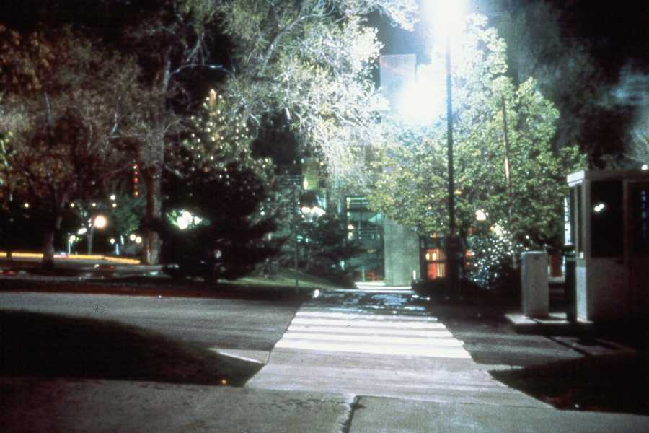
Glare
Too much background light.

Slide 20
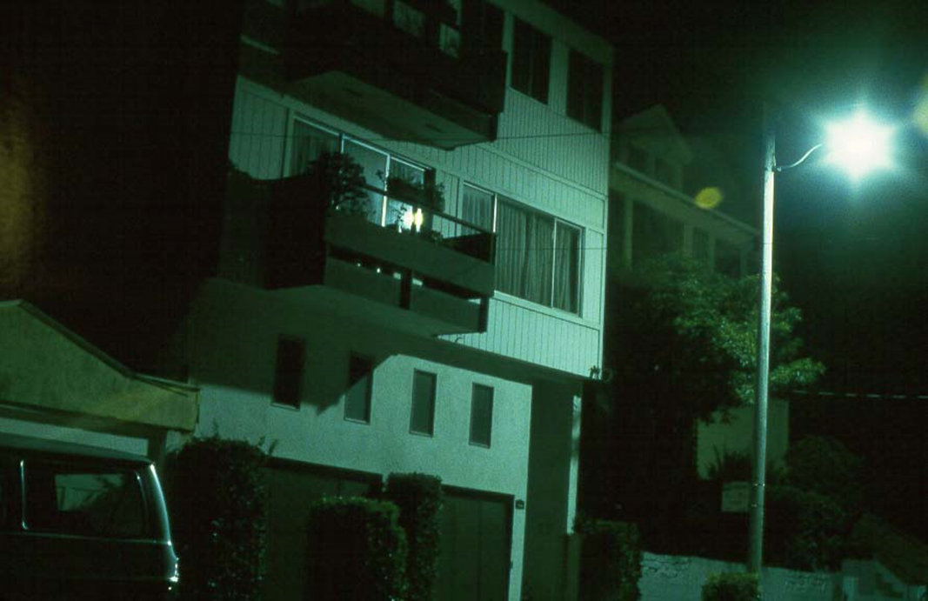
Light Trespass
Light that spills into an area where it is unwanted.

Slide 21
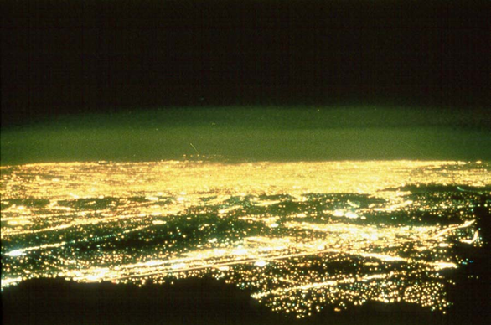
Sky Glow
Lots of light scattering off particles in the air, giving the appearance of a glowing sky.

Slide 22
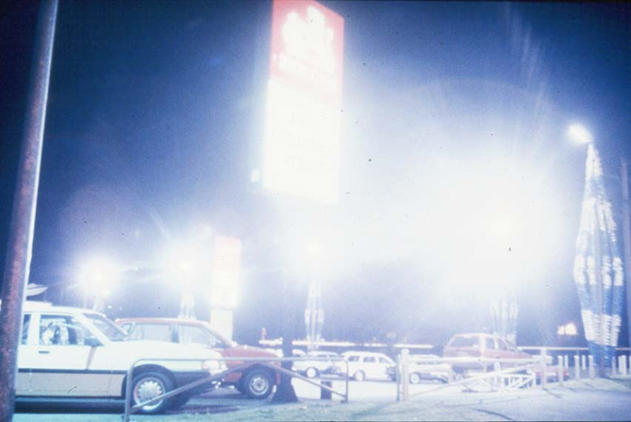
What can we do about it?

Slide 23
Light Pollution Challenge

Slide 24
Light Pollution Challenge
Criteria & Constraints:
Must include labeled blueprints of prototype(s)
Must address all three types of light pollution:
Sky Glow
Glare
Light Trespass
Must maintain a cost sheet (budget)
Must use recycled material wherever possible
Must be aesthetically pleasing and practical

Slide 25
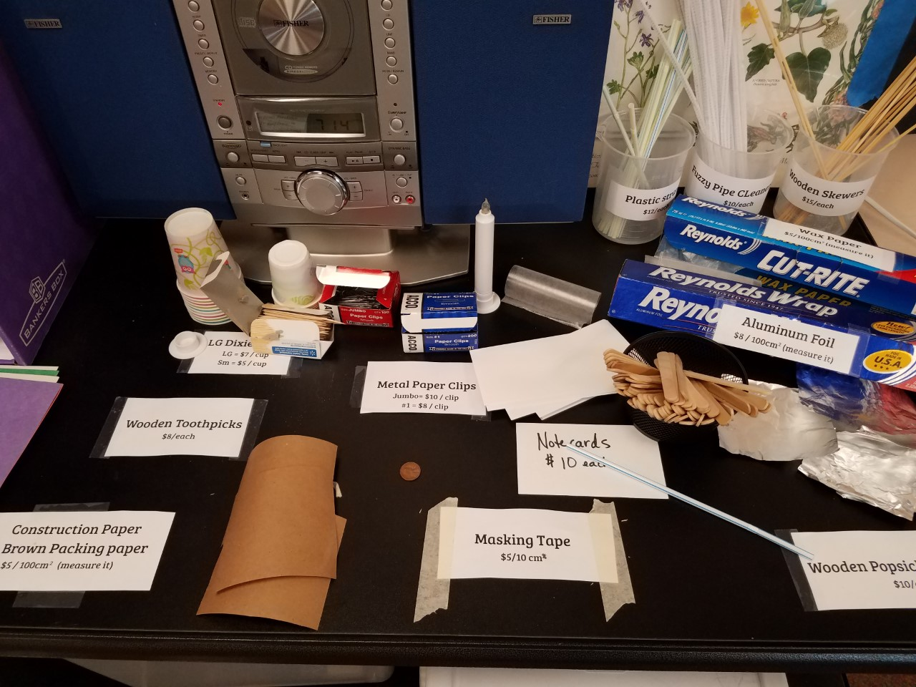
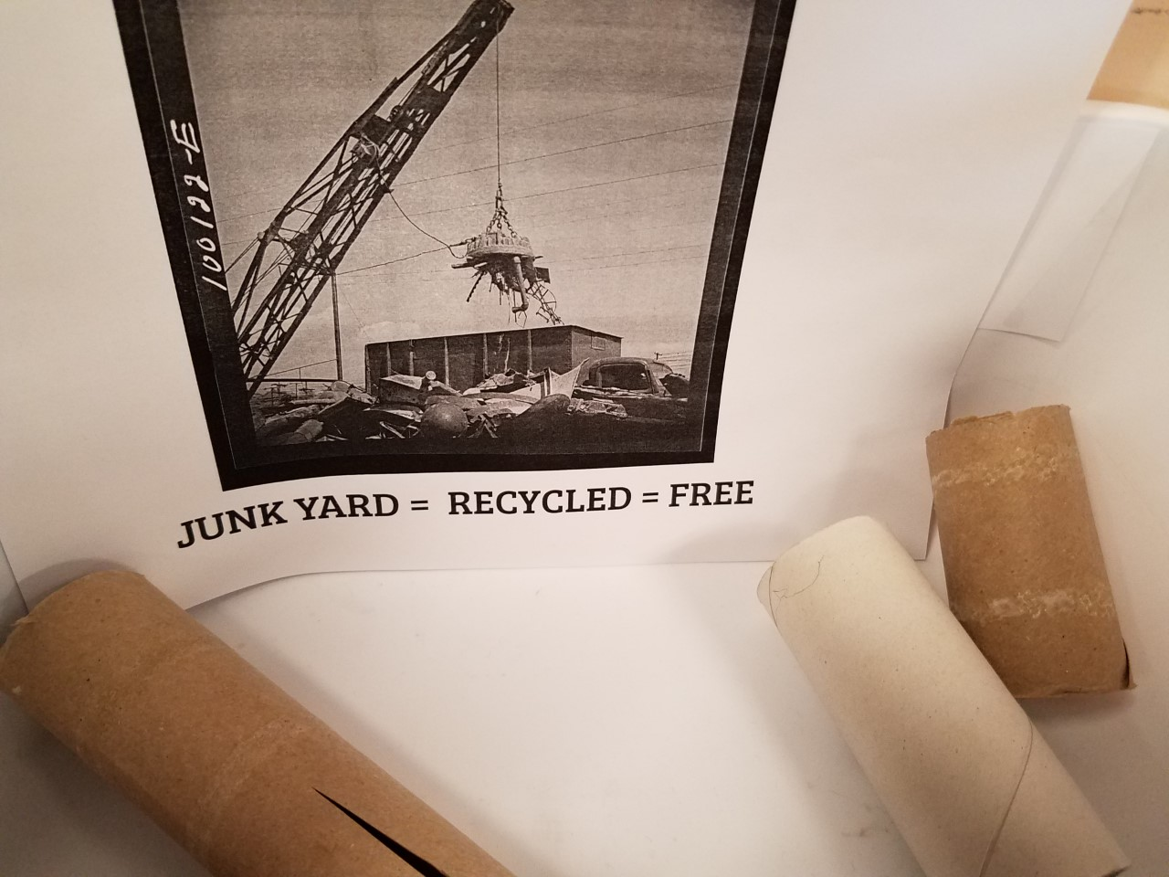
Budgeting resources

Slide 26
Light Pollution Challenge

Slide 27
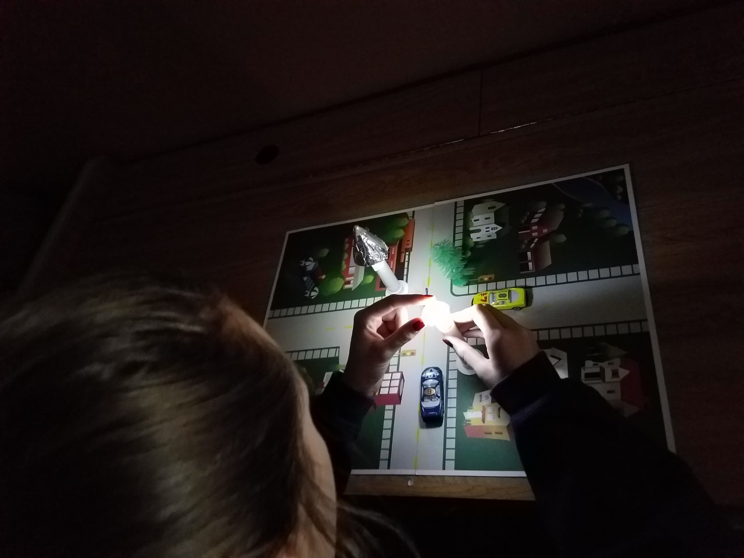
Light Pollution Challenge
Notes:
(Jeni) Demo and Challenge…..Identify the three types of light pollution ( Sky Glow, Glare, and Light Trespass).

Slide 28
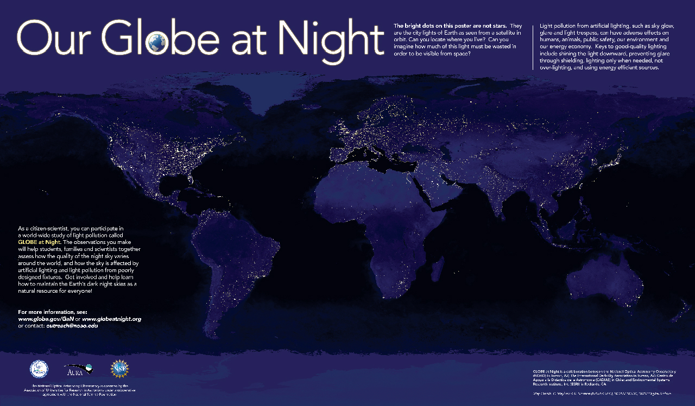
https://www.noao.edu/education/qltkit.php

Slide 29
MAKING connections
Cause
& Effect
Patterns
Systems & System
Models
Structure & Function
Scale, Proportion, & Quantity
Energy
&
Matter
Stability
&
Change
What do these activities look like in your classroom? How would you change them? How does the Engineering Design process fit with the CCC’s?
Notes:
(Digestion time) What do these activities look like in your classroom with your grade levels standards? How do these activities connect to the Cross Cutting Concepts of the k-12 Framework? (Break)

Slide 30
Students around the globe as Citizen Scientists
Lunch Guest : Constance E. Walker, Ph.D.
Scientist, NOAO and Director of the Globe at Night Campaign
Website: https://www.globeatnight.org/
Notes:
Connie will handout 2017 GaN postcards with the new campaign dates

Slide 31
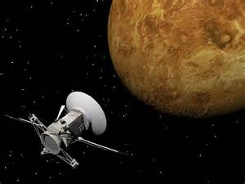
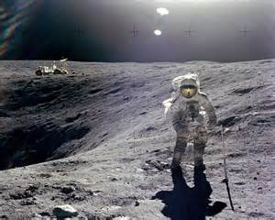
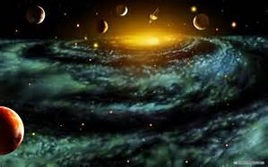
Beyond Earth Explorations (PreK-8)

Slide 32
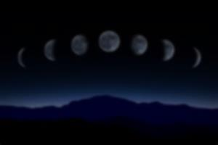
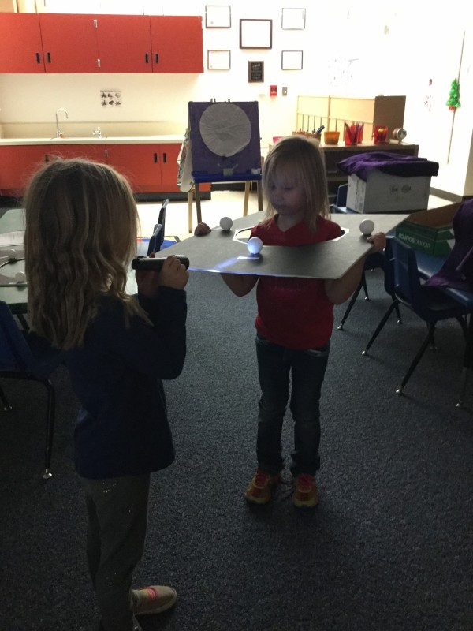
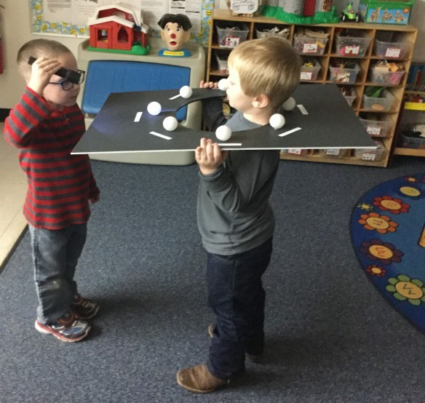
Exploring Lunar Phases
Notes:
(Amanda) Construction and use with prek-2
(Jeni) Using the model to address misconceptions of a “dark side” of the moon.

Slide 33
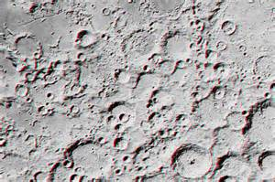
Moon Mapping
Sanlyn Buxner
Assistant Research Professor at University of Arizona - College of Education
Education Specialist & Research Scientist with the Planetary Science Institute

Slide 34
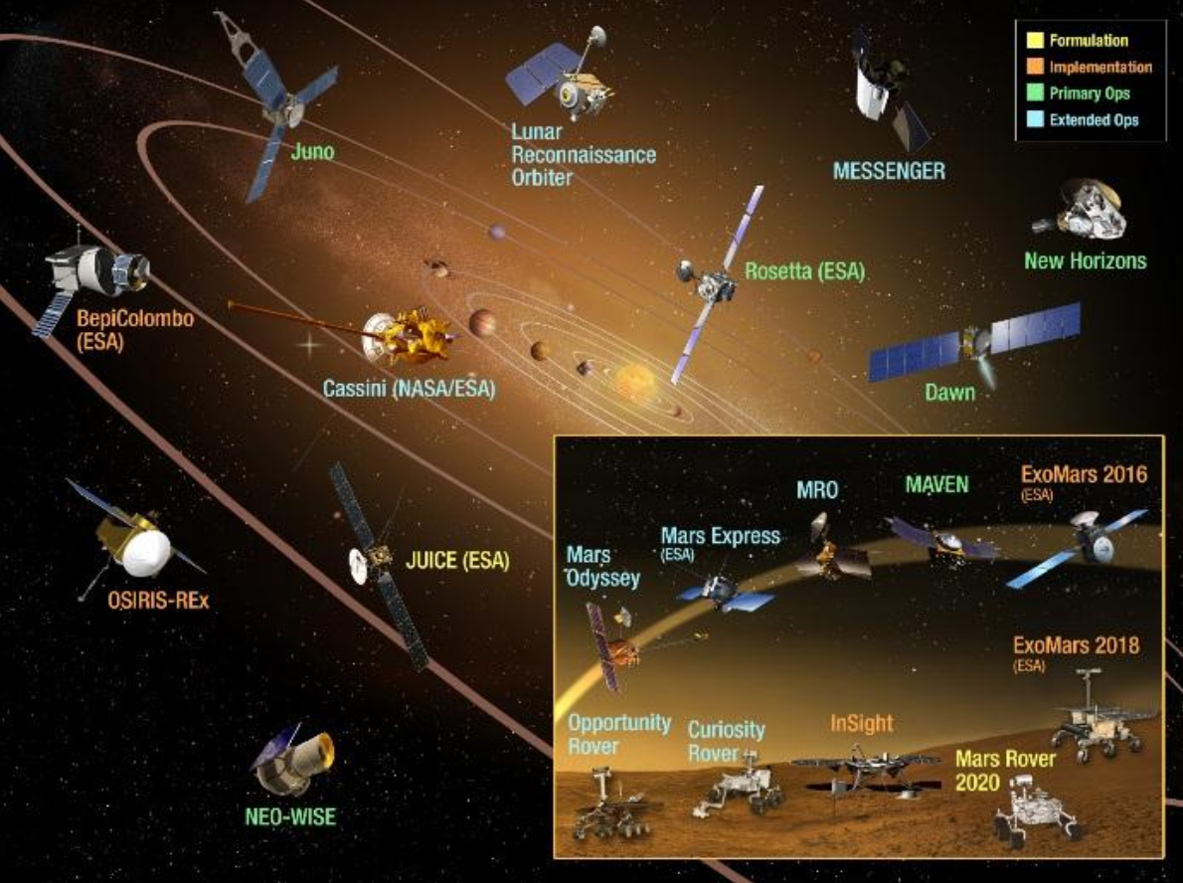
What’s your mission?
https://www.nasa.gov/missions
Notes:
(Jeni & Amanda)
Engineering Design Challenge: exploration challenge – what is your mission?
Why explore space? What is the purpose? Where would you like to explore? How will you explore it? Is it an unmanned mission or a manned mission? How will you/ your craft get there? What will it do there? How will it land? How will it transmit information to and from Earth?
Use the NASA website to investigate past, current, and future missions. Decide the criteria & constraints of your mission, design and construct a prototype of your exploration vehicle (robots!).

Slide 36
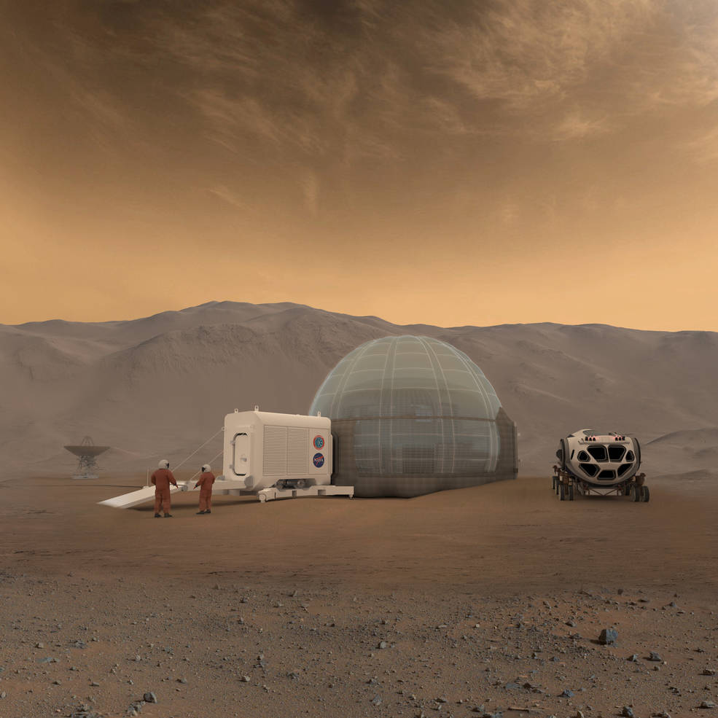
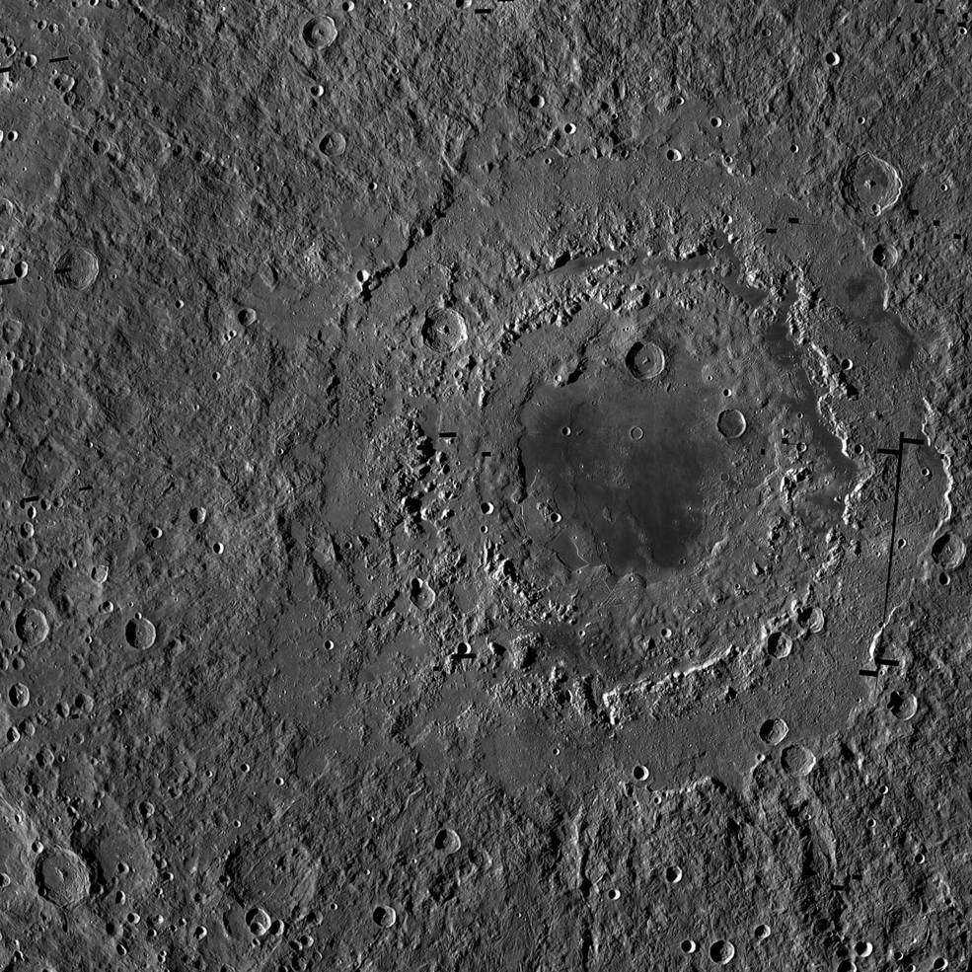
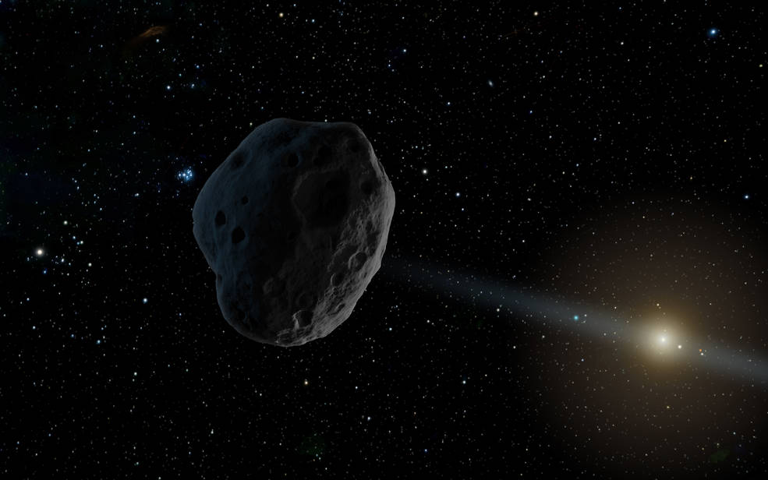
Whole Class Mission
Teams – Small Groups/Pairs
ASK: Where will your spacecraft go? What will it do there? Why is it important?
EXPLORE: Research past, present and future missions on the NASA website . What type of spacecraft /instruments are needed?

Slide 38
MAKING connections
Cause
& Effect
Patterns
Systems & System
Models
Structure & Function
Scale, Proportion, & Quantity
Energy
&
Matter
Stability
&
Change
How could you adapt this for use in your classroom? Where does it fit in the CCC’s?
Notes:
(Digestion time) What do these activities look like in your classroom with your grade levels standards? How do these activities connect to the Cross Cutting Concepts of the k-12 Framework? (Break)

Slide 39
30 Day Commitment & exit evaluations
Amanda McPherson - admcpherson@pima.edu
Jennifer Maxwell - jmaxwell@tanq.org

Slide 40
helpful resources
Windows to the Universe website - http://www.windows2universe.org/
Make a Star Finder pdf-http://www.dennisschatz.org/activities/Star%20Finder.pdf
Or - http://www.skyandtelescope.com/astronomy-resources/make-a-star-wheel/
There Once Was a Night Full of Stars: http://www.bobcrelin.com/author.html
Audio link to story: https://www.facebook.com/300736727031/videos/1382214754220/
Globe at Night Citizen Science & Quality of Light Kits- https://www.globeatnight.org/
Project Astro - https://www.noao.edu/education/astro/
PSI - http://www.psi.edu/
NASA - https://www.nasa.gov/missions
STEMAZing Institute - http://www.stemazing.org/

Slide 41
WORKS Cited
Earth From Space Station - jpegdesktopas.com
Cross Cutting Concepts Weebly by Peter A’Hearn
http://crosscutsymbols.weebly.com/
https://www.bing.com/images/search?q=Person+Gazing+at+Stars
Constellation Pringles Project · jpegncegt.blogspot.com , · jpegpinterest.com, jpegbluehouseschool.blogspot.com, and jpegholykaw.alltop.com
Apollo Astronauts On Moon - jpegarts-wallpapers.com
Awesome Space Backgrounds Universe · jpegallwallpaper.us
Chinese Moon Space Probe· jpegquazoo.com
Moon Phases· jpegtimeanddate.com
3D Moon Map · jpegwired.jp
NASA Planetary Missions · pngcommons.wikimedia.org
http://www.stemazing.org/stemazing-workshop-resources - UA Eng Des Process
https://www.noao.edu/education/qltkit.php - Globe at Night /Quality of Light images
Photos form NASA mission pages- https://www.nasa.gov/missions
Photos also contributed by Amanda McPherson and Jennifer Maxwell

