Slide 1
Biomimicry Problem Solving through the Eyes of Nature

Slide 2
STEMAZing Facilitators
Ginny Wheeler
Grades 2-6 Gifted Ed
Sunnyside Unified School District
Trish Patchin
Grades 4-5
Holaway Elementary School
Amphitheater School District

Slide 3
Introductions
Choose one item from the basket on your table that “speaks to you.”
Please tell us your name, school, grade level, and in one sentence why you chose the item you did.

Slide 4
What is Biomimicry?
Innovation inspired by nature…
~Janine Benyus
The Biomimicry Institute

Slide 5
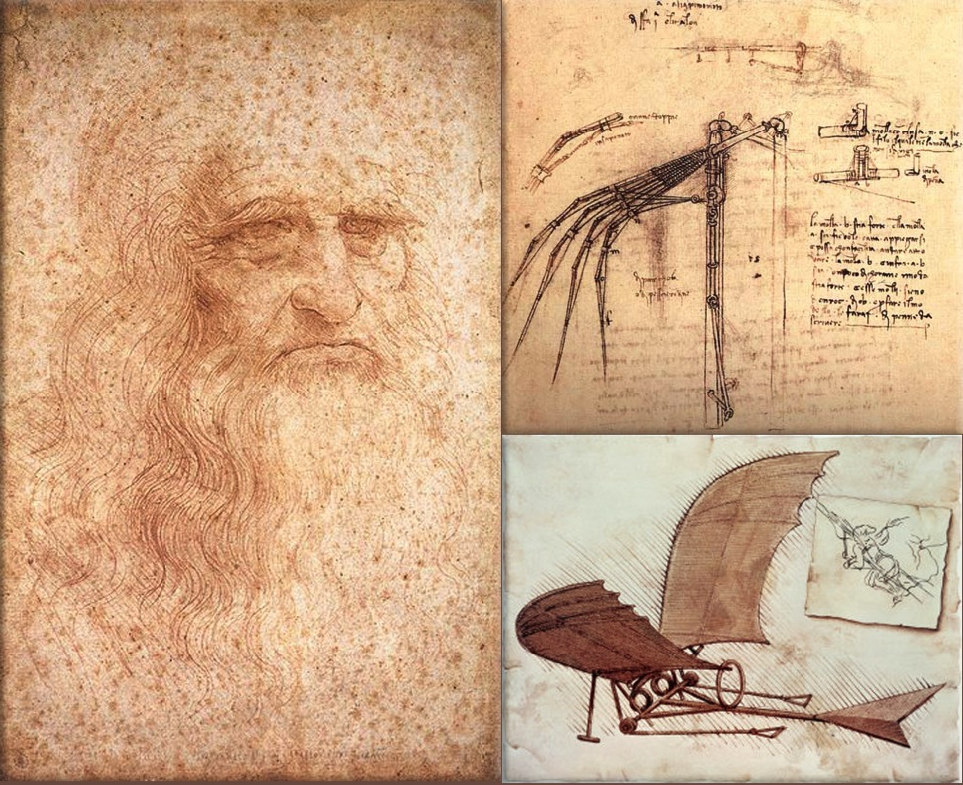
Early Examples of Biomimcry
“The genius of man may make various inventions, encompassing with various instruments one and the same end; but it will never discover a more beautiful, more economical, or a more direct one than nature's, since in her inventions nothing is wanting and nothing is superfluous.” -- Leonardo da Vinci
http://firststreetconfidential.com/images/images-history/0103-leonardo-da-vinci-flying-machine.jpg

Slide 6
Intro to Biomimicry Video
Start at beginning
Stop at 4 min 42 sec when it says “MATERIALS”

Slide 7
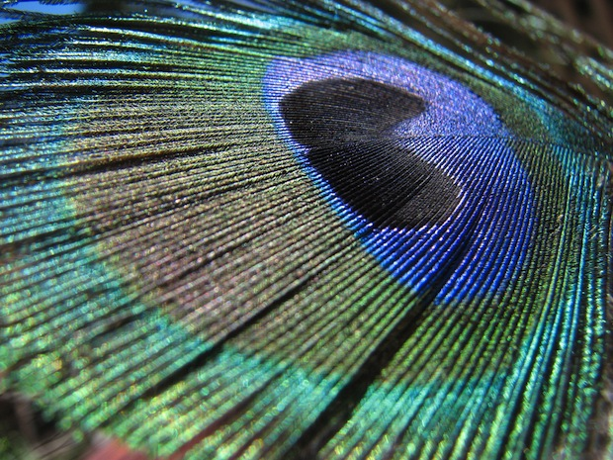
http://www.sandbirch.com/janine-benyus-biomimicry-is-innovation-inspired-by-nature/

Slide 8
Rules of Nature
Nature runs on sunlight.
Nature uses only the energy it needs.
Nature fits form to function.
Nature recycles everything.
Nature rewards cooperation.
Nature banks on diversity.
Nature demands local expertise.
Nature curbs excesses from within.
Nature taps the power of limits.
~Janine Benyus

Slide 9
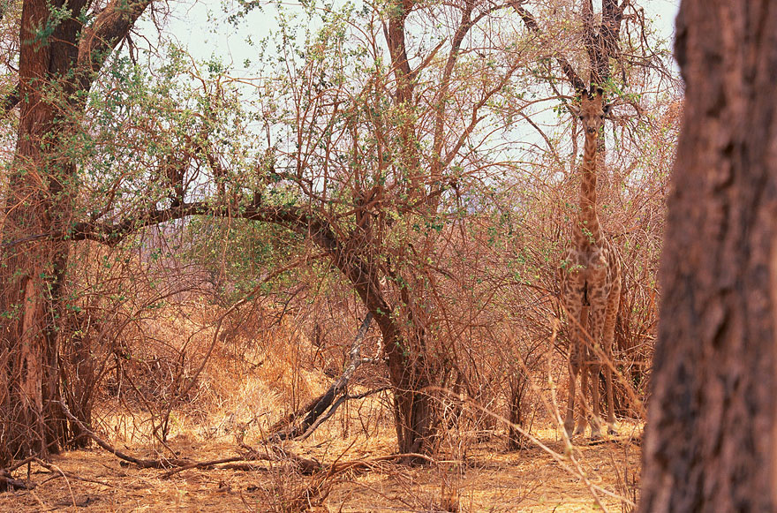
Which object at your table is linked to this picture?
http://www.boredpanda.com/animal-camouflage/

Slide 10
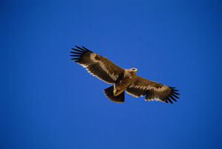
Which object at your table is linked to this picture?
http://www.airbus.com/innovation/future-by-airbus/the-concept-plane/innovating-for-the-future

Slide 11
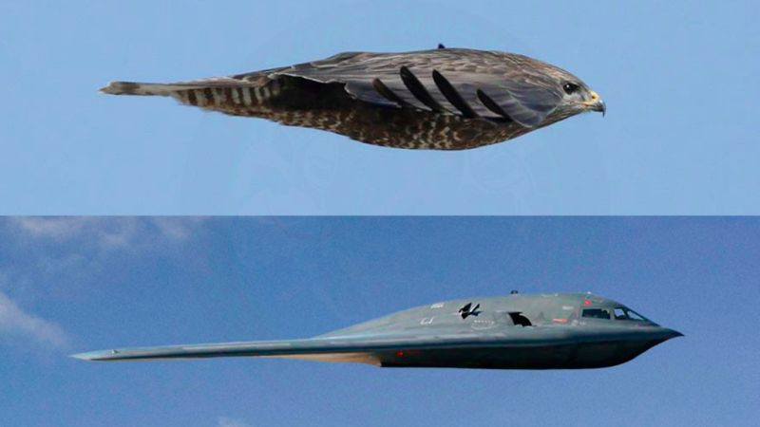
Birds = Jets
The B-2 Spirit, aka Stealth Bomber – shows design similarities to that of a hawk.

Slide 12
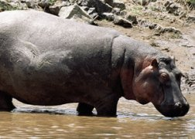
Which object at your table is linked to this picture?
https://www.sciencenewsforstudents.org/article/hippo-sweat-natural-sunscreen

Slide 13
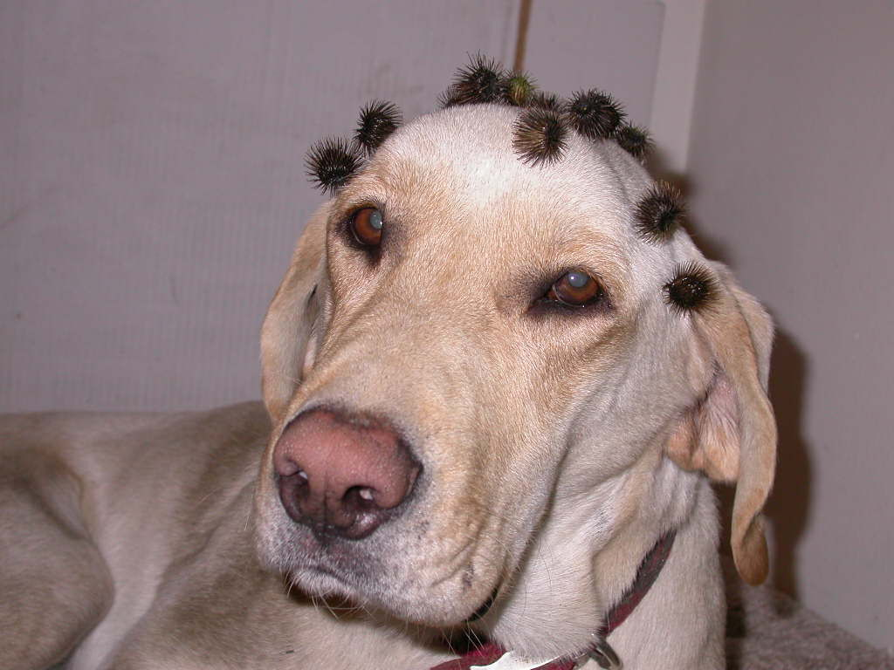
Which object at your table is linked to this picture?
http://www.southernminn.com/st_peter_herald/opinion/article_03693a64-6067-5e81-b832-5f878ea71b6f.html

Slide 14
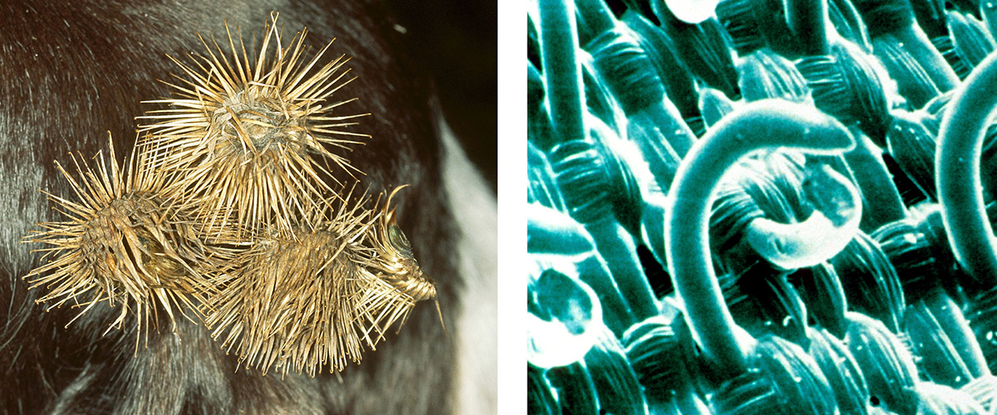
Burrs - Velcro
http://rt-bi.nl/social-responsibility/biomimicry/
http://rt-bi.nl/wp-content/uploads/2015/04/03-Velcro.jpg
Notes:
After a hunting trip in the Alps in 1941, Swiss engineer George de Mestral’s dog was covered in burdock burrs. Mestral put one under his microscope and discovered a simple design of hooks that nimbly attached to fur and socks. The small hooks found at the end of the burr needles inspired him to create the now ubiquitous Velcro.

Slide 15
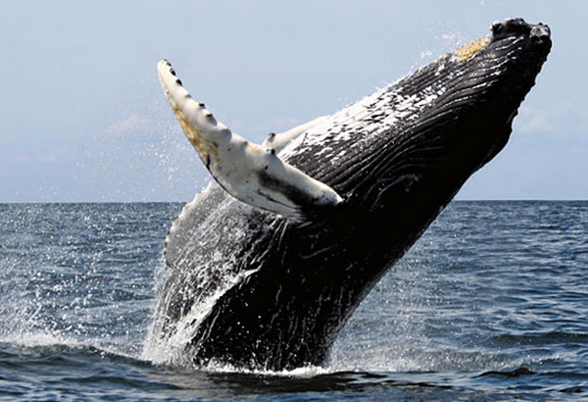
Which object at your table is linked to this picture?
http://www.uh.edu/engines/epi2935.htm

Slide 16
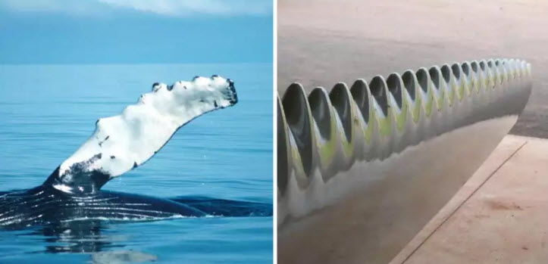
Whale – Turbine blades
http://emgn.com/entertainment/10-natures-genius-inventions-copied-purposes/

Slide 17
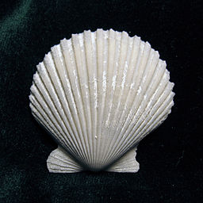
Which object at your table is linked to this picture?
http://library.acropolis.org/biomimicry-human-creation-inspired-by-nature/

Slide 18
Why teach Biomimicry?
3-Dimensional Instruction
Disciplinary Core Ideas
Crosscutting Concepts
Scientific and Engineering Practices
Multiple points of entry for learning
Sustainability
Offers kids a hopeful vision for the future of our planet

Slide 20
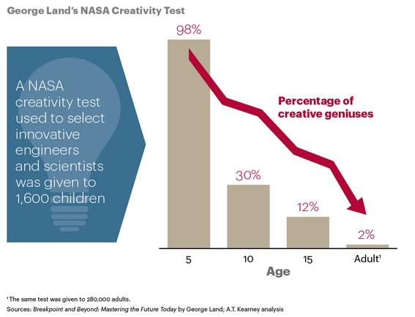

Slide 21
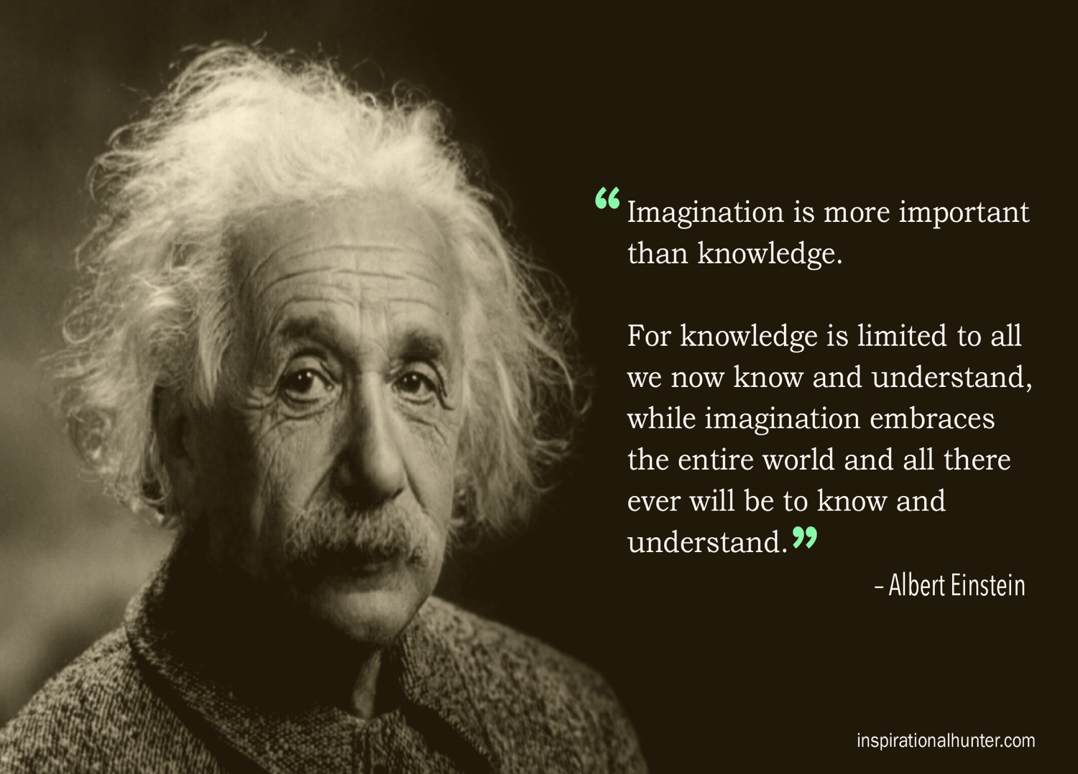
http://www.inspirationalhunter.com/albert-einstein-quote-imagination-is-more-important-than-knowledge/

Slide 22
Types of Biomimicry
Form
Process
Systems

Slide 23
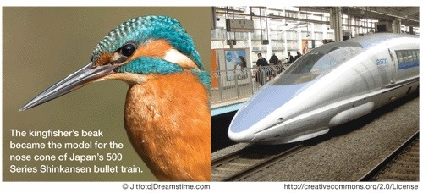
Form
These examples of biomimicry are more concrete and easier to understand, and can be especially helpful for younger students.
https://technologybeyond2035.wordpress.com/biomimicry-2/

Slide 24
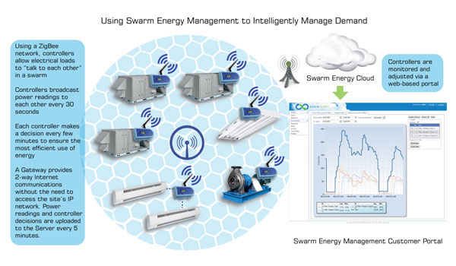
Process
http://dev.bdtenergygroup.com/product/swarm-energy-management/

Slide 25
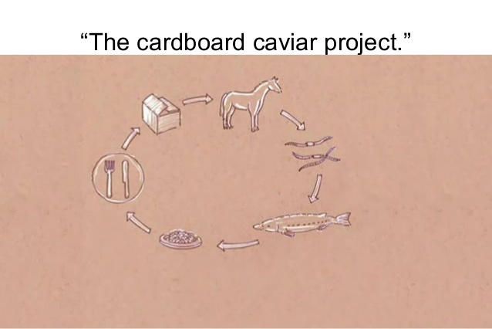
Systems
https://www.linkedin.com/pulse/biomimicry-using-environment-exploitable-resource-source-wieb
http://image.slidesharecdn.com/ad50da44-5280-4089-8fe6-aadc936d9ac0-161004172717/95/biomimicry-presentation-15-638.jpg?cb=1475602108

Slide 26
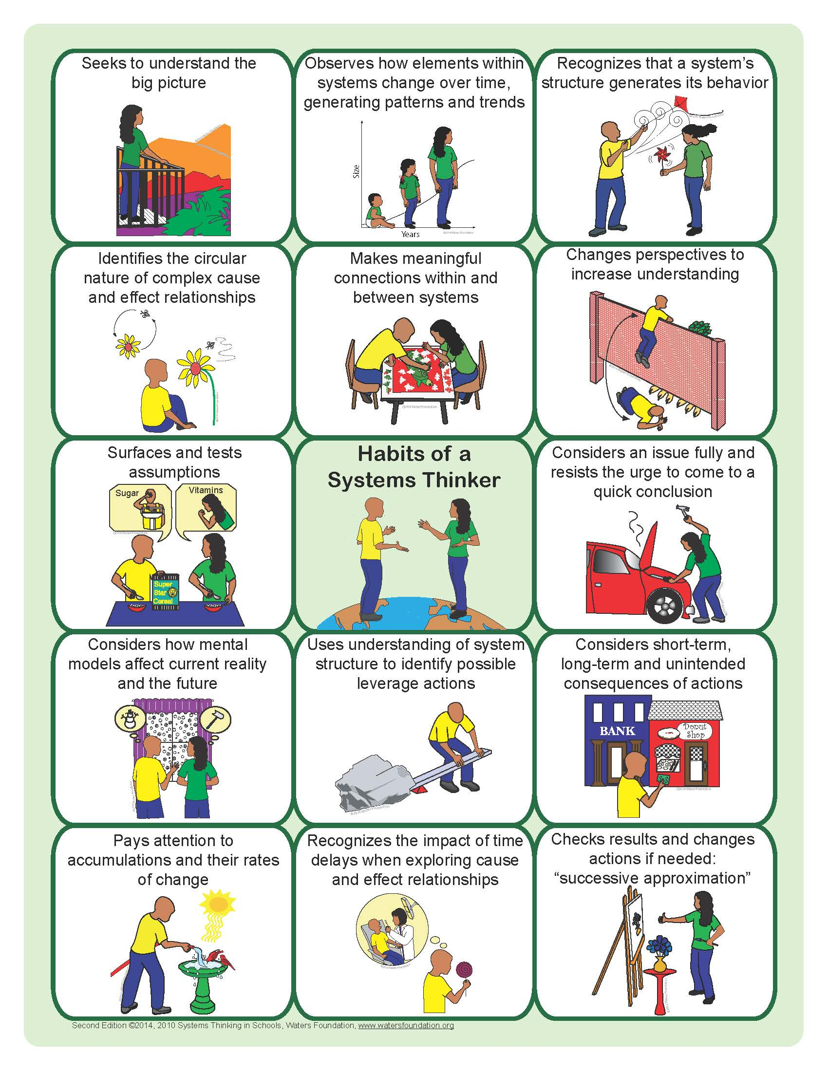

Slide 27
Biomimicry Video Materials Section
Start at 4 min 42 sec where it says “MATERIALS”
Stop at 9 min 0 sec when it says “ENERGY”

Slide 28
http://www.sandbirch.com/janine-benyus-biomimicry-is-innovation-inspired-by-nature/

Slide 29
Cross Cutting Concepts One of Three Dimensions from a Framework for K-12 Science Education
Patterns
Cause and Effect
Scale, Proportion, and Quantity
Systems and System Models
Energy and Matter
Structure and Function
Stability and Change

Slide 30
Digestion Time
What is something new you have learned and
how might you use it?
Which Crosscutting Concept can it be used to develop?
How could you assess learning?

Slide 31
Biomimicry Video Energy & Water Section
Start at 9 min 0 sec where it says “ENERGY”
Stop at 14 min 17 sec when it says “TOXICS”

Slide 32
http://www.sandbirch.com/janine-benyus-biomimicry-is-innovation-inspired-by-nature/

Slide 33
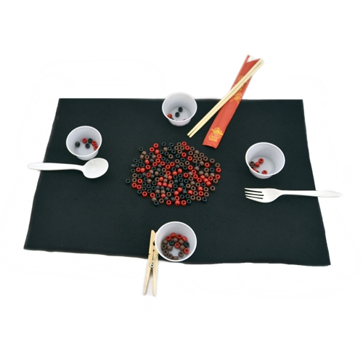
Adaptations Natural Selection: Birds and Critters
http://www.raftbayarea.org/ideas/Evolution%20by%20Natural%20Selection.pdf

Slide 34
Biomimicry Video Toxics & Structure Section
Start at 14 min 17 sec where it says “TOXICS”
Stop at 18 min 53 sec when it says “THE FUTURE”

Slide 35
http://www.sandbirch.com/janine-benyus-biomimicry-is-innovation-inspired-by-nature/

Slide 36
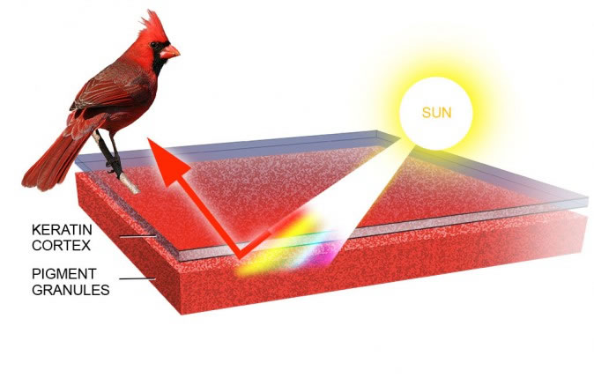
Pigments
Molecules that absorb some wavelengths (colors) of visible light. As a result, they change the color of the reflected or transmitted light.
http://www.nisenet.org/sites/default/files/catalog/uploads/InterferenceAcrylics_LessonPlan_May15_0.pdf
https://academy.allaboutbirds.org/how-birds-make-colorful-feathers/

Slide 37
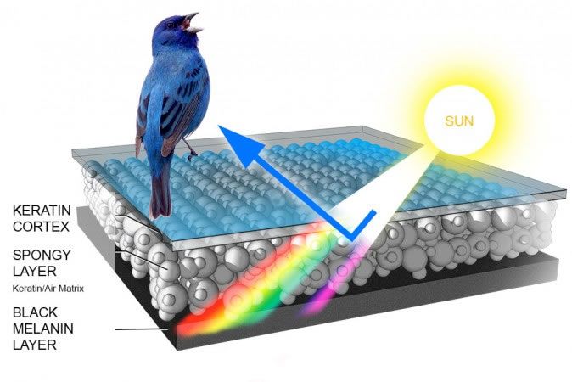
Structural Color
Color that results from the way light interacts with nano- or micro-scale structures in a material.
http://www.nisenet.org/sites/default/files/catalog/uploads/InterferenceAcrylics_LessonPlan_May15_0.pdf
https://academy.allaboutbirds.org/how-birds-make-colorful-feathers/

Slide 38
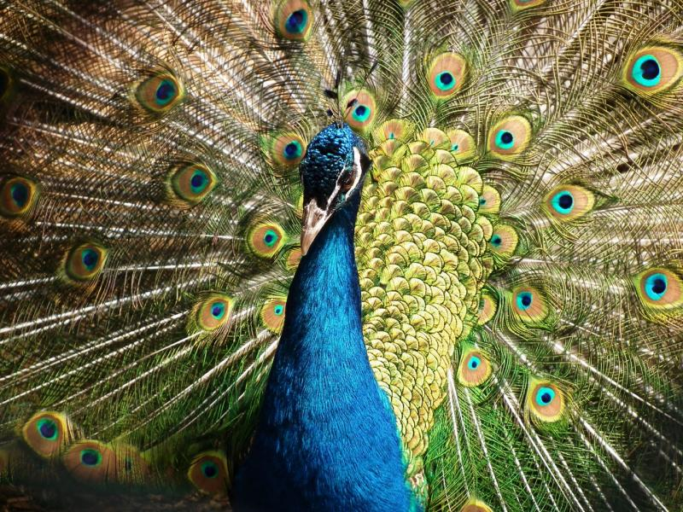
Peacock Feathers
https://www.seas.harvard.edu/news/2016/11/new-technique-for-structural-color-inspired-by-birds

Slide 39
Morpho Butterfly Video

Slide 40
Morpho Blue Butterfly

Slide 41
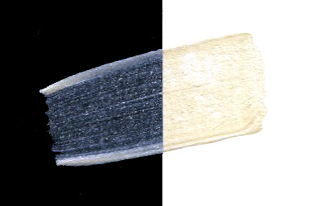
Interference Paint
https://www.goldenpaints.com/products/colors/interference-colors

Slide 42
Digestion Time
What is something new you have learned and
how might you use it?
Which Crosscutting Concept could it be used to develop?
How could you assess learning?

Slide 43
Jigsaw Activity
https://appsftw.com/app/nature-jigsaw-puzzles-free-2016-best-picture-puzzle-brain-games-for-kids-and-adults

Slide 44
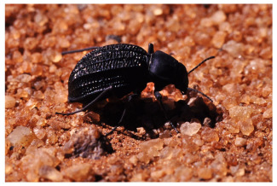
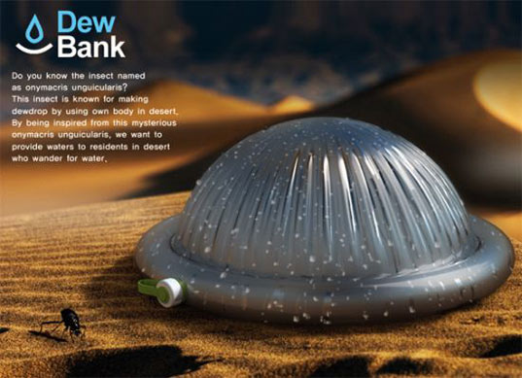
Desert Beetle Water Bottle
https://ninithi.com/2015/07/20/how-a-desert-beetle-make-self-filling-water-bottles-possible/ http://inhabitat.com/beetle-inspired-bottle-harvests-drinking-water-from-thin-air/

Slide 45
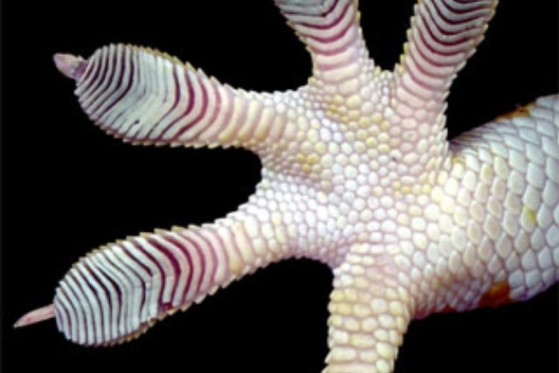
Gecko Feet Adhesives
https://www.scientificamerican.com/article/sticky-situation-gecko-toe-adhesive/

Slide 46
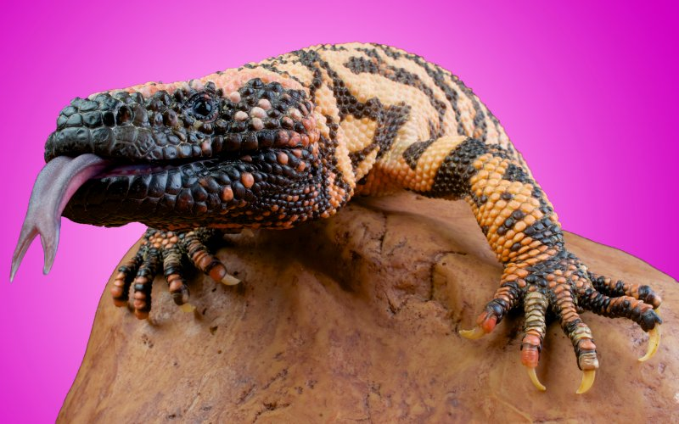
Gila Monster Diabetes Drug
http://www.thedailybeast.com/articles/2016/04/08/the-greatest-hope-for-diabetes-is-the-gila-monster-and-it-s-about-to-go-extinct.html

Slide 47
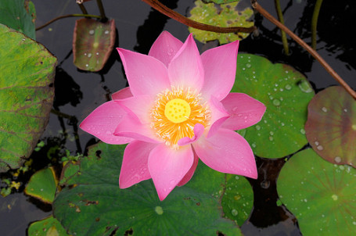
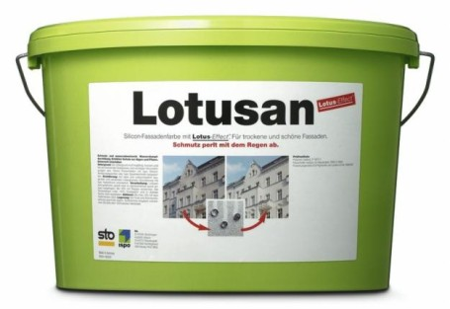
Lotus Paint
http://ecosalon.com/eco-friendly-house-paint-self-cleaning-lotus-flower/
https://phys.org/news/2006-02-scientists-role-nano-hairs-self-cleaning-lotus.html

Slide 48
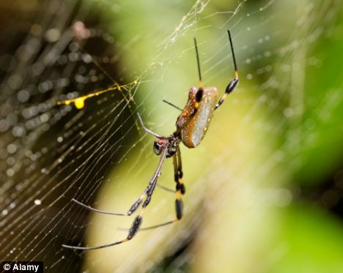
Spiderweb Glass
http://www.dailymail.co.uk/sciencetech/article-2187058/New-type-glass-inspired-SPIDER-WEB-aims-stop-birds-crashing-windows.html
https://asknature.org/idea/ornilux/#.WMI4Mm8rLIU

Slide 49
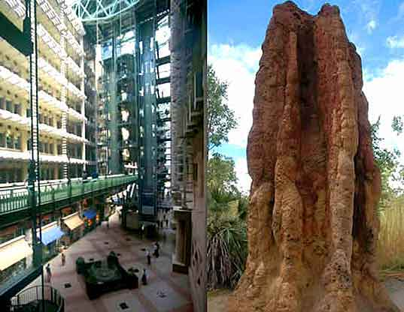
Termite Architecture
http://inhabitat.com/building-modelled-on-termites-eastgate-centre-in-zimbabwe/
http://www.being-here.net/page/6670/learning-from-termites-how-to-create-sustainable-buildings
https://www.greenbiz.com/blog/2009/09/02/how-termites-inspired-mick-pearces-green-buildings

Slide 50
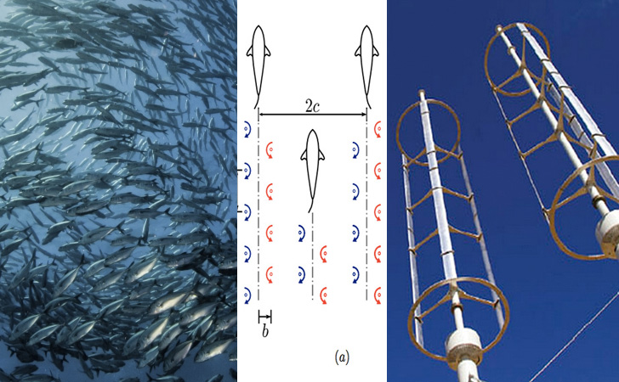
Wind Turbine Farms
http://inhabitat.com/john-dabiri-uses-biomimicry-to-design-cheaper-and-more-efficient-wind-farms/

Slide 51
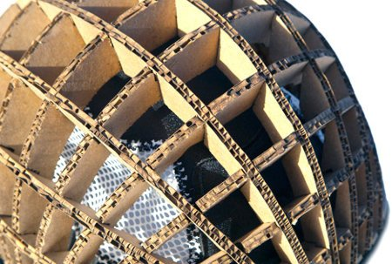
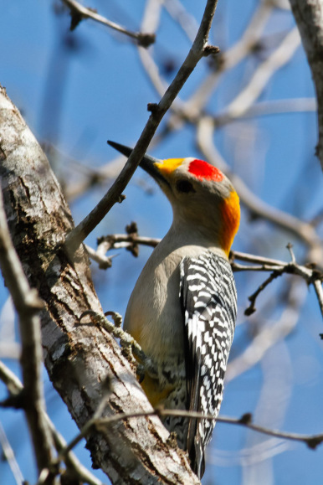
Woodpecker Inspired Helmets
https://blog.education.nationalgeographic.com/2015/02/27/creature-feature-woodpeckers-are-pros-at-protecting-their-brains/
https://www.good.is/articles/a-stronger-bike-helmet-made-of-cardboard-and-inspired-by-a-woodpecker

Slide 52
Biomimicry Video Toxics & Structure Section
Start at 18 min 53 sec where it says “THE FUTURE”
Stop at the end of video

Slide 53
Design Inspiration
Design a …
Inspired by a …

Slide 54
Resources
JanineBenyus: Biomimicry video https://www.youtube.com/watch?v=sf4oW8OtaPY
The Biomimicry Institute https://biomimicry.org/
Ask Nature https://asknature.org/
Waters Foundation http://watersfoundation.org/
RAFT http://www.raftbayarea.org/ideas-and-activities
Benyus, Janine. Biomimicry: Innovation Inspired by Nature. Harper Collins, 2009. ISBN 0061958921, 9780061958922
NISE Network http://nisenet.org
The Center for Learning with Nature http://www.learningwithnature.org/

