Slide 1
Have a Heart Body, Bones, and Beyond!

Slide 2
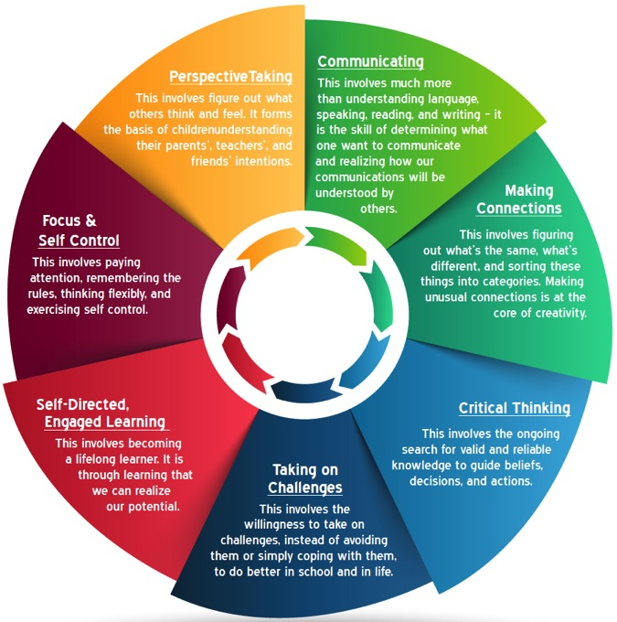
7 Essential Life Skills Mind in the Making
Focus & Self Control
Perspective Taking
Communicating
Making Connections
Critical Thinking
Taking on Challenges
Self-Directed, Engaged Learning
Notes:
The seven essential life skills as identified by Ellen Galinsky in her book Mind in the Making. These will be the lens through which we digest today’s activities.

Slide 3
Draw a Heart Discussion
Notes:
Teacher’s were asked to complete the STEMAZing Journal Hack and draw a heart when they arrived at the workshop. Nearly all teachers drew something similar to what is shown here. After we engage with the animal hearts and see a model of a real human heart, we expect drawings which are closer to the actual organ.

Slide 4
Animal Organs
Chicken Hearts
Cow Heart
Sheep Kidney
What do you notice?
What do you wonder?
Notes:
Nitrile gloves sourced at Harbor Freight are being used in case anyone has a latex allergy. Consider using a Venn Diagram when discussing the similarities and differences students notice when handling and observing the cow heart and chicken heart.

Slide 5
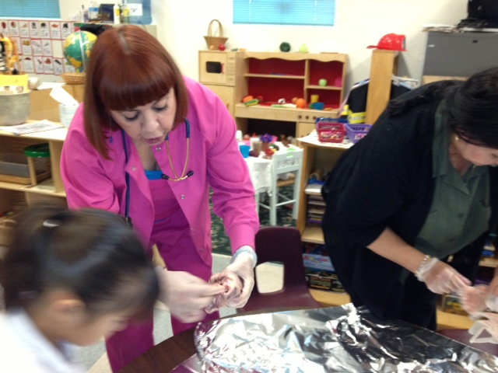
Notes:
The inspiration of this activity showing a young learner the heart.

Slide 7
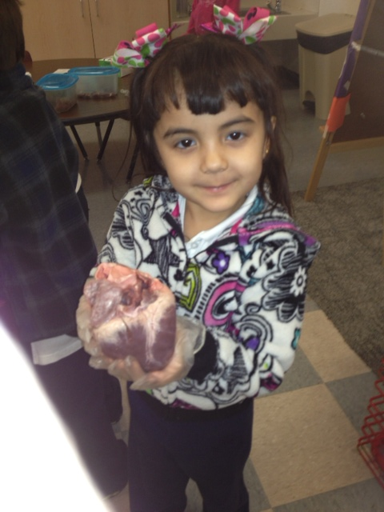
Notes:
One of our youngest learners enjoys handling and observing the heart.

Slide 8
My Body Book
Heart Section
How would you use this with students?
What do you notice?
What do you wonder?

Slide 9
Digestion Time
Something new you learned.
How will you use it?
When will you use it?
What else can you do?
How does it link with what you are already doing?
Which 7 Essential Life Skills can it be used to develop?

Slide 10
Listening to Your Heart
Real Stethoscope
Simple Homemade Stethoscope
Active vs. Resting Heart Rate
Chart of Heart Rates vs. Age
http://www.beatsperminuteonline.com/

Slide 11
Seeing and Feeling Your Heart Beat
Play-Doh with Straw
Feeling your pulse.

Slide 12
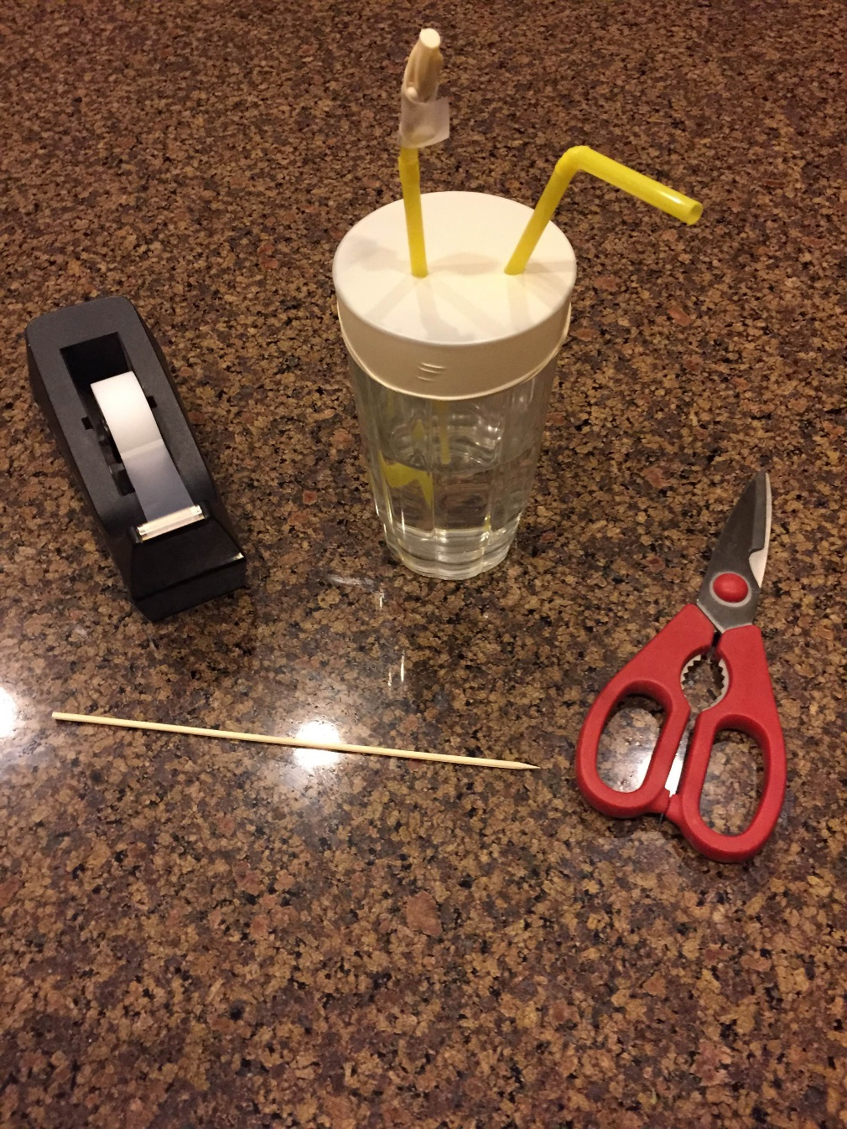
Your Heart is a Pump

Slide 13
Digestion Time
Something new you learned.
How will you use it?
When will you use it?
What else can you do?
How does it link with what you are already doing?
Which 7 Essential Life Skills can it be used to develop?

Slide 14
My Body – Head to Toe Book
How would you use this with students?
What do you notice?
What do you wonder?

Slide 15
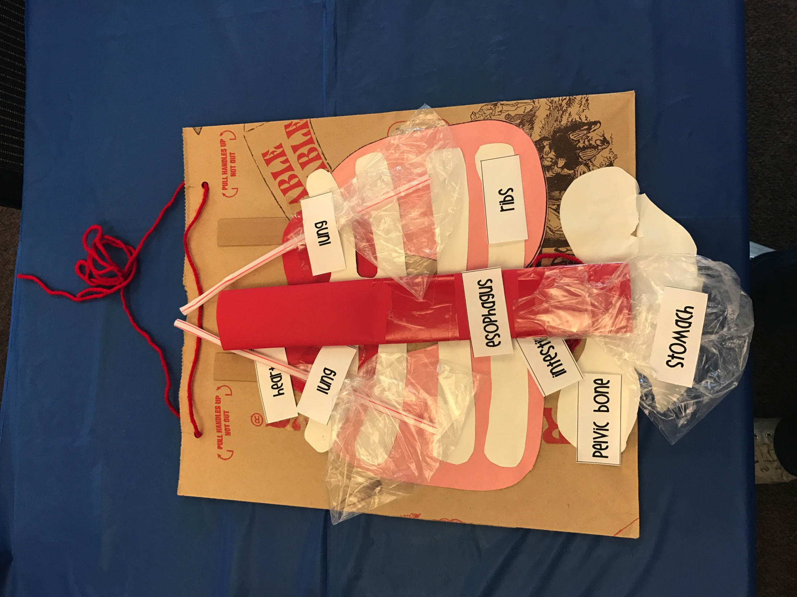
Body Bag

Slide 16
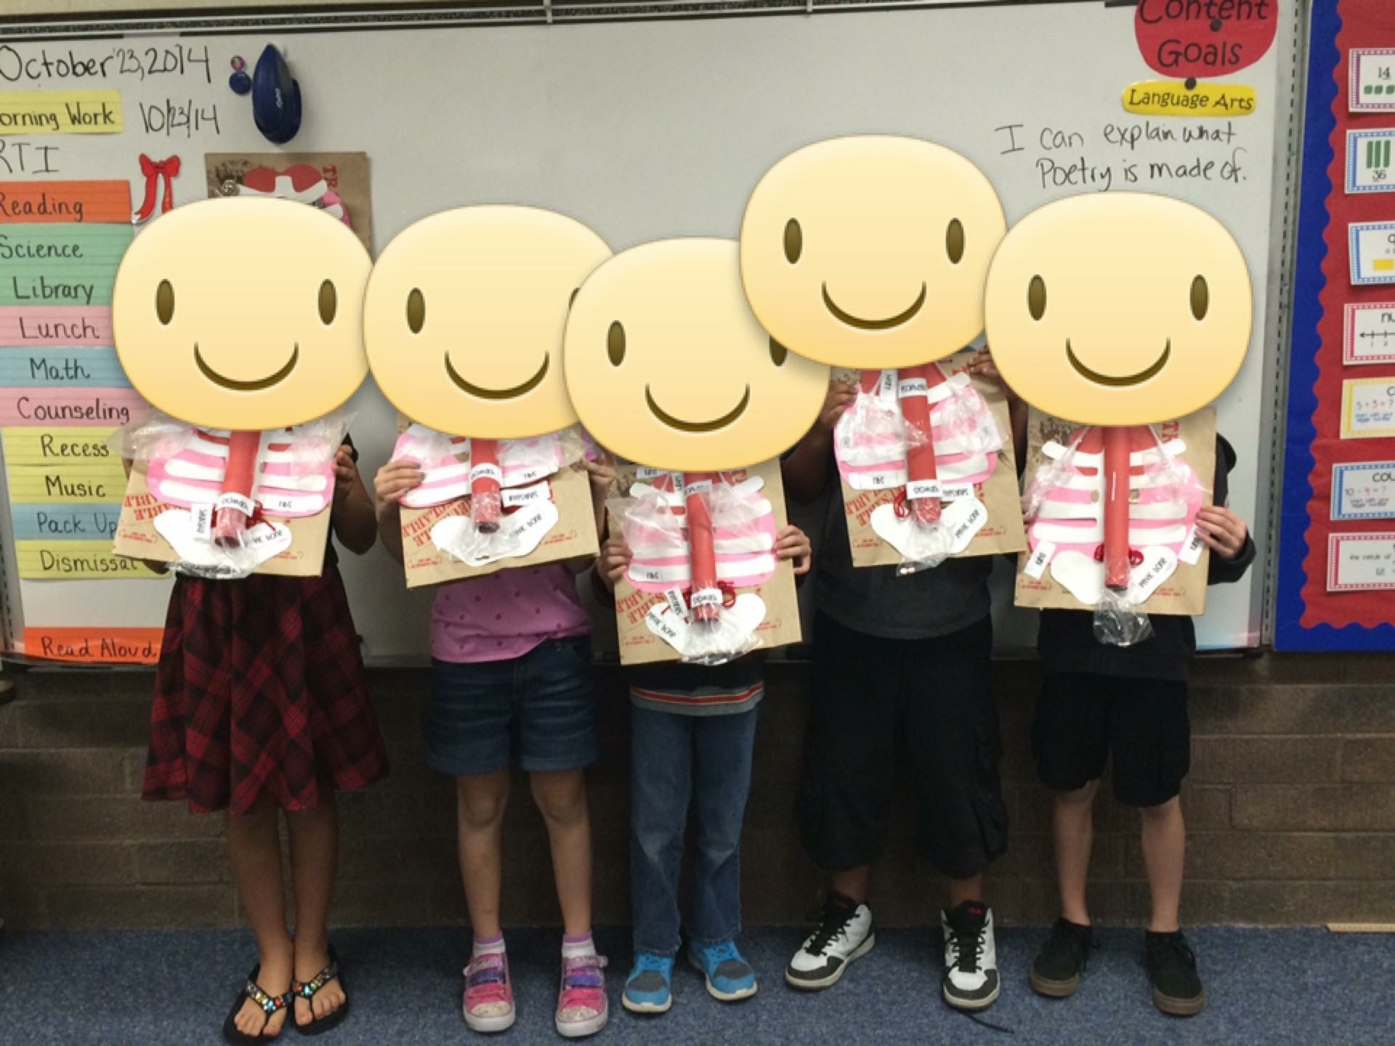
Body Bag

Slide 17
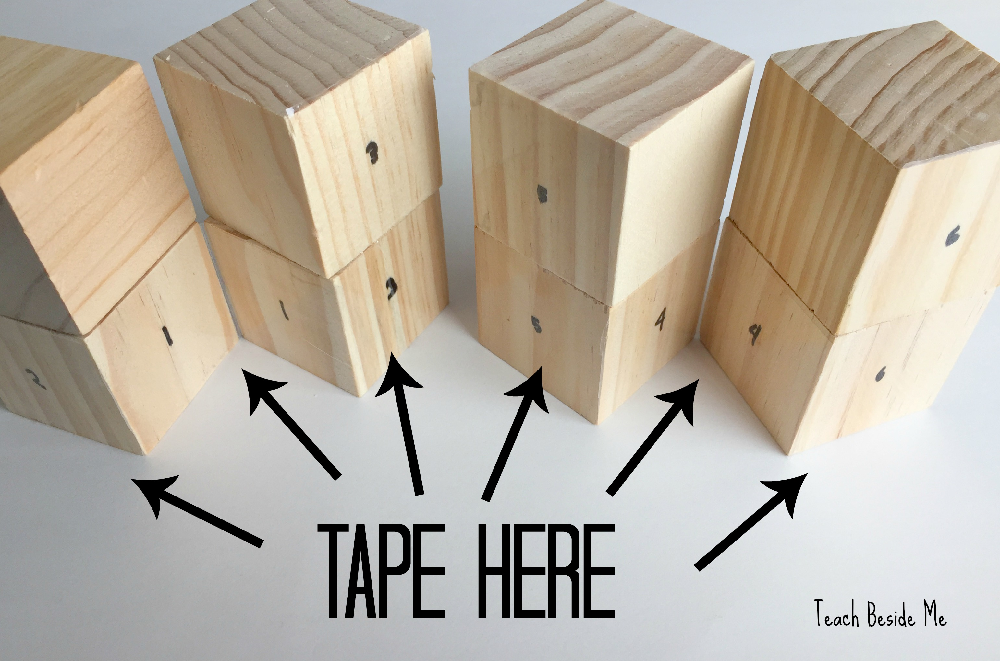
Body Puzzle Cube

Slide 18
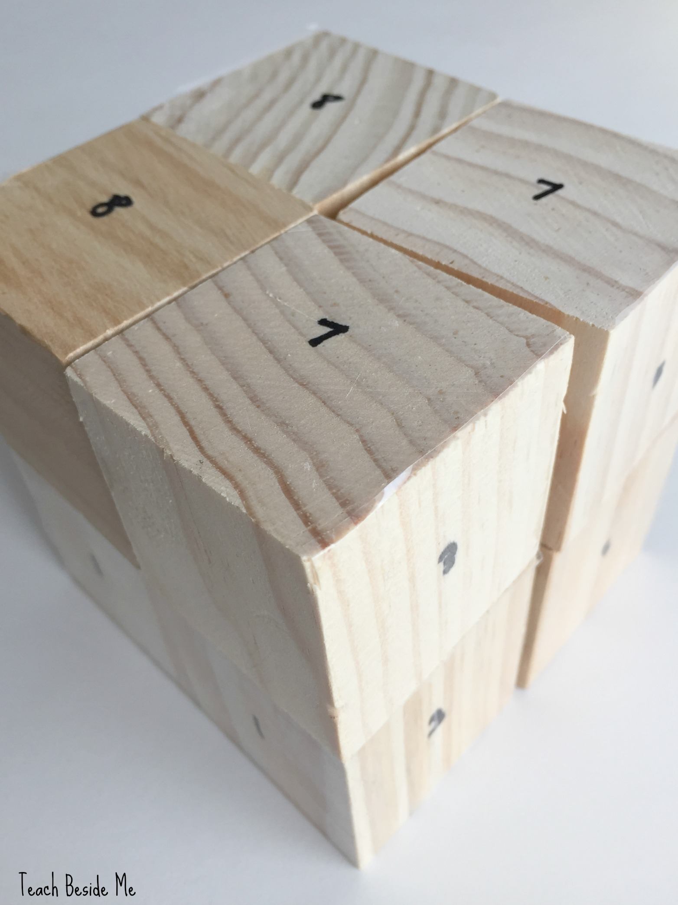
Body Puzzle Cube

Slide 19
Digestion Time
Something new you learned.
How will you use it?
When will you use it?
What else can you do?
How does it link with what you are already doing?
Which 7 Essential Life Skills can it be used to develop?

Slide 20
30-Day DOT and Survey
30-Day DOT – Do One Thing – What is at least one thing you commit to trying in your classroom in the next 30 days?
Survey – tell us how we did. What did you like? How could this workshop be improved?
Don’t forget the power of PLAYING in order to LEARN!
Play to Learn, Learn to Play

