Slide 1

Construct This!
Blocks, Building, and Beyond!

Slide 2
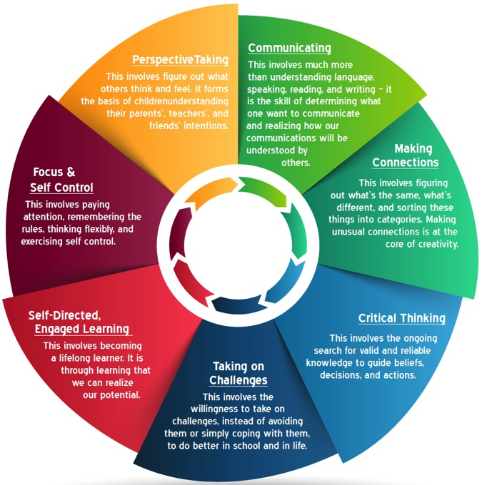
7 Essential Life Skills
Mind in the Making
Focus & Self Control
Perspective Taking
Communicating
Making Connections
Critical Thinking
Taking on Challenges
Self-Directed, Engaged Learning

Slide 3
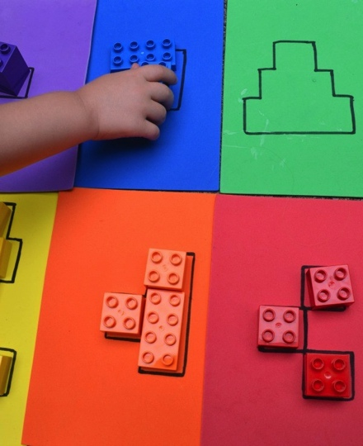
Block Puzzles

Slide 4
Structured Block Play
Children challenged with recreating a construction by consulting a model or blueprint.
Children must:
  Analyze what they see
  Perceive the parts that make up the whole
  Figure out how the parts relate to each other

Slide 5
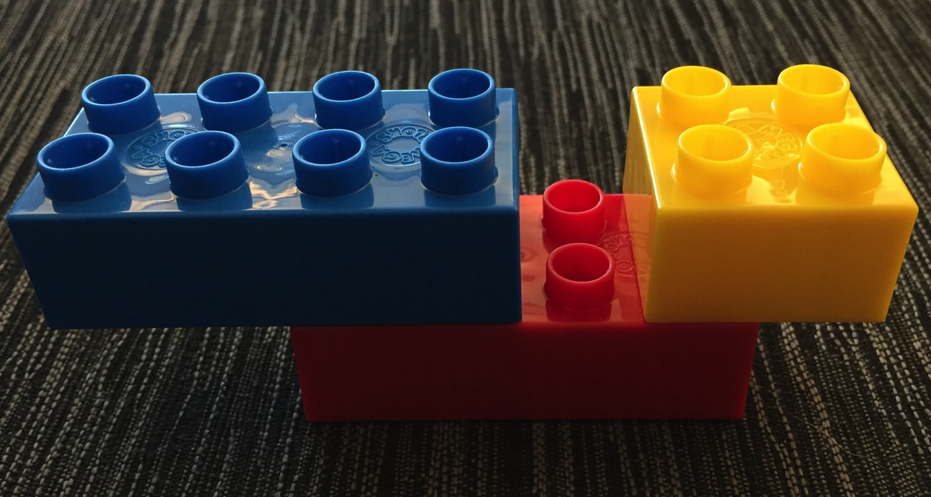
Construct This!

Slide 6
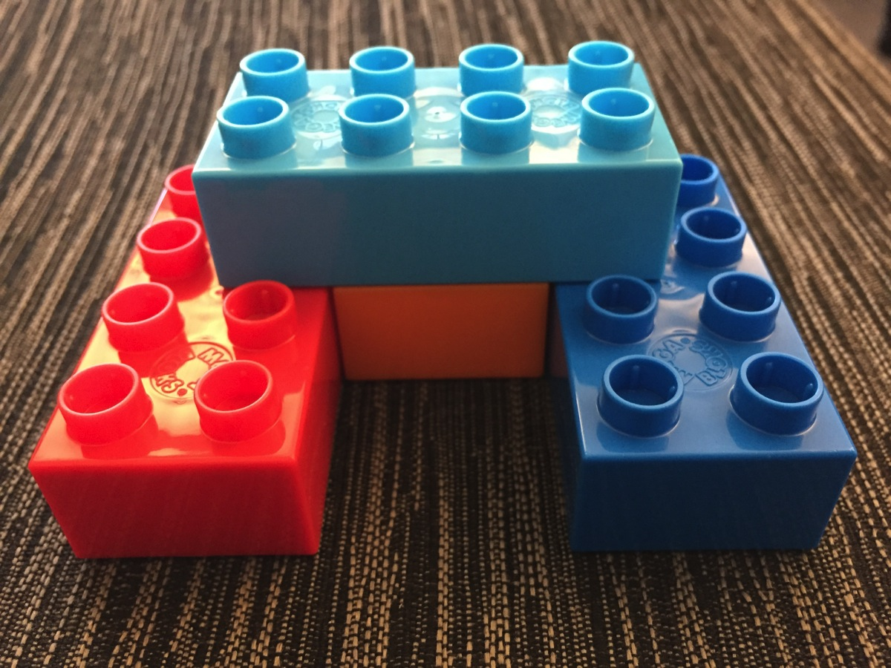
Construct This!

Slide 7
Digestion Time
Something new you learned.
How will you use it?
When will you use it?
What else can you do?
How does it link with what you are already doing?
Which 7 Essential Life Skills can it be used to develop?

Slide 8
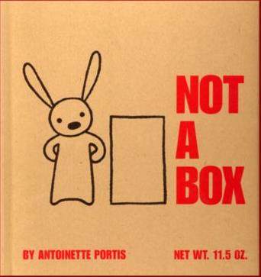

Slide 9
7 Essential Life Skills
Mind in the Making
Focus & Self Control
Perspective Taking
Communicating
Making Connections
Critical Thinking
Taking on Challenges
Self-Directed, Engaged Learning

Slide 10
Getting the Most from Toy Blocks
Engage young children by participating yourself.
Stimulate pretend play with character toys and other accessories.
Combine block play with story-time.
Challenge kids with specific building taks.
Encourage cooperative building projects.
Remember that fantasy is a valuable aspect of play.
From article by Gwen Dewar: http://www.parentingscience.com/toy-blocks.html

Slide 11
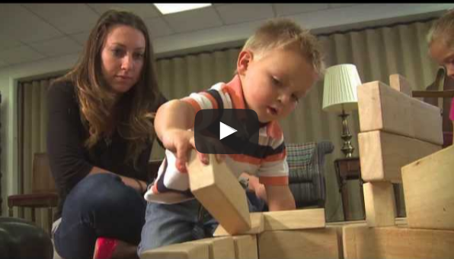
Purdue Block Party Video

Slide 12
Craft Sticks and Cups
A few minutes to build structures using the supplies.
Building Challenge 1: Build a structure that uses only two cups as the base.
Building Challenge 2: Build a structure that uses only one block as the base.
Building Challenge 3: Build a structure with something sticking out in an impressive way.

Slide 14
Vocabulary
Criteria – what are the details of the solution we are looking for?
Constraints – the limited materials, space, and time you have for design
Iteration – looping through the engineering design process multiple times to improve performance

Slide 15
Engineering Challenge Examples
Build a structure with just two cups as the base.
Build a structure with just one blocks as the base.
Using any size base, build the tallest possible structure.
Make something stick out in an impressive way!
Use all the building materials supplied in your structure.

Slide 16
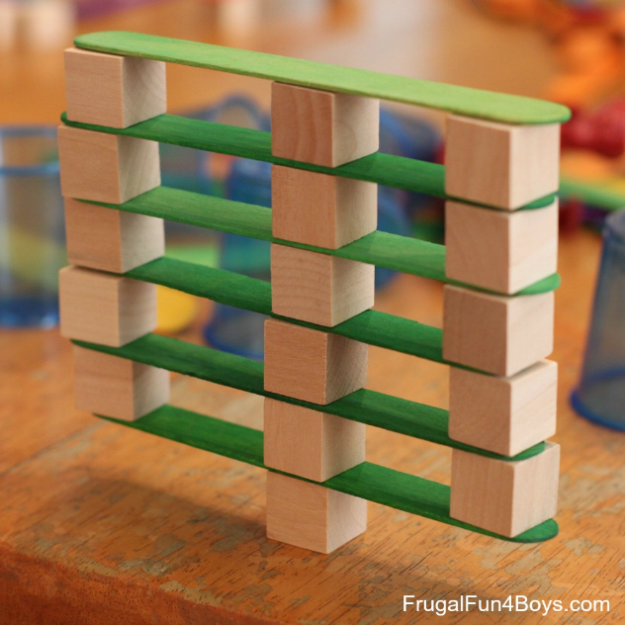
Craft Sticks, Cups, and Blocks

Slide 17
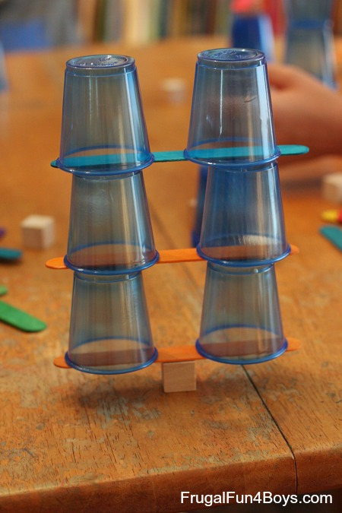
Craft Sticks, Cups, and Blocks

Slide 18
Digestion Time
Something new you learned.
How will you use it?
When will you use it?
What else can you do?
How does it link with what you are already doing?
Which 7 Essential Life Skills can it be used to develop?

Slide 19
Cup Stacking Teamwork Challenge

Slide 20
Bottle Stand Up

Slide 21
Digestion Time
Something new you learned.
How will you use it?
When will you use it?
What else can you do?
How does it link with what you are already doing?
Which 7 Essential Life Skills can it be used to develop?

Slide 22
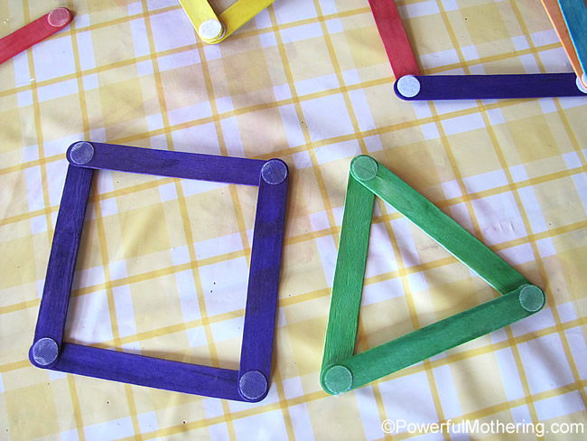
Velcro Craft Sticks

Slide 23
Velcro Craft Stick Ideas
Alphabet and Number Challenge
  Can you make all the letters of the alphabet and the numbers 0-9?
Geometric Shapes
  Can you match/make a triangle? Square? Rectangle? Pentagon? Hexagon?
Miscellaneous
  Can you make a flower? Sun? house? Etc.

Slide 24
Newspaper Dowel Construction
What is the strongest shape?
Design and build a superhero hideout!
Build a house.
Build a tower taller than you.

Slide 25
Digestion Time
Something new you learned.
How will you use it?
When will you use it?
What else can you do?
How does it link with what you are already doing?
Which 7 Essential Life Skills can it be used to develop?

Slide 26
30-Day DOT and Survey
30-Day DOT – Do One Thing – What is at least one thing you commit to trying in your classroom in the next 30 days?
Survey – tell us how we did. What did you like? How could this workshop be improved?
Don’t forget the power of PLAYING in order to LEARN!
Play to Learn, Learn to Play

