Slide 1

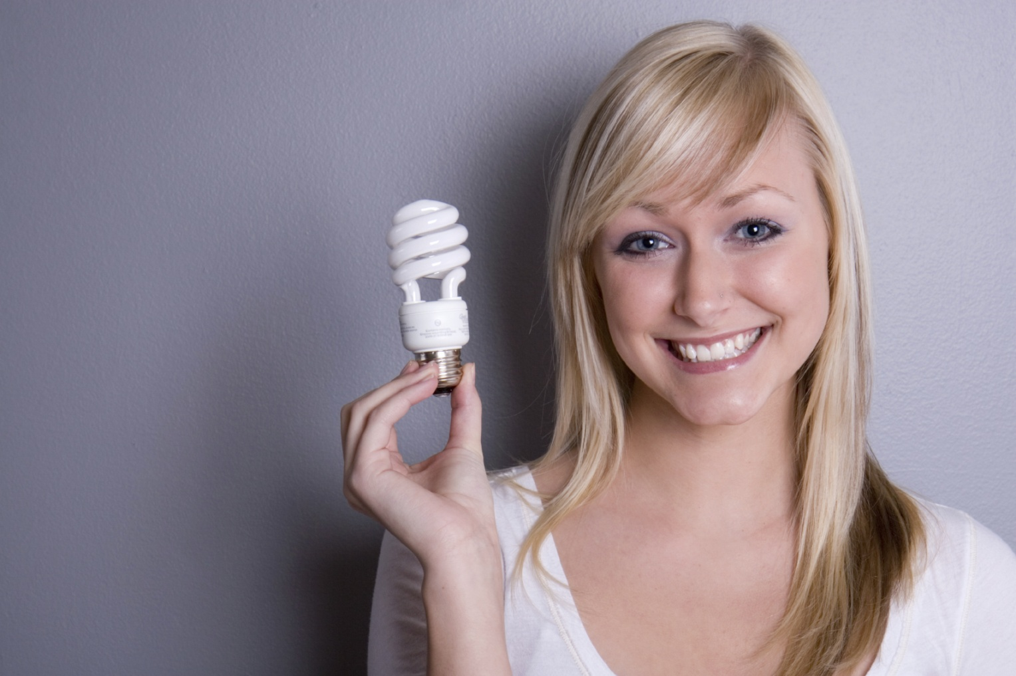

Energy Efficiency

Slide 2

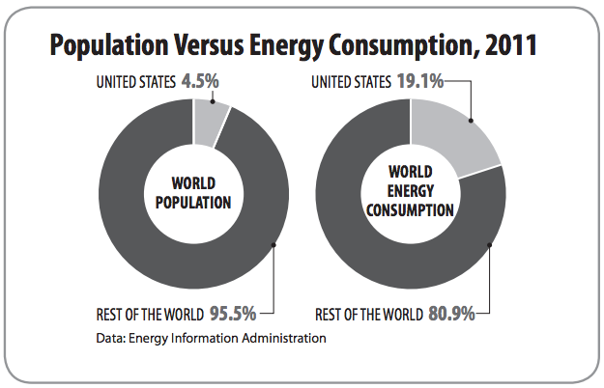
Energy Hogs
Notes:
The United States uses a lot of energy—over two million dollars worth of energy per minute, 24 hours a day, 365 days a year. With less than five percent of the world’s population, we consume about 20 percent of the world’s energy resources.
All of us use energy every day—for getting from one place to another, cooking, heating and cooling rooms, making products, lighting, heating water, and entertainment. We use a lot of energy to make our lives comfortable, productive, and enjoyable. Most of that energy is from nonrenewable energy sources. It is important that we use our energy resources wisely.

Slide 3
Energy Efficiency vs. Conservation
Energy efficiency focuses on technologies that use less energy to perform the same tasks or the same amount of work.
Energy conservation is any action or behavior that results in using less energy.
Notes:
NEED’s Energy Infobooks provide information on energy and energy efficiency. They are available free on-line in PDF format. Go to www.need.org/EnergyInfobooks.php

Slide 4
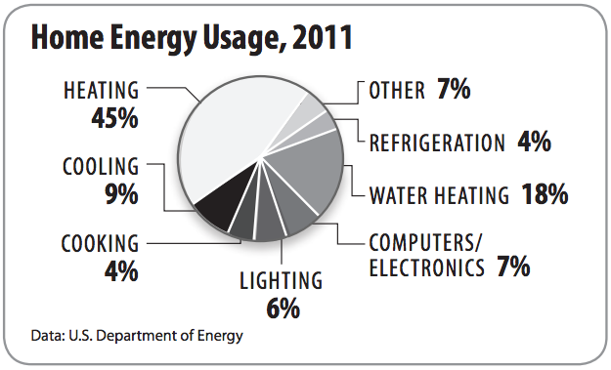
Where does the energy go?

Slide 5
Heating and Cooling Systems
Programmable Thermostats
Insulation and Weatherization
Doors and Windows
Landscaping

Slide 6

Appliances and Machines
Joint program of the U.S. Environmental Protection Agency and the U.S. Department of Energy.
National symbol for energy efficiency.
Products and/or buildings must meet certain standards to display label.
For homes & businesses.
Notes:
ENERGY STAR® is a joint program of the U.S. Environmental Protection Agency and the U.S. Department of Energy helping us all save money and protect the environment through energy-efficient products and practices.
Source: www.EnergyStar.gov

Slide 7
Other considerations…
Lighting
Water Heating
Cooking

Slide 8
Take note…
are the unit of measure used to compare how much light is produced by different types of light bulbs.
Lumens

Slide 9
Take note…
load refers to the electricity consumed by an appliance or device that is plugged into an outlet but not currently “on”.
Phantom or vampire

Slide 10
Benefits of Energy Efficiency
Reduces consumption
Increases comfort & safety
Reduces pollution
Makes our economy stronger
Increases our energy security
Notes:
Ask students to brainstorm some concrete examples of each one.

Slide 11
How Efficient are U.S. Schools?
Average annual energy bill to run America's schools: $6 billion
A typical school district with 3,000 students spends $400,000 on energy per year.
The least efficient schools use 3 times more energy than the best energy performers
Top performing ENERGY STAR® labeled schools cost $.40/square foot less to operate than the average schools.
Luckily, energy is a manageable expense.
Notes:
Source: U.S. Dept. of Energy

Slide 12
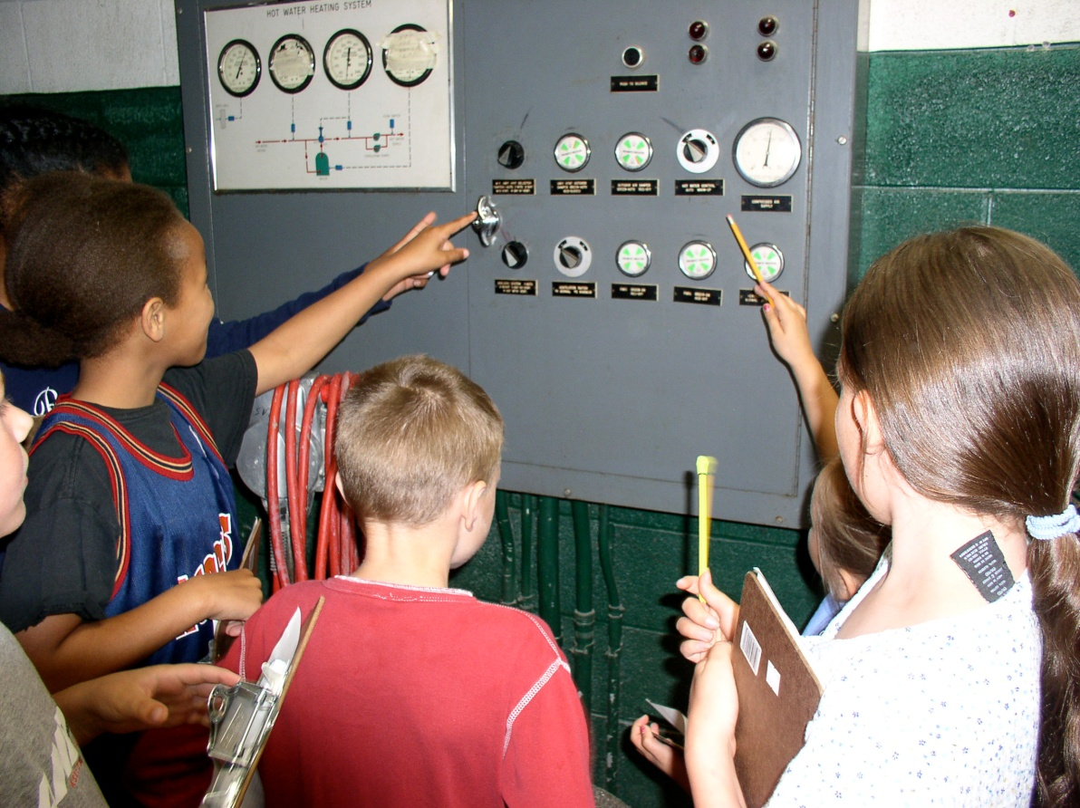
When we look for ways to save energy in a school, we must keep in mind:
The health and safety of the occupants.
Indoor air quality – adequate ventilation.
The comfort of the occupants.
Notes:
We must keep in mind the services energy provides. Energy efficiency is providing (or improving) these services while decreasing energy use.

Slide 13
How Does Your School Use Energy?
  Energy System Components
  Building Shell
  Heating, Ventilation and Air Conditioning (HVAC)
  Lighting
  Electric Appliances
Notes:
There are many energy-consuming devices and systems in a school building. It’s helpful to break down the school’s energy system into these components.

Slide 14
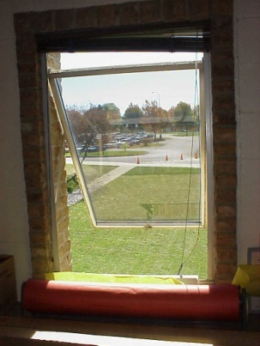
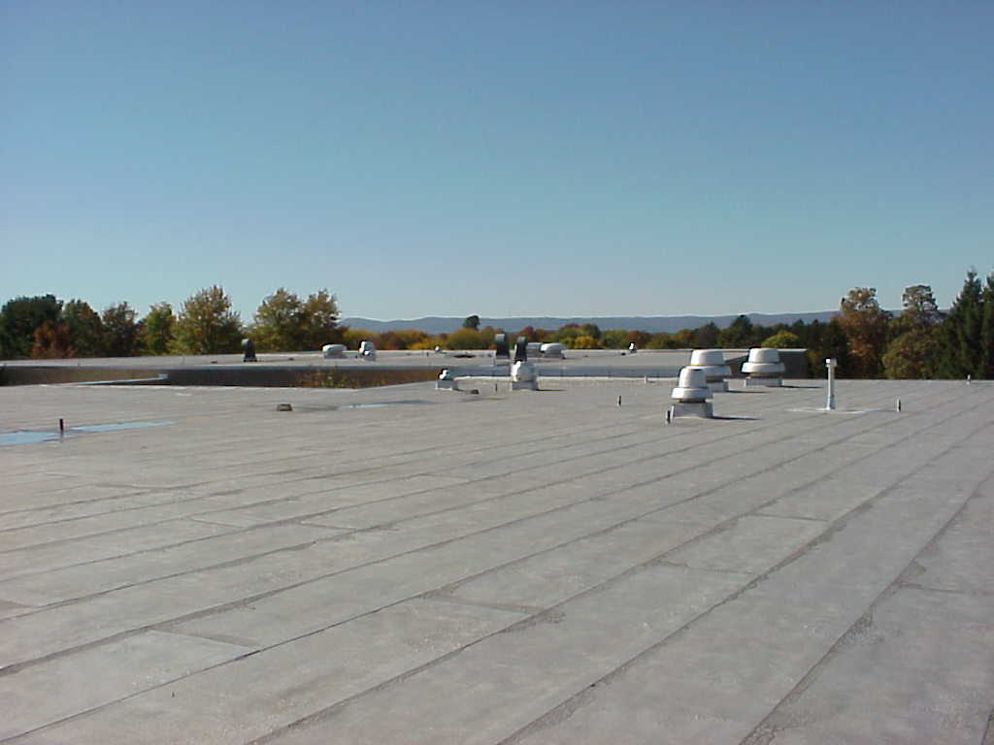
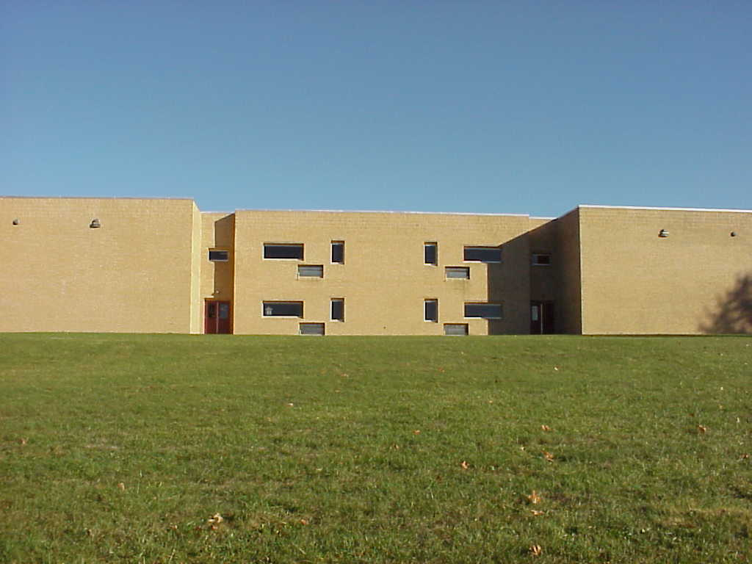
The Building Shell
Any part of the building which creates a boundary between indoor and outdoor space. Includes:
  Walls
  Roofs
  Ceilings
  Doors
  Windows

Slide 15
The Building Shell
The shell should limit:
  The amount of thermal energy conducting through.
  The amount of air that moves in and out of the building.
Notes:
Conduction is limited with insulating materials. Air movement is limited by sealing gaps in the building shell (i.e. weather stripping, caulking, etc.)
We go into detail about the building shell in the Efficiency at Home workshop.

Slide 16

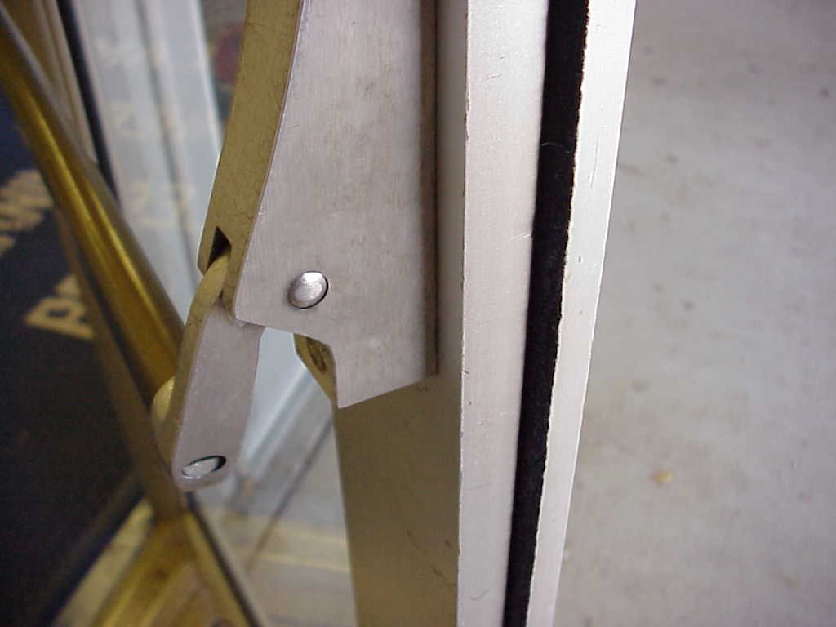
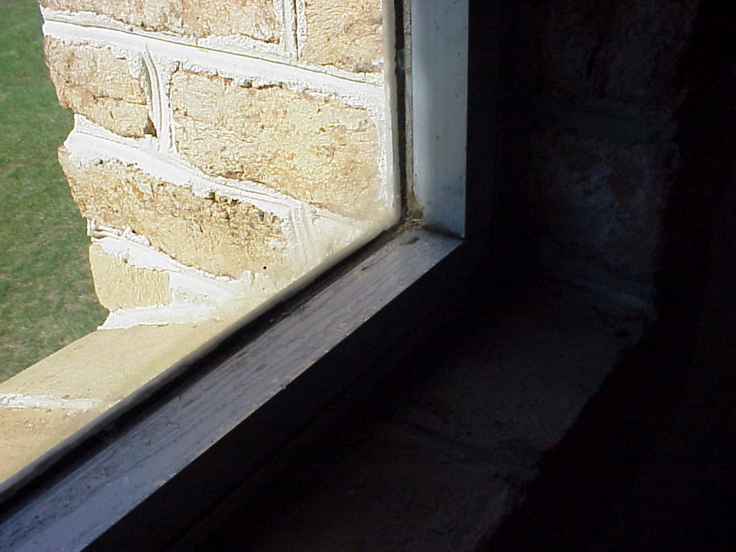
Savings Opportunities: Building Shell
Inadequate weatherstripping
Single-paned windows
Windows left open
Notes:
Keep windows and doors closed when the heating or cooling systems are operating

Slide 17
HVAC
Heating System (boiler, furnace)
Air Conditioning (chillers)
Hot Water
Ventilation System
Thermostats
Ducts and Pipes
Notes:
Look around the room – what evidence do you see of an HVAC system?

Slide 18
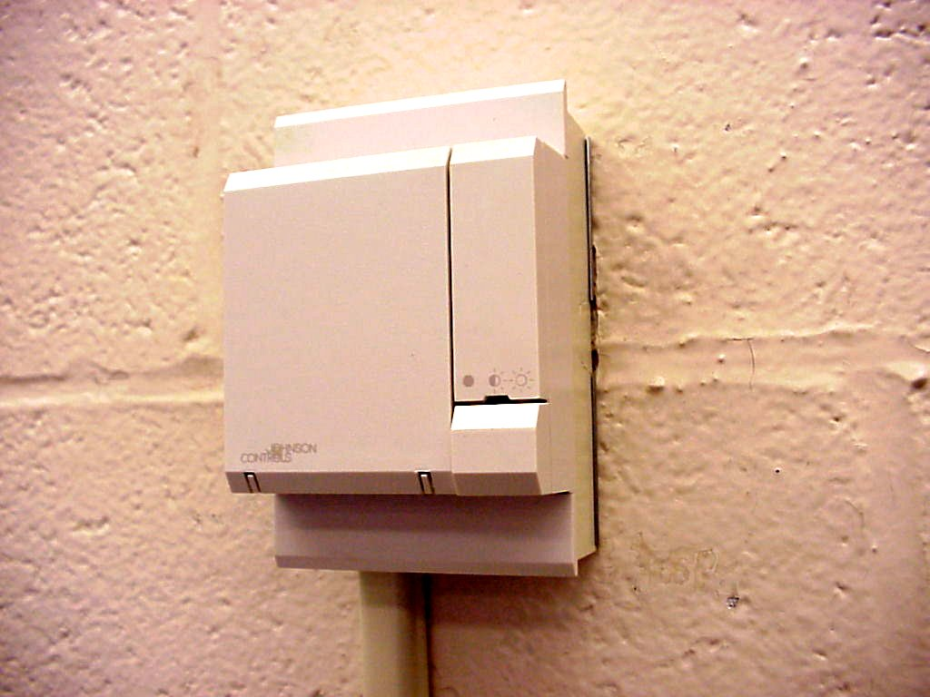
Building Automation System (BAS)
Provides school personnel with real time energy and performance data to manage the building’s energy needs.
Temperature Sensor
Notes:
Temperature sensors around the building send information to a central computer which makes decisions about providing heat, cooling, or ventilation at programmed rates.

Slide 19
Types of Lighting Found in Schools
Incandescent
Fluorescent
High Intensity Discharge (HID)
Light Emitting Diode (LED)
Notes:
We will be focused on incandescent and fluorescent.
HID lighting is used as outdoor security lighting at home and school. At school it is used in gyms and parking lots.
LED’s are mainly found in exit signs at schools at this point.
Lighting can account for 60% of electricity costs at school. At home, it is a much smaller percentage.

Slide 20
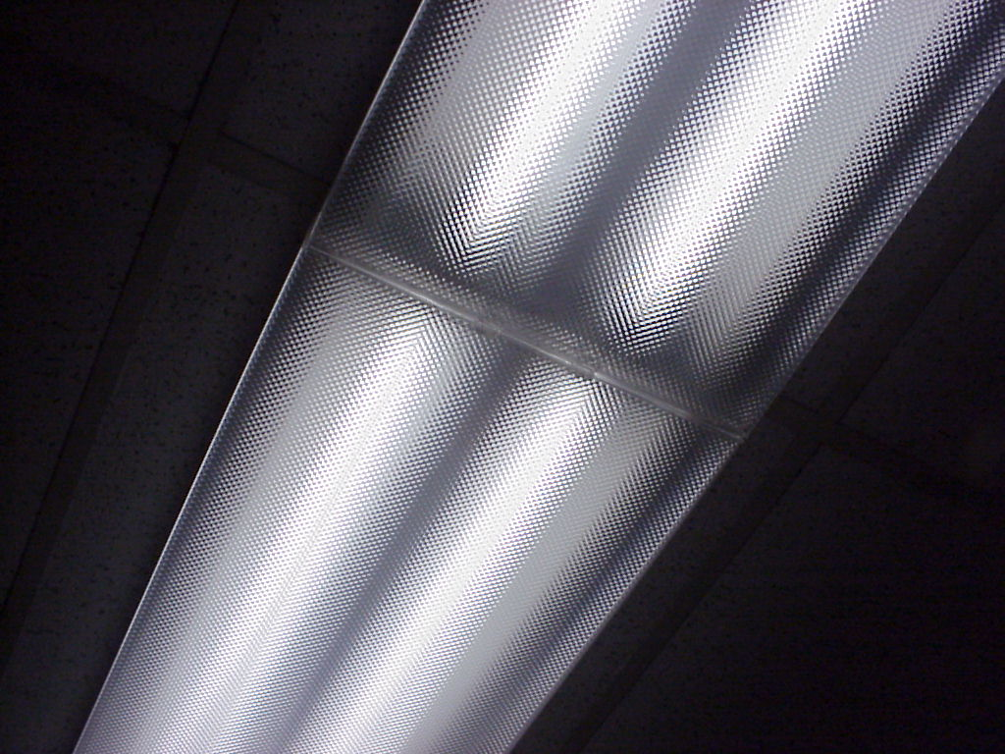
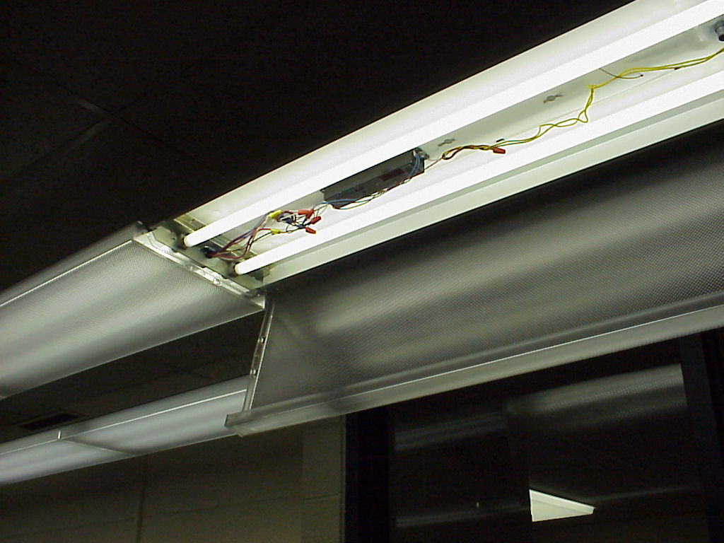
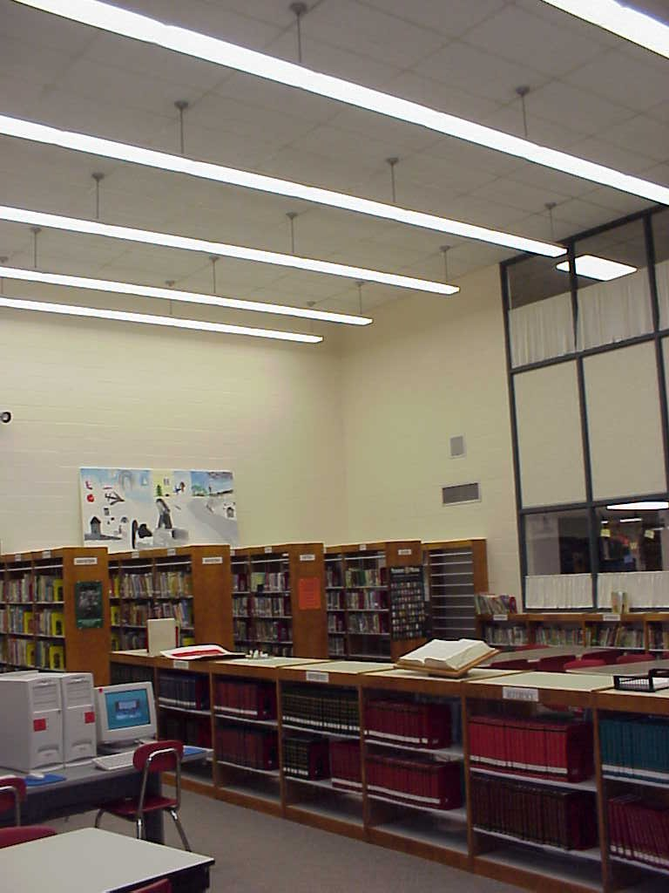
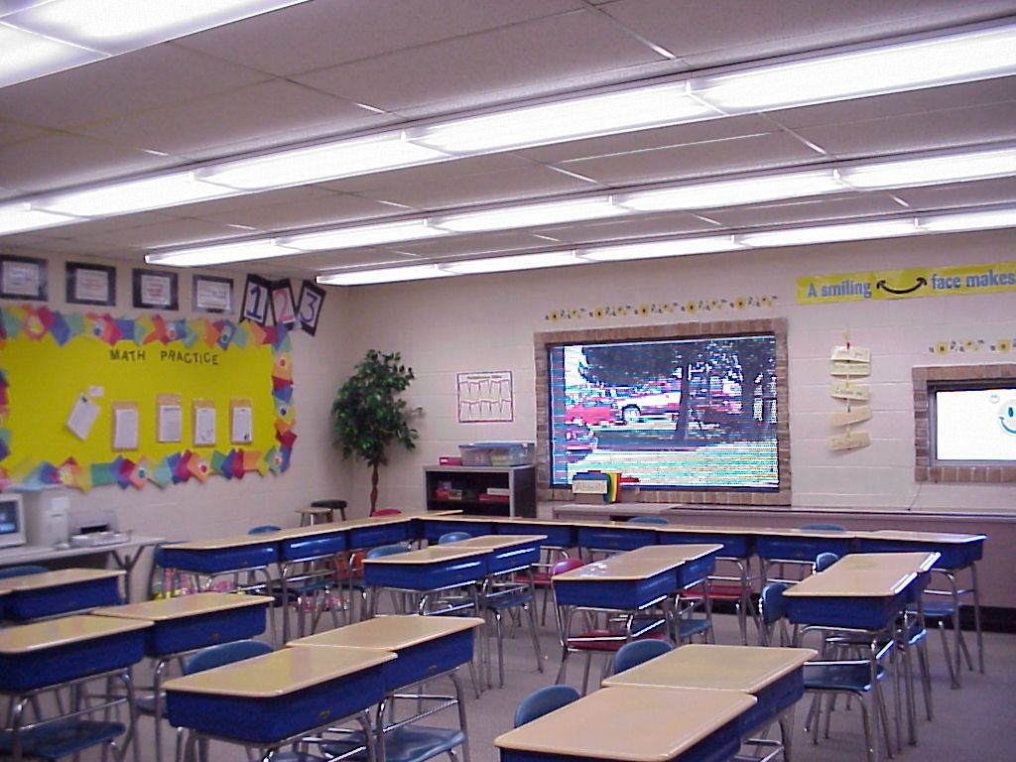
Fluorescent
Notes:
Fluorescent fixtures are the most common lighting found in schools. Most classrooms are lit by fluorescent lamps.
Point out that lighting can account for 60% of electricity consumption in a school, which is a much higher percentage than most homes.

Slide 21
Ballast
  Required for operation of fluorescent lamps.
  Provides initial arc to start lamp.
  Regulates current during operation.
  Two main types:
    magnetic
    electronic

Slide 22
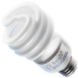
Compact Fluorescent
Miniature fluorescent with built in ballast
Ideal for replacement of incandescent lamps
Saves 66-75% on energy use
Lasts 7-10 times longer than an incandescent
Low thermal energy output
Improved color rendition
Notes:
Source: www.EnergyStar.gov

Slide 23
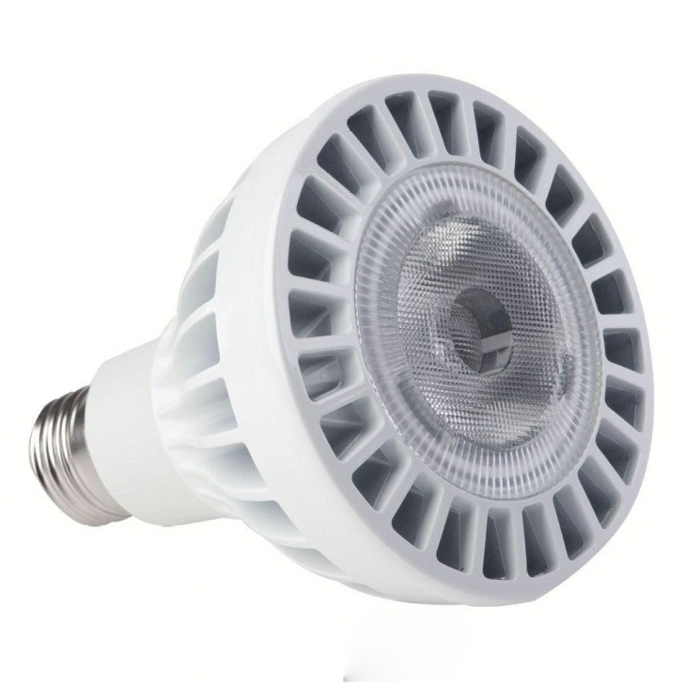
Light Emitting Diodes (LEDs)
Energy Star bulbs rated at 25,000 hours.
Can use up to 50% less energy than a CFL.
Widespread use over the next 20 years could reduce lighting demand by 33%.
Currently expensive to purchase compared to Incandescent and CFLs.

Slide 24

What are the major users of electricity at school?
Electric Space Heaters
Air Conditioning
Electric Water Heaters
Refrigerators/Freezers
Lighting
Computers and Office Equipment
Notes:
Ask students to brainstorm some major users of electricity. Emphasize that they must think conceptually about what tasks require the most energy to accomplish. Generally, these tasks are associated with generating or removing heat.

Slide 25
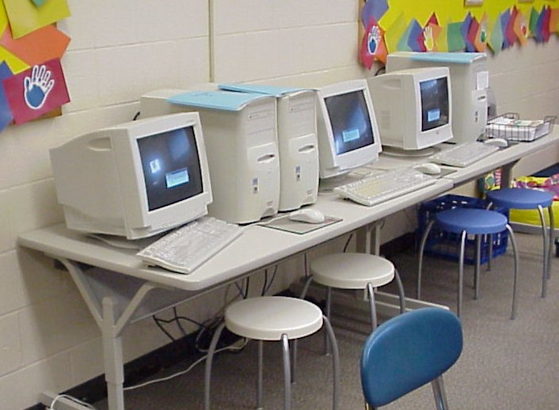
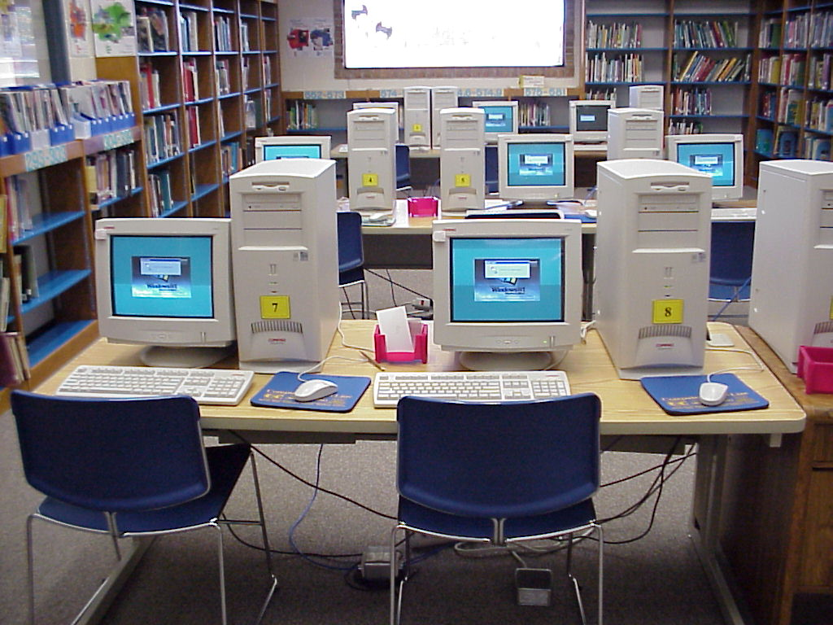
Savings Opportunities: Electric Appliances
Monitors with Screen Savers, Power Saving Options Not Enabled

Slide 26
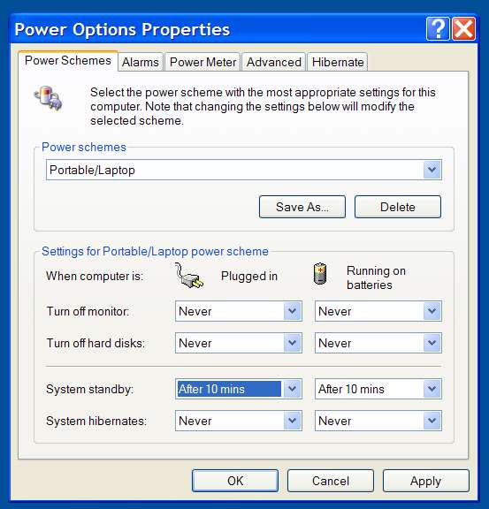
Personal Computers
Enable Power Management Settings
Personal Computers
Set your computer to automatically go into STANDBY mode after 10 minutes.
To bring it back up, either move your mouse or hit the power button (depending on your machine).
Disable screensavers!
Notes:
Screensavers do not save energy. The monitor is running at full power and this is the biggest energy user in a system, especially if it’s a CRT monitor.

Slide 27
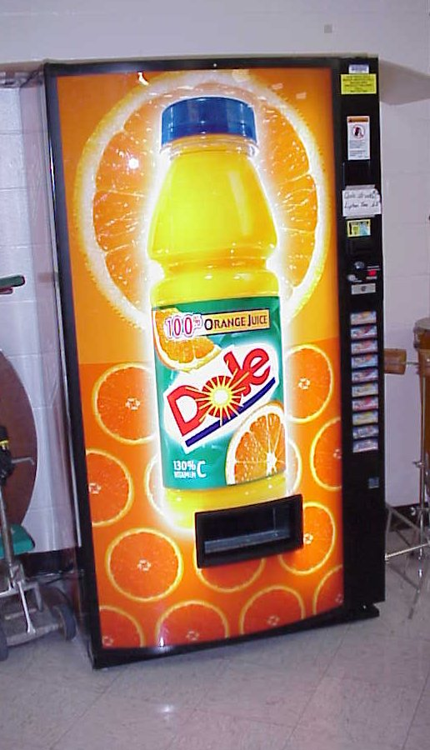
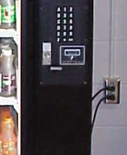
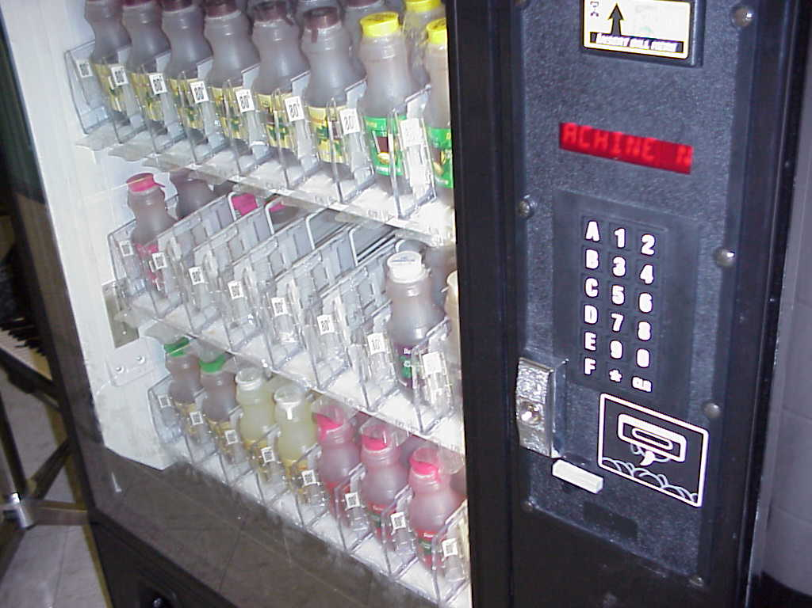
Saving with Vending Machines
Unplug during vacations
Install timers

Slide 28
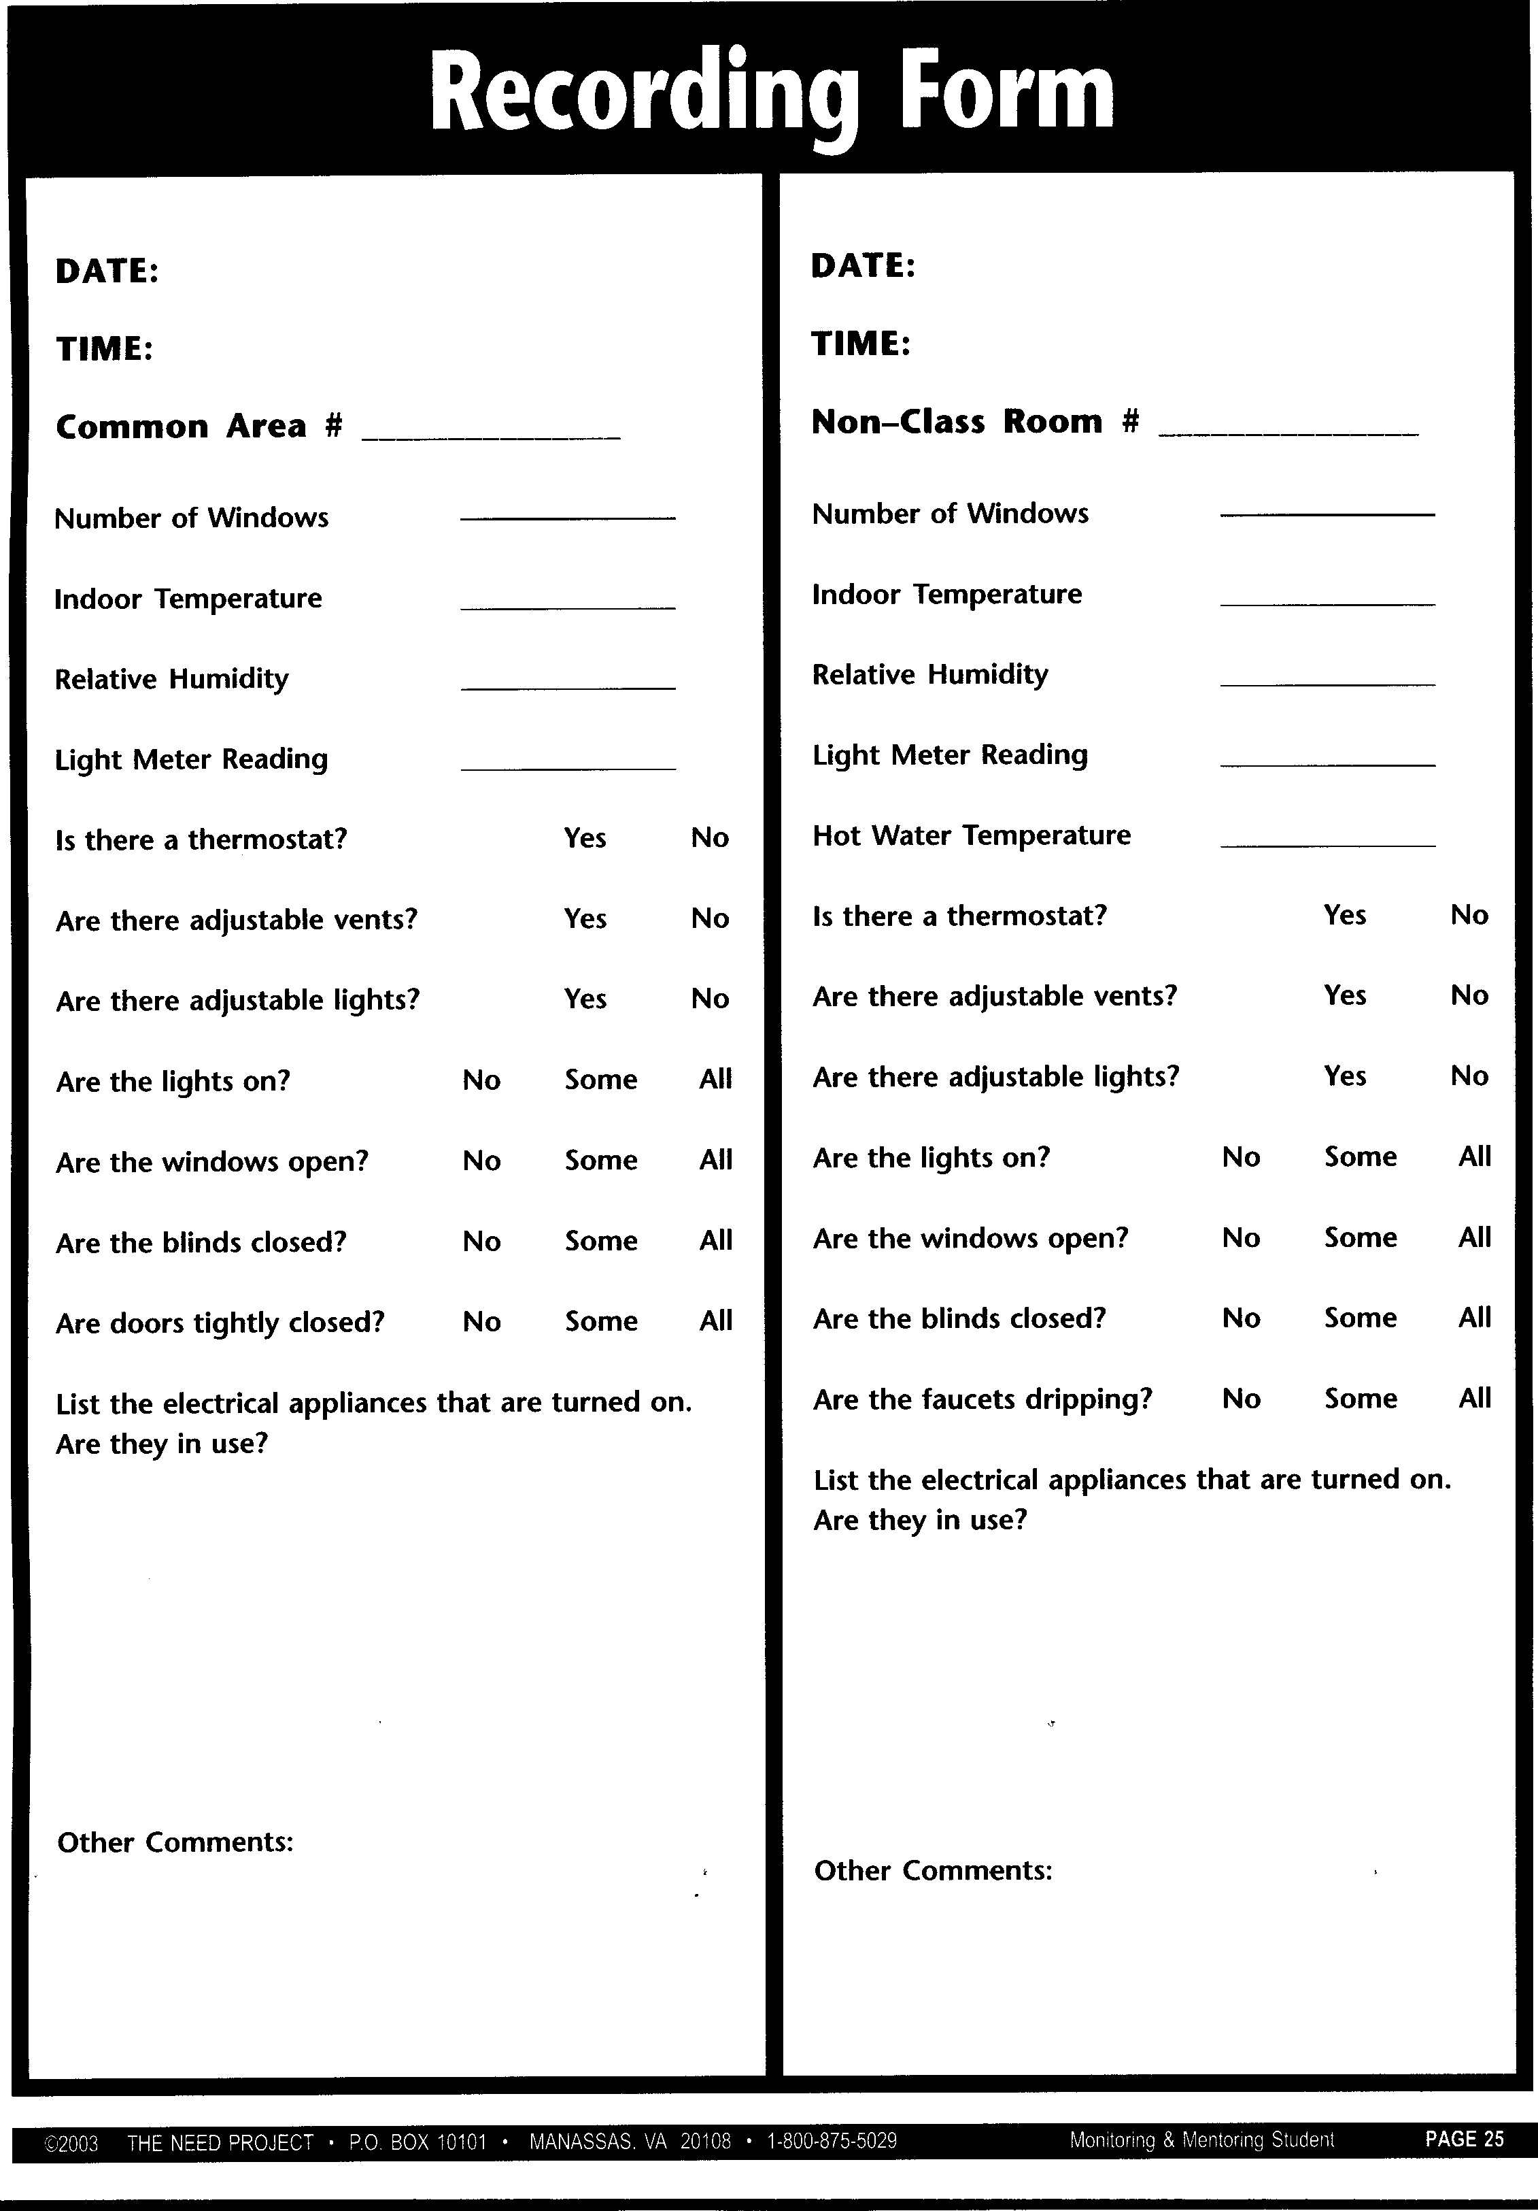
Energy Efficiency: The Assessment
Notes:
This sheet is from the Monitoring and Mentoring (gr. 4-6) curriculum. It is also found in Learning and Conserving.
Have students take out their audit packets and open to this form. Point out the data related to the HVAC system that they will need to gather during the audit.

Slide 29
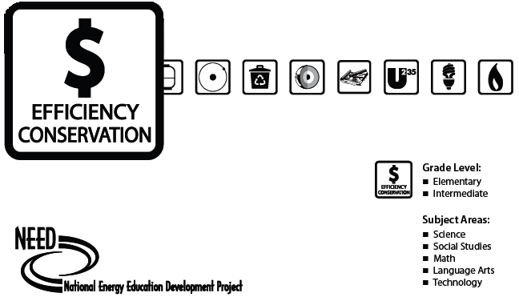
Energy Audit Curriculum
Flicker Checker
Monitoring and Mentoring

Slide 30
Energy Efficiency: Take Action
Awareness Campaign
What Makes a Campaign Effective?
Clearly defined message.
Motivational components.
Delivering message via multiple media.
Persistence in delivering message.

Slide 31
Awards and Competitions
DOE’s America’s Home Energy Education Challenge
  www.homeenergychallenge.org
EPA’s President’s Environmental Youth Awards
  www2.epa.gov/education/presidents-environmental-youth-award
NEED’s Youth Awards Program
  www.need.org/youth-awards
Eco-Schools
  www.eco-schools.org/
ED’s Green Ribbon Schools Program
  www2.ed.gov/programs/green-ribbon-schools/
Zayed Future Energy Prize
  www.zayedfutureenergyprize.com/en/prize-categories/global_high_school_prize/

Slide 32
Kill-A-Watt Meter
Energy Audit
  Use your Kill-A-Watt meter to measure the number of watts used at least 3 devices in your home – blow dryer, toaster, microwave, refrigerator, lamp, phone charger, anything you plug in!

