Slide 1
Branching Out Activity

Slide 2
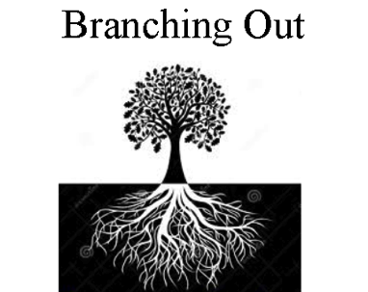
Branching Out Exercise:
What disciplines or fields of study are related to tree-rings?
Working with a partner, turn over your “branching out” cards so that you can read the “disciplines” or “fields of study”
Read each card, do you know what each field of study is? Ask if you don’t know!
Divide the set of cards in two separate stacks to show which fields of study are “related” or “unrelated” to tree-rings
Be ready to share why you felt that a field of study was “related” or “unrelated” to tree-rings

Slide 3
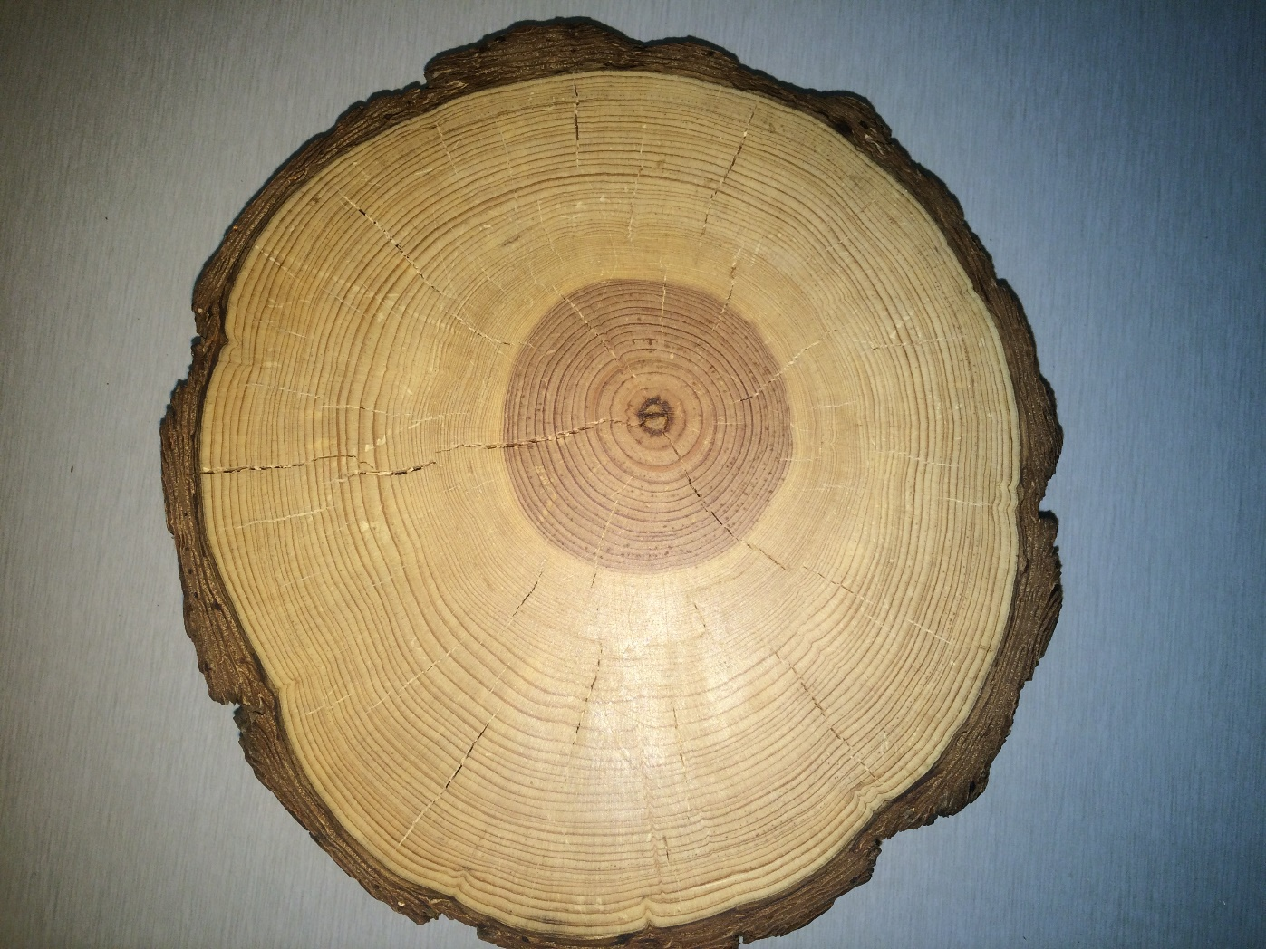

Disciplines related to tree-rings:

Slide 4

Disciplines unrelated to tree-rings:
X

Slide 5
Share Out
What disciplines did you select as being related to tree-rings?
What disciplines did you select as being unrelated to tree-rings?
Why?

Slide 6
Synthesis
Tree-Rings are related to every discipline – some are closely related while others are distantly related
We like to say that all trees have a tale to tell and that tree-rings connect to everything, from Art History to Zoology
The reason for this is that humans have a strong connection to trees especially through the used of tree based materials such as lumber, sap, gum, cellulose, and bark which are used in many ways:
Paper, Furniture, Musical Instruments, Building, Transportation, Art, Tools, Recreation etc.

Slide 7
Dendrochronology Concepts

Slide 8
Dendrochronology is Interdisciplinary
Disciplines highlighted above in yellow are included on set one for an activity with 20 cards.
Disciplines that are not highlighted are included in set two for an activity with 12 cards.
All are related in some way to Dendrochronology.

