Slide 1
Coring and Sampling Techniques
Stumps/Deadwood, Purposefully Harvested (cross-sections)
Purposefully Harvested, Live Trees (coring)
Does not kill the tree
Technique can also be used to sample archaeological specimens, sacred pieces, artwork using different diameters of increment borers or other instrumentation
Research permits and permission to access property are essential so this is a practice that should only be done by forestry officials and permitted researchers!!!

Slide 2
Sample Selection, Preparation & Analysis
Species sampled are identified/selected by research team based on the research question to be answered
A fire ecologist may want fire scarred samples
An archaeologist may want structural samples
Samples are cut to the appropriate size, mounted and sanded to expose the best view of the rings
As samples are analyzed, they may require special handling, labelling and re-sanding
Analysis: Human eye, Microscopes, Scanning, Cell Staining, Cellulose Grinding and Isotope Analysis:
Simple → Complex based on the needs of the researcher

Slide 3
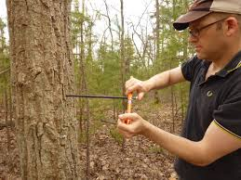
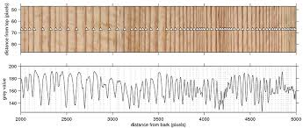
Photographs of Cores and Coring

Slide 4
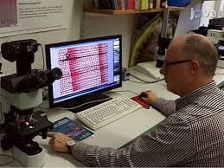
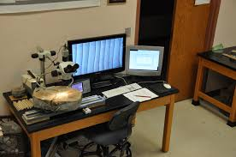
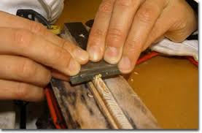
Tree-Ring Preparation & Analysis

Slide 5
Tree-Ring Vocabulary Terms (A-Z)
Annual Ring
Anthropogenic
Bark
Branch
Cambium
Carbon Cycle
Cell
Cellulose
Climate
Core
Cross-Dating
Cross-Section
Dendrochronology
Disturbance
Drought
Earlywood
Evapotranspiration
Fire Regime
Fire Scar
Fire Severity
Fire Triangle
Geography
Geology
Hardwood
Increment Borer
Insect
Instrumentation
Interdisciplinary
Latewood
Limiting Factor
Master Chronology
Nutrients
Palmer Drought Severity Index (PDSI)
Phenology
Phloem
Photosynthesis
Precipitation
Proxy
Ray
Resin Duct
Sapwood
Signal
Skeleton Plotting
Standardization
Tree-Cookie
Topography
Variability
Vessel
Wildland Urban Interface
Xylem

Slide 6
Dendrochronology Workshop Kit
Your Dendrochronology Kit contains the following items:
Workshop Notebook with lessons and supplementary materials
Thumbdrive with lesson plans and supplementary materials
Cross-Sections and Cores
Re-useable Dry Erase Laminates
Macrolenses (for use with a cell phone camera for magnification)
Magnifying Glasses

Slide 7
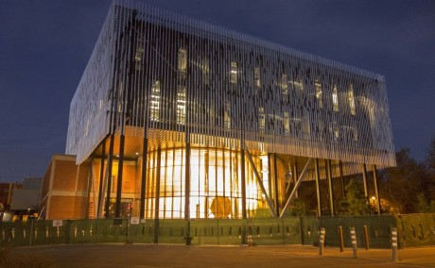
UA Laboratory of Tree-Ring Research Contact Information
Free Resources for Educators and Students of any age!
Field trips
Classroom visits
Lesson materials
Lab visits
Specialist talks
Portable Dendro Kits
Tucson Festival of Books
LTRR Main Website: http://ltrr.arizona.edu/
LTRR Outreach Website: http://ltrr.arizona.edu/outreach
LTRR Public Calendar of Events: http://ltrr.arizona.edu/calendar/month
LTRR Facebook Page http://goo.gl/2qRGqS
Pamela Pelletier – Director of Outreach, Sky Island Science Investigators Program
pamela@email.arizona.edu T. 520.248.9933
Arin Haverland – Outreach, Research, and Education
arin@email.arizona.edu T. 520.248.0714
Randall Smith – Retired Educator and Docent
rssmars@aol.com
Will Smalzer - Retired Educator and Docent
wsmalzer@yahoo.com
Janice Gallagher - Retired Educator and Docent
jregallagher@hotmail.com

Slide 8
Online Resources: Readings & Videos I
http://ltrr.arizona.edu/outreach/sky-island-science-investigators LTRR info on 4-8th grade field classes
http://ltrr.arizona.edu/outreach/become-docent LTRR Activities
http://ltrr.arizona.edu/outreach/tree-ring-open-house-tucson-festival-book LTRR Event Info
http://ltrr.arizona.edu/content/art-bryant-bannister-tree-ring-building LTRR News Story
http://video.pbs.org/video/2330301577/ LTRR News Story
http://www.nytimes.com/2015/04/14/science/californias-history-of-drought-repeats.html?smid=fb-share&_r=0 NYT News Story
http://uanews.org/story/the-art-and-science-of-the-environment UA News Story
https://goo.gl/21vkYx UA News Story

Slide 9
Online Resources: Readings & Videos II
http://uanews.org/story/the-lord-of-the-tree-rings UA News Story
http://www.bbc.com/news/science-environment-31588671 BBC News Story
http://goo.gl/QeIT1x video
http://video.pbs.org/video/2330301577/ video
http://www.npr.org/2012/08/23/159373691/how-the-smokey-bear-effect-led-to-raging-wildfires NPR video
http://www.12news.com/story/weather/talking-weather/2015/11/15/treering-time-travel/75837144/ LTRR on ABC News Phoenix

