Slide 1
SARSEF
Southern Arizona Research, Science & Engineering Fair

Slide 2
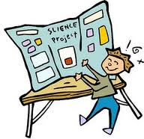
Research and Explore This!
HAVE FUN WITH SCIENCE and ENGINEERING COMPETITIONS AS YOU HELP YOUR STUDENTS CREATE THEIR
PROJECTS!
Notes:
One of the things that you will want to do is to help students and parents find fun and enjoy science. This project is a great way to do this.

Slide 3
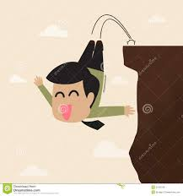
Jumping In!
You want to make sure that you
aren’t jumping off the cliff into
the unknown and taking your students
with you!
Instead….
Be ready to jump in
with knowledge!
!

Slide 4
PLAN FOR TODAY
IDENTIFY WAYS TO GET STARTED WITH SUCCESSFUL SCIENCE IINVESTIGATIONS FOR YOUR STUDENTS USING STANDARDS.
DISCUSS TEACHER STEPS/IMPLEMENTATION THAT LEAD TO PROJECTS THAT FOLLOW THE SCIENTIFIC AND ENGINEERING PRACTICES.
DISCUSS ELEMENTS OF SUCCESSFUL SCIENCE AND ENGINEERING INVESTIGATIONS.
DISCUSS ROLE OF RESEARCH, CRITICAL THINKING AND DATA IN SCIENCE, ENGINEERING AND RESEARCH.
PARTICIPATE IN INVESTIGATIONS TO FURTHER YOUR OWN ABILITIES AS A COUACH AND MENTOR.

Slide 5
Nature of Science Activity
THEORY CUBES
Basic
Higher Level Thinking

Slide 6
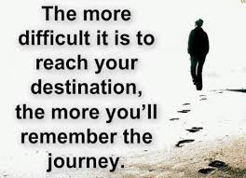
The Journey of Your Idea
Science Fair/Competitions are based on the
Scientific Investigations and Engineering Design.
Scientific Investigations and Engineering Design follow practices that are used by scientists and engineers throughout the world.
Keep in mind that this is a journey and not a list of steps. You will move back and forth through the method.

Slide 7
Value of Projects
Arizona Science Standards/Next Generation Science Standards (NGSS)
Marzano’s 9 Effective Instructional Strategies
21st Century Thinking/Learning Skills
The 5 E Model
Critical Thinking Skills
Habits of a System Thinker
Commonalities Among Practices in Science, Math and ELA
Three Dimensions of Framework for K-12 Science Education
Engineering Design Process

Slide 8
Science and Engineering Practices
Engineering Design
Science
How nature works -begins with a question
Researches question
Observations/investigations are conducted
Data is collected from experiments
Interpret, analyze and construct explanations
Creates solutions – begins with a problem
Researches problem
Possible alternatives to problem are developed
Prototypes are created and tested
Evaluate ability to solve problem

Slide 9
Ways to Participate
As a school you will want to decide how your students will participate:
You may choose: whole school participation, grade levels, teacher per grade level, interested/independent students, clubs, parents as leaders
Types of projects: Individual, Team (2-3 students, Group/Class Projects (K-5 only)

Slide 10
But, What Do I Really Have To Do?
Decide your commitment, time frame, support and determination for the process.
Determine how doing this can support your standards, curriculum/school requirements.
Talk to your students -
What are they interested in?
Gain their “buy in” to the process.
Commit to science or engineering practices.

Slide 11
More specifically….
Determine your goals for students.
What science, math, and ELA Standards do I want or can I address?
Determine the configuration for completing investigations within your own confines. Problem solve expected challenges.
What resources will you need? How will you get them? What supports with you need from school/administration?
Determine your timeline. What check points will you require?
Work time into your schedule.
How will you configure/manage this within the classroom?
Will projects be completed in or out of school? How will you check in with those that are completing them at home?

Slide 12
Then, Just Get Started!

Slide 13
Reflect and Share
Reflect on your own for 2 minutes, then…With the others at your table,
share where you are at this time in the process.
Talk about getting started, share the ideas and concerns that you are facing right now as you move your students towards their science and engineering projects.

Slide 14
Scientific Practices: Step 1
Get an Idea - Ask a Question
Or Determine a Problem
Science Project ideas come from your students’ minds; from what they like to do
Not an book or the internet.
They will have fun,
want to do their projects and
learn more if they pick something that
interests THE STUDENT!
Notes:
Hand Gesture: Thinking motion, tap head

Slide 15
More On Brainstorm Ideas
This is the time to use “creative teaching” to guide students where they need to go in terms of standards/curriculum. Or open the doors to their choices depending on your design of projects.
Take time to go through brainstorming:
Ask your students:
What do you think about when not in school?
What do you do in your free time?
What did you do last weekend?
What do you like to read or watch on TV?
THE ANSWERS TO THESE QUESTIONS IS WHERE YOU WILL START ON PROJECTS!
Notes:
Take each question, answer questions with partner
Share out

Slide 16
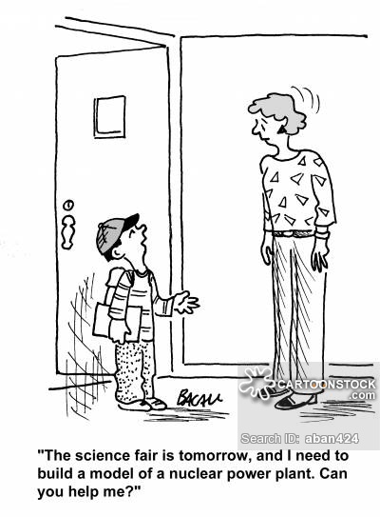
Do What Students Care About and is Reasonable
You will want to have the conversation
about whether or not the idea
Is POSSIBLE or
AFFORDABLE
Notes:
Your students may have grand ideas. Help them to bring the large idea to a manageable size that is both possible and affordable.

Slide 17
Continue The Discussions
Science: What exists? What happens? Why does it happen? How does one know?
Engineering: What can be done to address a particular need? What tools and technologies are available, could be developed to address the problem?

Slide 18
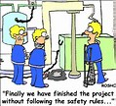
Make Sure Safety is Considered For Both Students and Subjects
Projects that MUST have permission before starting:
Human Subjects
Vertebrate Animals
Must have Adult Supervision if:
Growing mold, bacteria
Certain activities
Possibly dangerous tools and chemicals
Do you need special permission:
If you are just observing (watching) you do not
need special permission before starting your project
SCIENTIFIC REVIEW COMMITTEE

Slide 19
Scientific Review Committee SRC Paperwork
It is crucial that all projects that involve non-human vertebrate animals, animal or human tissue, recombinant DNA, pathogens, human subjects, controlled substances, or hazardous devices obtain SRC approval. Any survey or interaction with humans other than pure observation must be reviewed. This needs to be done prior to starting the project!
What is SRC approval?
Process of filling out SRC Approval Form that will be reviewed by your school committee to ensure safety for all. It does not need to be submitted for approval to SARSEF. It will need to be available for view at SARSEF in March.
How do I get SRC approval?
This is a committee of generally 3 people from your school. They usually consist of the science teacher, administrator and health personnel from the school. The project is reviewed for safety concerns.
PLEASE SEE: www. sarsef.org for specific guidelines.
WHEN IN DOUBT, FILL IT OUT!!

Slide 20
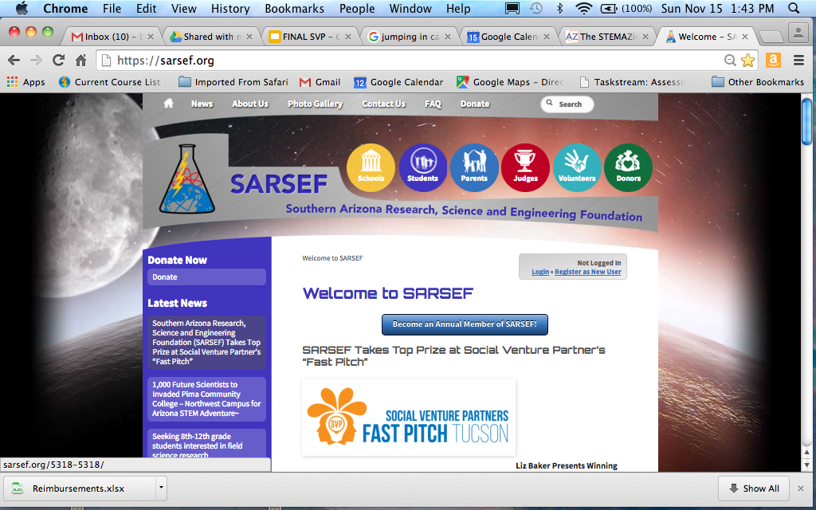
Sarsef.org

Slide 21
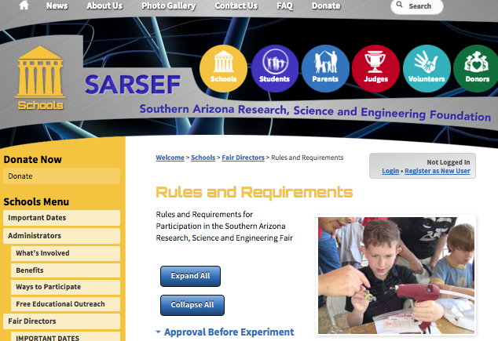
School Tab

Slide 22
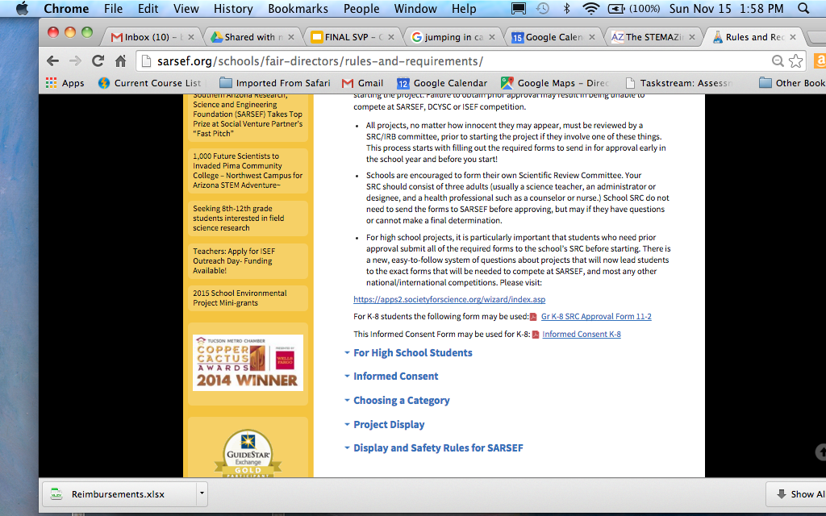
Approval Before Experiment

Slide 23
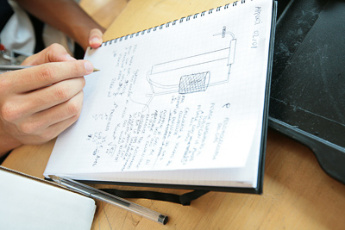
Create Lab Books
As soon as students start thinking about their topic it is time to start keeping track of their project in a lab book. This is students’ first form of data collection!
Ideas
Research
Materials
Experiment Set Up
Data & Results
Data Analysis
Conclusions
Write an entry for each day students work on their projects. Date it!

Slide 24
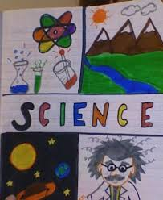
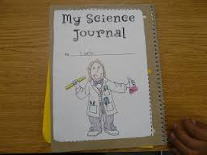
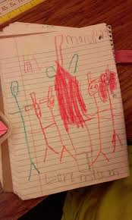
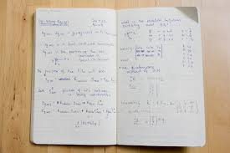
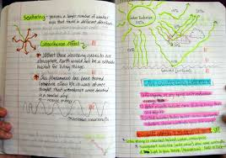
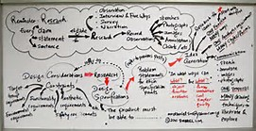
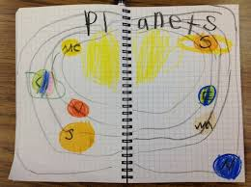
Sample Lab Journals and Engineering Design Briefs

Slide 25
Scientific Practices: Step 2
Research
You will need to decide what is required for your students.
At the very least students will want to find out:
What others already know about their question or
problem?
What have others already done?
What questions are still being asked?
Have students think– why, when,
where, which, how????
Notes:
Hand Gesture: Fold hands like reading a book
Share why research is fundamental

Slide 26
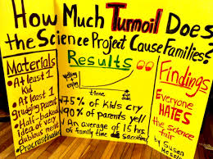
WORKING WITH PARENTS - The Not So Happy One
There is the parent who just heard that their child will have to do a Science Fair project in school and wants to find out how much work this will be for THEM – they are NOT happy.

Slide 27
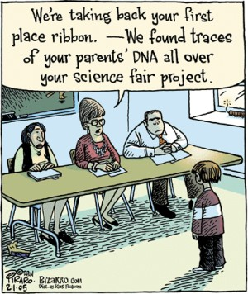
Working with Parents – The Over Zealous One
The parent just heard that their child will have to do a Science Fair project in school and can’t wait to get started on THEIR idea for this year’s project.

Slide 28
Working with Parents – The kind you are hoping for!
The parent just heard that their child will have to do a Science Fair project in school and they can’t wait to get started on a project together with either your class or their child. They just want to find out what to do and how…

Slide 29
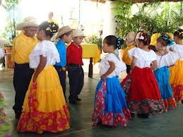
Is it OKAY to get help?
Would we expect students to go
into a soccer championship without ever
practicing dribbling the ball
with a coach?
Would we ask students to put on a performance in singing, dance or band without working with instructors to practice?
Science projects are no different! Students WILL need help and it is OK to ask for “coaches” or mentors to help–most likely parents and teachers! Some students will even connect with scientist and engineers.

Slide 30
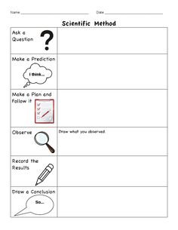
Scientific Practices: Step 3
Design a Plan to Answer Question
(Formerly Hypothesis)
Use pictures, diagrams or scale models to help you do this.
Make a specific plan. Design the plan that will help you solve the problem or answer the question. It may look like a cooking recipe.
Develop models or predictions based on your
current understanding of the question.
Determine what data you will need
to answer your question.

Slide 31
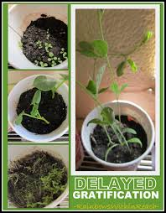
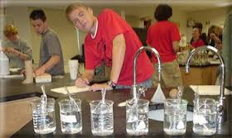
Variables
Help your students to
conduct a fair experiment
This means only changing one thing (variable) at a time
Identify variables
they can and can’t
control.
Identify the variables that you can’t control
Notes:
As the teacher you will want to decide how far you develop variables such as dependent and independent ones.

Slide 32
IDC (not IDK!)
How to turn absolutely anything (well almost) into a science experiment!

Slide 33
Some Concepts First
Independent Variable – a variable manipulated or changed by the experimenter (“I” control it)
Dependent Variable – a responding variable which could depend on other factors and can be measured
Control Variable – a variable kept constant, not varied by the experimenter, to eliminate its impact on the dependent variable being studied

Slide 34
Step 1
Observe something happening.

Slide 35
Step 2
List independent
variables.

Slide 36
Step 3
List dependent variables.

Slide 37
Step 4
Ask a question.
How will systematically changing this “I” affect this “D”?

Slide 38
Step 5
Control all independent variables not being tested!

Slide 39
Step 6
Write experimental procedure.

Slide 40
Step 7
Collect data.

Slide 41
Step 8
Graph results.
Dependent
Responding
Y-axis
Manipulated
Independent
X-axis

Slide 42
Step 9
Report findings.
Direct relationship
Indirect relationship
No correlation
Notes:
A direct relationship is one in which an increase in the independent variable causes an increase in the dependent variable or a decrease in the independent causes a decrease in the dependent.
An indirect relationship (not to be called inverse as this has a specific mathematical meaning) is one in which an increase in the independent variable causes a decrease in the dependent or vice versa.
No correlation means changing the independent variable seems to have no impact on the value of the dependent variable.

Slide 43
Let’s Try It!
Let’s turn absolutely anything (well almost) into a science experiment!
At your tables take an idea and determine the IDC Variables for it.
Determine how this would look on a graph. What would your DRY MIX be?

Slide 44
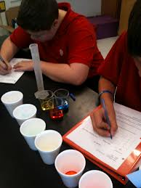
Scientific Practices: Step 4
Carry Out Your Plan
INVESTIGATION
Repeat trials or use multiple subjects to make sure that you get the same results time after time.
Think the “Rule of 5”. Discuss iterations.
Take pictures as students do the investigation.
Follow steps exactly as you planned.
Collect data, and record during the investigation.
Notes:
Hand Gesture: Pouring liquid into test tubes

Slide 45
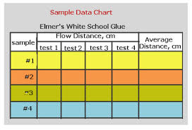
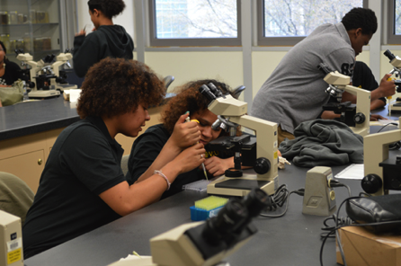
Scientific Practices: Step 5
Data
Collect data exactly as planned.
Be precise and in collecting data.
Decide how much data is needed.
Record the data.
Organize the data so that it makes sense to others.
Notes:
Hand Gesture: Act like writing on one hand with a pen.

Slide 46
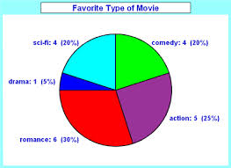
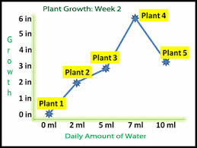
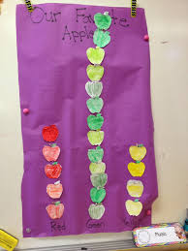
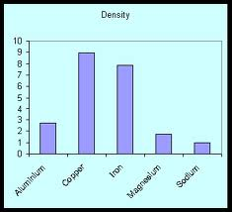
Scientific Practices: Step 5
Data Analysis
Evaluate your data.
What does the data show you?
Do you need more data?
How will you display the data to make
sense to others?
How will your data help you explain
the results of your investigation?

Slide 47
Scientific Practices: Step 6
Conclusion
Summarize the project in a
few sentences/paragraphs. Explain
your theory for your results.
Use the data to help you. Use math in your explanation.
What might future investigations for your question or problem be?
Discuss what went wrong or that you WISH you could have done differently.
Notes:
If your hypothesis is not correct, explain why.

Slide 48
Other Want to Know, Can Students:
ORGANIZE, ANALYZE, CRITIQUE AND INTEPRET what it means.
Use data to reveal relationships, explain patterns and draw conclusions. The best scientists think critically about their data and explain what it means. They can ARGUE about the results or their demonstrate. They are committed to what they have learned, determined and shared in their investigations. They can communicate this!

Slide 49
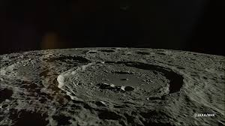
Evidence-Based Argumentation
MOON ACTIVITY
RELATE & REFLECT:
ALIGN TO EVIDENCE-BASEC PRACTICES AND INVESTIGATIONS.

Slide 50
Make a Difference!
Why is the project
important for the
real world?
Write about it.
Make others care!

Slide 51
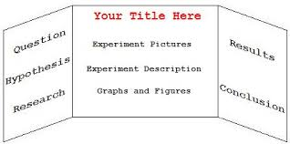
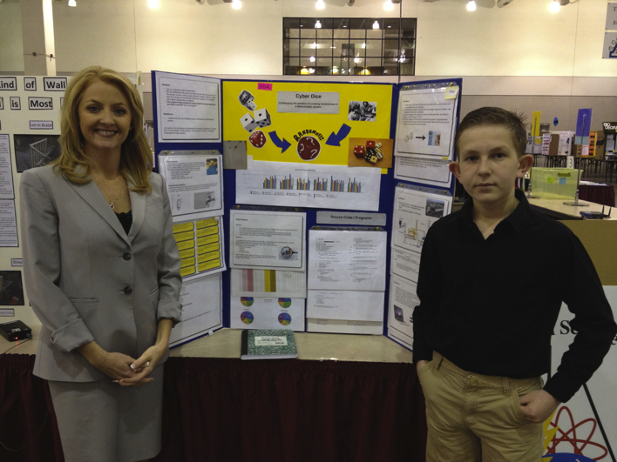
Scientific Practices: Step 7
Communicate
Students will want to create a display board that helps
tell the story to others!
Encourage students to take
photos all along the way.
Do not allow students to bring liquids, soil, live animals, plants or something that might be broken or stolen to the Fair.
Notes:
Hand Gesture: Hands talking

Slide 52
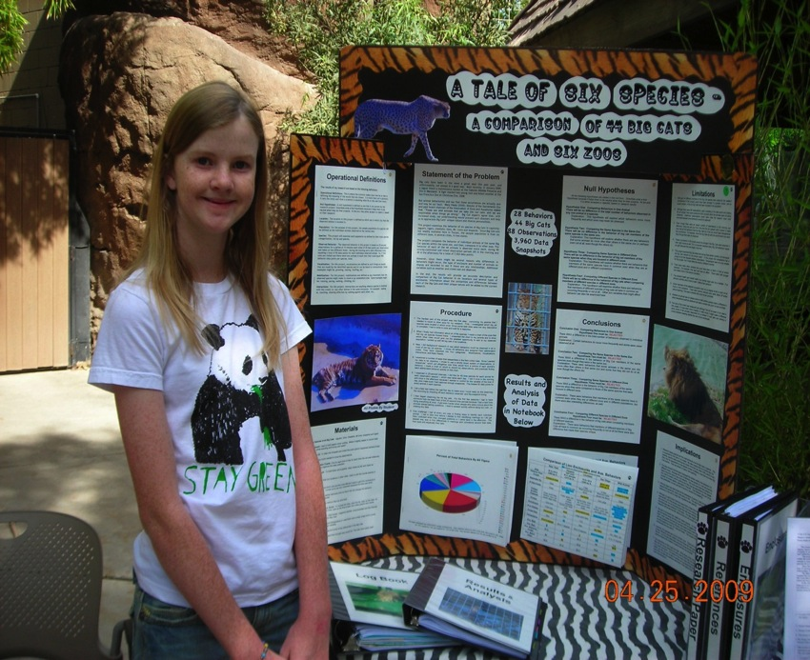
A Good Example
It is colorful
It has photos
There is a log
book
She has a chart
and a graph
It is not cluttered
Notes:
What are the things that this person did well with this project?

Slide 53
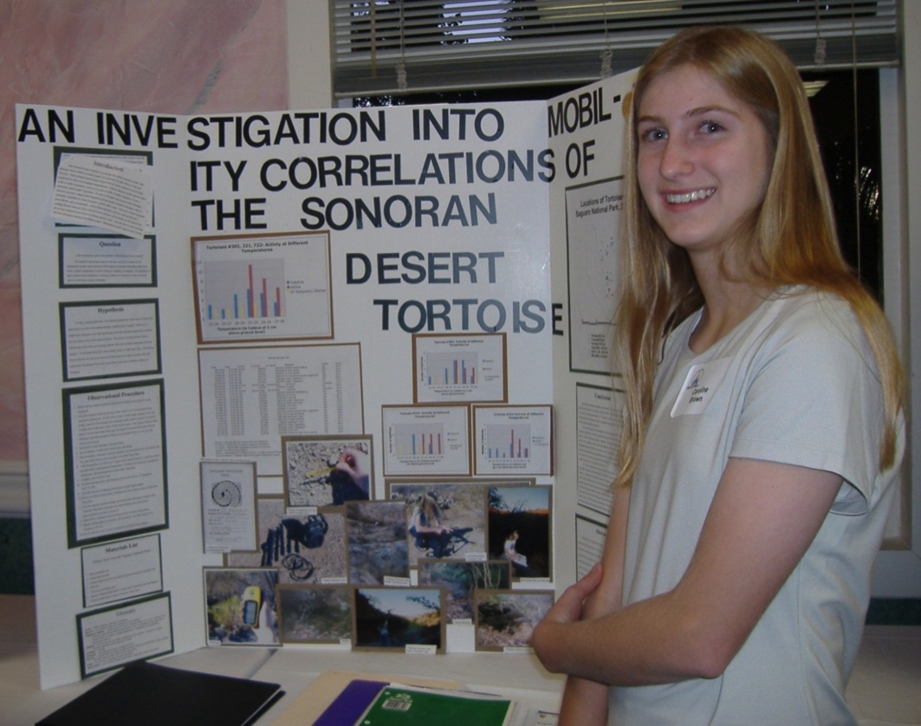
An Example that Could Be Improved
This young
lady won
First Place,
but says there
are many ways
to make it better.
What would
you change?
Notes:
This is a 7th grader who one 1st place, however, her board is in need of help.
She offered for us to use this as a “what not to do” example.
Share with one another what needs to be improved/what were her mistakes.
What kinds of things would you do differently?
Share with class.

Slide 54
Value of Projects
Arizona Science Standards/Next Generation Science Standards (NGSS)
Marzano’s 9 Effective Instructional Strategies
21st Century Thinking/Learning Skills
The 5 E Model
Critical Thinking Skills
Habits of a System Thinker
Commonalities Among Practices in Science, Math and ELA
Three Dimensions of Framework for K-12 Science Education
Engineering Design Process

Slide 55
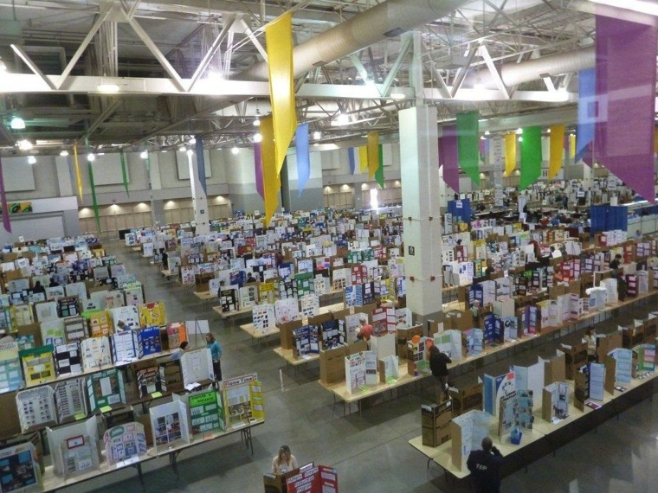
After you have completed the project….
Your school has a class/school fair
Top projects from school are then eligible to go to SARSEF to compete in fair at TCC

Slide 56
Middle School Student Interview
Interviews are not required for Middle School Students, but are STRONGLY encouraged.
Students will be able to explain their project to experts in the field.
Students should practice maintaining good eye contact. They will need to dress appropriately and use formal language.
This is a good time to practice before the required in high school interviews.
Only those interviewed will be eligible for the INTEL trip!
Notes:
Only 1 hour

Slide 57
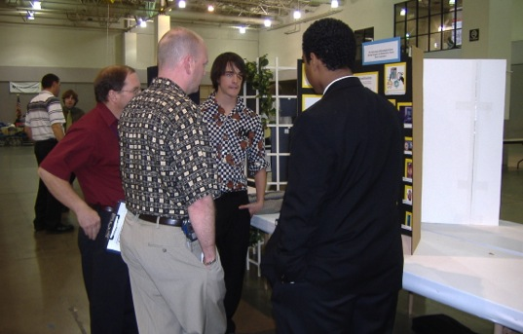
High School Interviews
Interviews are part of the scoring process for high school students. Students are required to participate the entire interview time. It takes place on judging day of fair week in the afternoon.
Encourage your students to practice, dress professionally and write a short, rehearsed summary about 30 seconds to 1 minute for when the judge says, “Tell me about your project!?

Slide 58
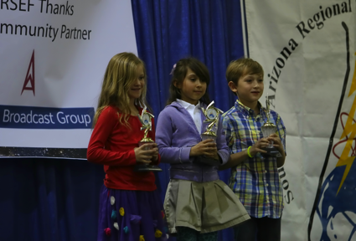
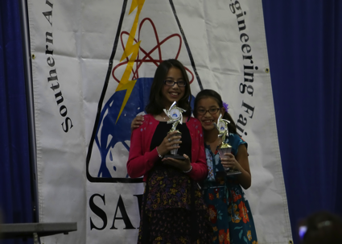
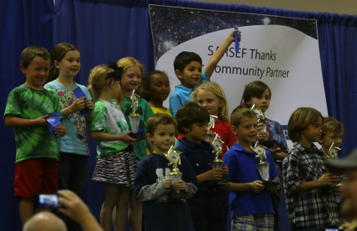
What Can Students Win at SARSEF?
Cash prizes from $25-$2000
Trophies, plaques, certificates, medals, and ribbons
Kindles, Ipods, calculators, computers, books, gift cards
Camps, gift bags, memberships
TV, Media, Newspaper, Magazine Interviews
Scholarships (High School)
Trips
Notes:
This past year, 2014, SARSEF gave away over $70,000 in prizes thanks to our donors and sponsors here in Southern Arizona.

Slide 59
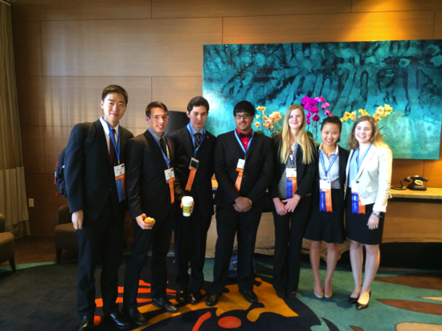
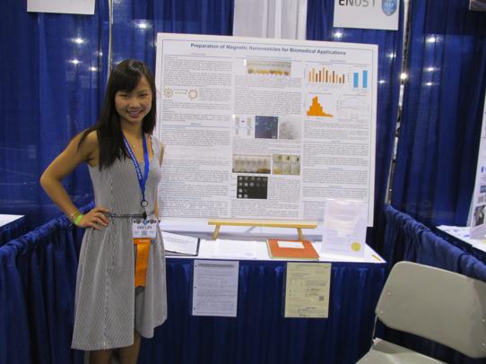
International Science and Engineering Fair
Take the challenge, meet the standards and help your students create successful projects!
You never know how far YOUR students can go!

Slide 60
YOU are Ready! Dive in!
How are you going to take
YOUR next steps?
What will be the things that you now can feel positive and comfortable with as you guide students in science and engineering projects?
What are some areas where you would like more support? How will you go about getting it?

