Slide 1
Paper Tree Cookie #1

Slide 2
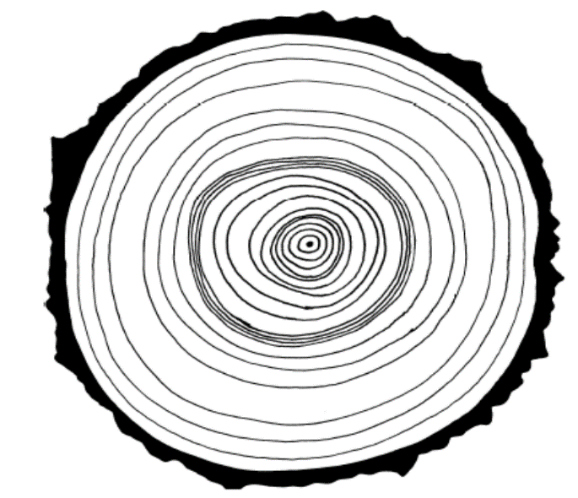
Paper Tree Cookie #2

