Slide 1
LittleBits

Slide 2


Slide 3
Introductions
Introduce yourselves
  Name
  School
  Grade level you teach
  Familiarity to circuits
    (on a scale of 1-10 with 10 = GENIUS and 1 = what’s a circuit?)

Slide 4
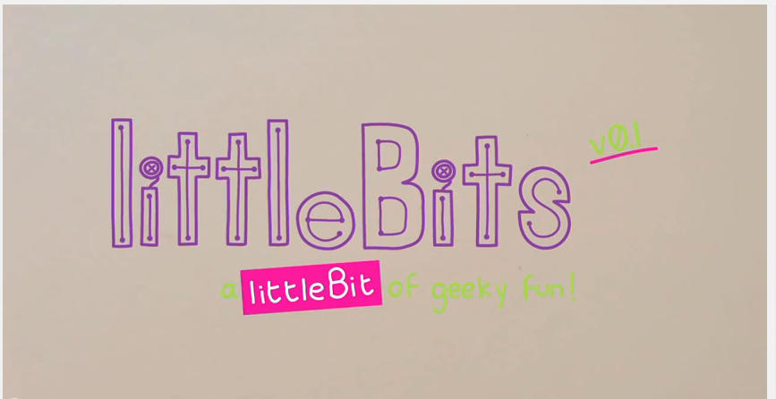
Introduction to LittleBits
https://www.youtube.com/watch?v=msatgXl4zEY

Slide 5
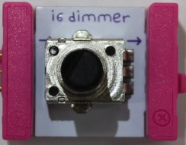
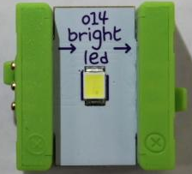
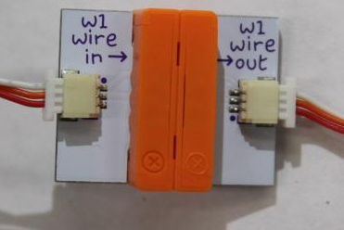
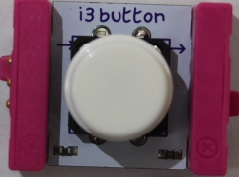
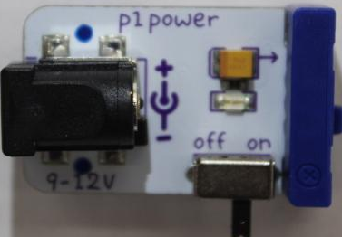
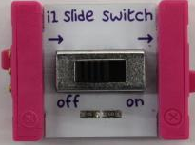
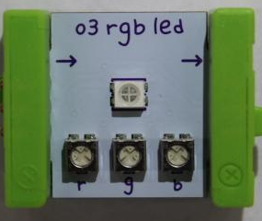
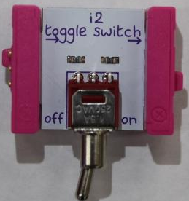
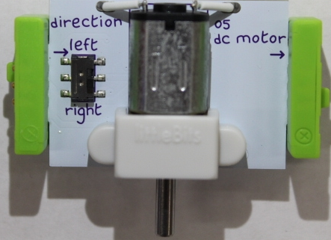
Activity 1
Using the LittleBits in your box, match the piece with its function.
Functions: Output
Power
Input
Wire Connections

Slide 6
Activity 1
How are the LittleBits coordinated?
List the Inputs:
Describe what an input is:
List the Outputs:
Describe what an output is:

Slide 7
Activity 2
Switches and Lights!
  Use all the pieces that you have in your box, create a circuit that uses a switch to turn on and off a LED.

Slide 8
Introduction to Switches
What is the purpose of a switch?
What are the different types of switches used in the Little Bits kit?
Dimmer Slider
Button Roller
Toggle

Slide 9
Discussion on Switches
Vocabulary
  What is an OPEN Circuit?
    There is a break or opening in the circuit.
  What is a CLOSED Circuit?
    There is no break or opening in the circuit. complete

Slide 10
Activity 3
What types of devices does one find around their home and school that there is a light?
What INPUT is needed for each of these?
Button
motion sensor
dimmer switch
List:
Flashlight
Motion sensor
Dimmer

Slide 11
Activity 3
Pick one of the devices discussed and its corresponding switch and BUILD IT….
Share: Using the Terminology that has been previously discussed in this workshop, describe the device that you built!

Slide 12
Outputs
Buzzer
Fan
Servo
Vibration motor
Bargraph
Transmitter
Dc motor
Synth speaker
Long led
Ir led

Slide 13
Activity 4
We have done circuits and devices with 1 output, but in reality, circuits have many outputs!
1. build a circuit using two outputs and a switch
  -the switch can control both outputs
2. build a circuit using two outputs and a switch
  -the switch can only control one output

Slide 14
Discussion
Series and Parallel Circuits
What is a series circuit?
a circuit that is a continuous branch.
What is a parallel circuit?
a circuit that is split up into separate branches.

Slide 15
Activity 5
Integration of other “stuff” into your project/circuit design.
In this activity, you will make a device of your choice….the parameters are:
1. Device made of Legos or K’NEX.
2. Must have 2 outputs and an input.

Slide 16
Share
As a group, come up and present what you built and what it does.
Be sure to…..
Use the vocabulary that we had discussed in the morning!

Slide 17
Parts that have not been used
Mp3 player
Speaker
Keyboard
ScoreBoard
Micro Sequencer
Pressure Sensor
Flex sensor
Random
Delay
Timeout
Light Sensor
Sequencer
Filter
Oscillator
Slide Dimmer
Envelope
Mix
If curious about any of these please come up and ask what they are and how they work.

Slide 18
Freebuild
Choose one project as a group and then come and take the folder.
Come get corresponding LittleBits and extra supplies needed.
Once completed, if time, you may choose another project or switch with a group that is finished.

Slide 19
Ending
Maintenance & care
  never thrown around or dropped
  pieces that moves need extra handle
  wire should not be twisted, crimped, or bent at extreme angles
Booklet
  Make: Getting Started with littleBits
Cards
  info about each piece with example project you can build

